Slide 1
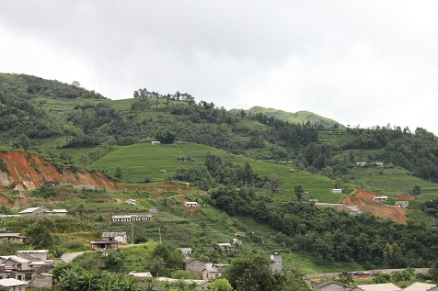
CRRS USA YOUTH CAMP & ENGLISH PROGRAM Jinping, Yunnan, China

Slide 2
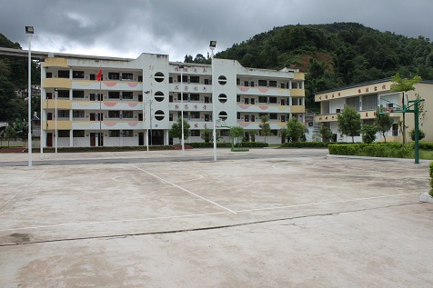
Venue

Slide 3
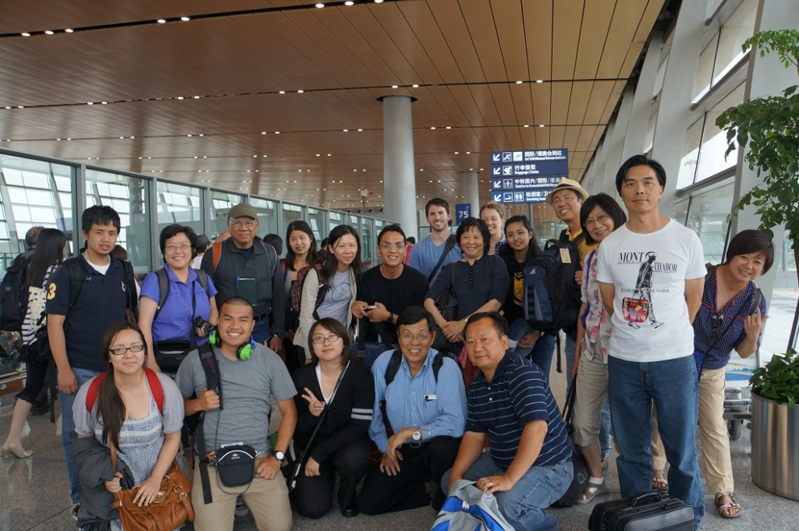
Our Team

Slide 4
Opening Ceremony

Slide 5
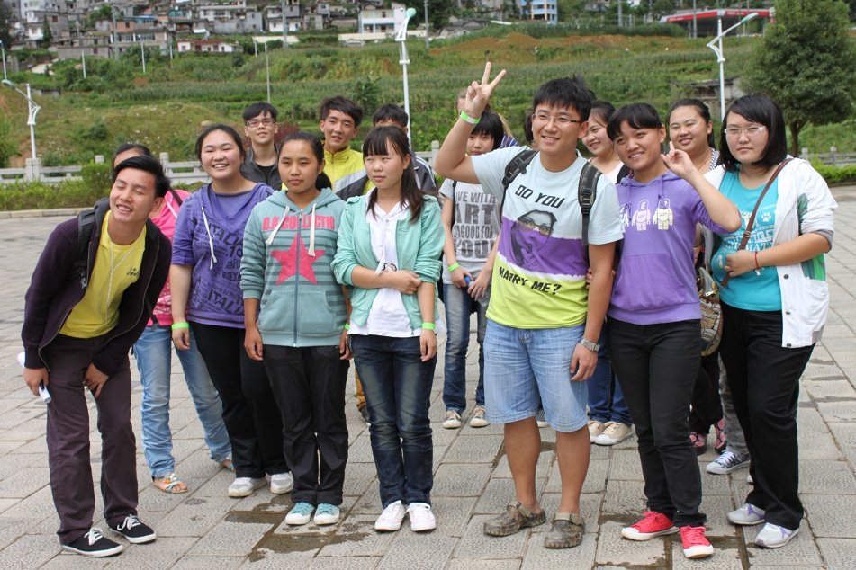
YOUTH CAMP

Slide 7
Small Groups

Slide 8
Games

Slide 9
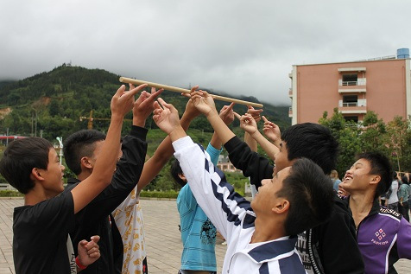

Slide 10
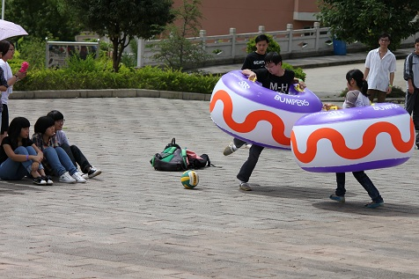

Slide 11
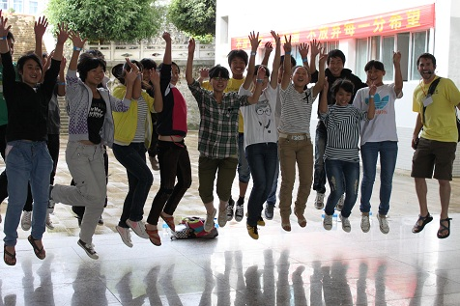

Slide 12
ENGLISH PROGRAM

Slide 13
Trainees – Local Teachers

Slide 14
Sing-A-Song, Sing Along

Slide 15
Practice Makes Perfect

Slide 16
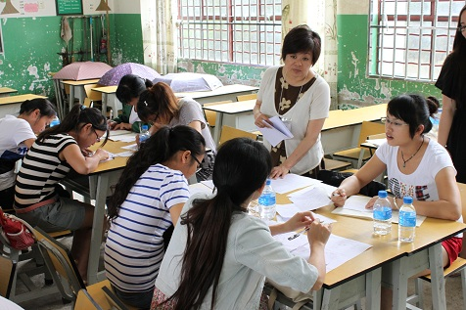
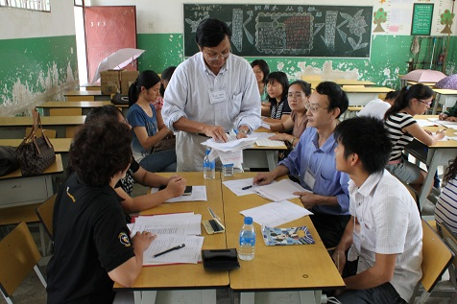
Group Discussions

Slide 17
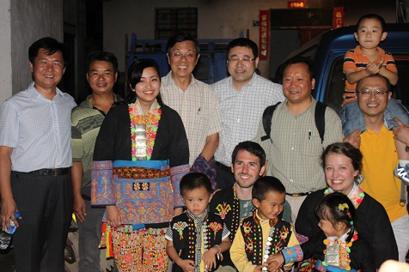
Minority Tribe Visitation

Slide 18
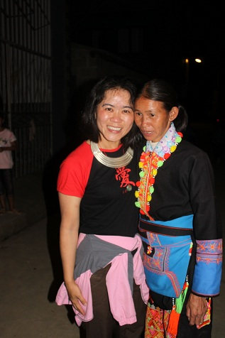

Slide 19
Time Flies: So Long, Farewell

