Slide 1
Raising a Generation of Leaders
Leadership Development for Preteens , Jr Highers and High Schoolers

Slide 2

What is Leadership All About?
What is Leadership?
Who are Leaders?

Slide 3
The 10-13 Window
Moral Development Peaks at 14
Cognitive development starts to transition from concreteness to understanding abstract concepts

Slide 4
Not All Leadership Looks the Same
Director
Inspirer
Strategist
Collaborator
How do we help our preteens discover their leadership temperament?

Slide 5
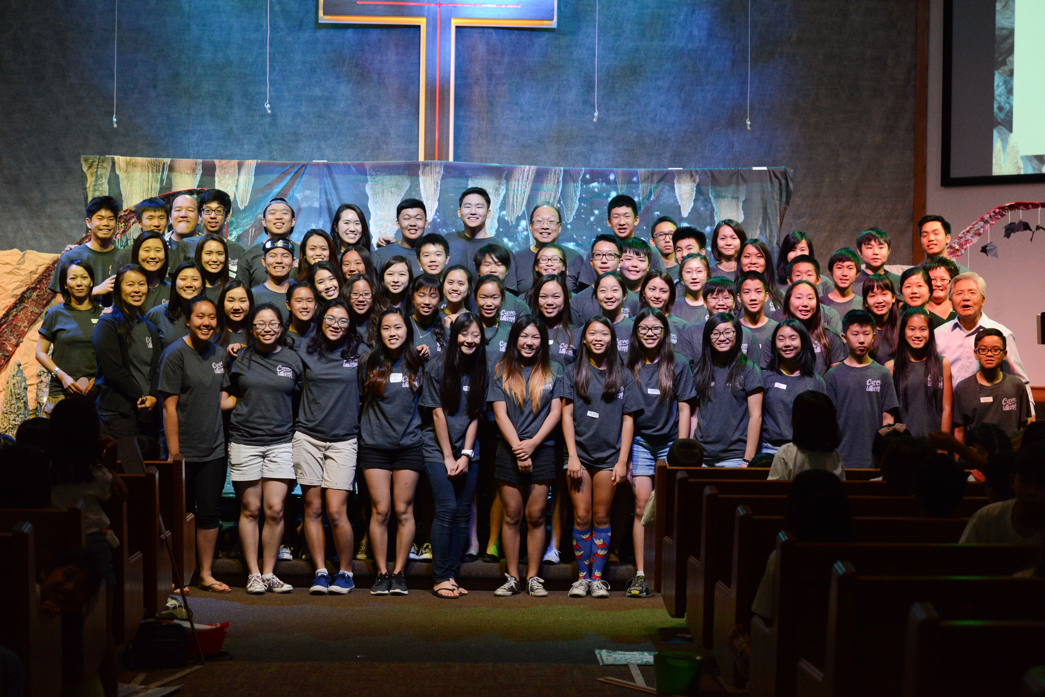
Fruit of leadership development

Slide 6
Steps to developing a preteen leadership development plan
Identify potential leaders
Teach leadership
Best Practices (Practice with feedback before
doing)
Spiritual Leadership
Organizational leadership
Give opportunities to develop leadership

Slide 7
Leaders Help teams achieve more
(Main point of the day)
There are many different ways of leading you can use based on the situation at hand
TELL
SELL
GEL
DEL
(Teaching on leadership)

Slide 8
Practice leadership activity balloon relay
(Designate Koach)
Pick a team leader
Give directions (suggest for leaders to take notes)
3 part race: no hands, in air, kicking
5 minutes to practice
team leader’s job to help team practice effectively and prepare everyone

Slide 9
Koach’s debrief
Koach to Leader: good/better/best
Koach lead discussion:
1. Teams had time to practice in this activity, how does practice help a team achieve more? (Notice this goes back to the main point)
What is the team leader’s role in helping a team practice? (pointing out what a good leader will do)
What does a good practice consist of?

Slide 10
Pass the card
Pick new team leader
Directions
3 minutes for team leader to help you strategize and practice.
Your goal is speed, so figure out how to do it quickly.

Slide 11
Debrief
The goal of a team is to improve its performance. Why is this important?
What is the leader’s role in helping a team improve?
What makes it difficult when leaders have to work together with other leaders and their teams?

Slide 12
Thank you!

