Slide 1
ENTERTAIN OR ENGAGE
kids in Children’s Ministry?
dawnkdiaz@gmail.com

Slide 2
What is the purpose of Children’s Ministry?
* To WATCH kids?
* To TELL kids?
* To TEACH kids?

Slide 3
The purpose of Children’s Ministry
To Teach the kids about God in a way that they
not only remember
but also begin to internalize
and cause their own relationship with God to
Grow ….

Slide 4
Know and grow

Slide 5
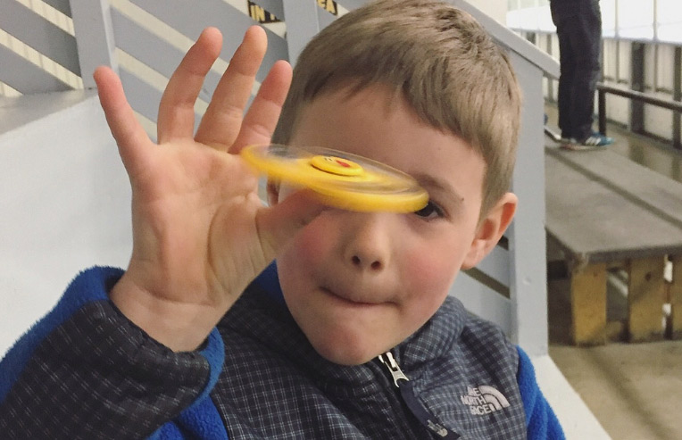

Slide 7
Thinking and
We need to CHANGE OUR . . .
TEACHING METHODS
so we can reach today’s kids if we expect to make an impact on their lives

Slide 8
TRADITIONAL
SUNDAY SCHOOL
WARNING:
This method seldom works!

Slide 9
ENTERTAIN
To provide someone with amusement or enjoyment.

Slide 10
E N G A G E
KIDS IN LEARNING
To occupy, attract, or involve someone’s interest or attention.
To participate or become involved in.

Slide 12
Capturing
the hearts and minds of children
in order to develop a
lifelong passion
for Jesus Christ

Slide 13
E N T E R T A I N

Slide 15
E N G A G E
Engage all
E
Is it for all kids?
Are all kids able to participate?

Slide 16
E N G A G E
Never fill time
N
Don’t just fill time
Does this have a purpose?

Slide 17
168 hours a week
42 hours on an Electronic devise

Slide 19
168 hours a week
42 hours on an Electronic devise
29 hours in school
90 minutes a week in church

Slide 20
85% of all Christians make a commitment to Christ between the ages of 4 and 14

Slide 21
E N G A G E
Glorify God
G
Does this bring kids to God?
Do they understand?
Do they see the connection?

Slide 22
E N G A G E
Appropriate
A
Language appropriate?
Age appropriate?

Slide 23
E N G A G E
Grow
G
Learning to please God?
Getting closer to God?
Showing attributes of God?
See difference from the world?

Slide 24
E N G A G E
Encouraging
E
Speaking kindly?
Showing God’s love?

Slide 25
* WORSHIP * INTERACTION * ACTIVITIES * TEACHING

Slide 26
WORSHIP that ENGAGES

Slide 27
WORSHIP that ENGAGES
Learn a new song

Slide 28
WORSHIP that ENGAGES
Learn a new song
Create a worship atmosphere

Slide 29
interaction that ENGAGES

Slide 30
interaction that ENGAGES
Verse Balloon Volleyball

Slide 31
interaction that ENGAGES
Verse Balloon Volleyball
Human Tic Tac Toe

Slide 32
interaction that ENGAGES
Verse Balloon Volleyball
Human Tic Tac Toe
Plate Skate

Slide 33
activities that ENGAGE

Slide 34
activities that ENGAGE
Play Dough Animals

Slide 35
activities that ENGAGE
Play Dough Animals
Wordless Book

Slide 36
activities that ENGAGE
Play Dough Animals
Wordless Book
Puzzle Prayer Box

Slide 37
teaching that ENGAGEs

Slide 38
teaching that ENGAGEs
Use Learning Styles

Slide 39
teaching that ENGAGEs
Use Learning Styles
Use the senses

Slide 40
teaching that ENGAGEs
Use Learning Styles
Use the senses
Use movement

Slide 41
R E V I E W . . .
Our purpose is to TEACH, so kids REMEMBER, INTERNALIZE & GROW
Change our THINKING, METHODS OF TEACHING to IMPACT their lives
E ENGAGE all kids in activities
N NEVER just fill time
G GLORIFY God
A Be APPROPRIATE
G Help kids GROW in the Lord
E ENCOURAGE Kids

Slide 42
See then that you walk circumspectly, not as fools but as wise, redeeming the time, for the days are evil Ephesians 5:15, 16

Slide 43
The world entertains
Let’s be about our
Father’s business and
E n g a g e kids
So they will know and grow in God

Slide 44
E n g a g e
dawnkdiaz@gmail.com

Slide 45
E n g a g e
please!
dawnkdiaz@gmail.com

