Slide 1
ABC 2017: Children Education Ministry
Pastor Terrence Shay: FCBC Walnut
WORKSHOP:
FAMILY FOUNDATIONS
SEPTEMBER 16, 2017

Slide 2
CONNECTION TIME
Gather in groups of 2-3
Name, Church, Ministry
Q: Why are you here?

Slide 3
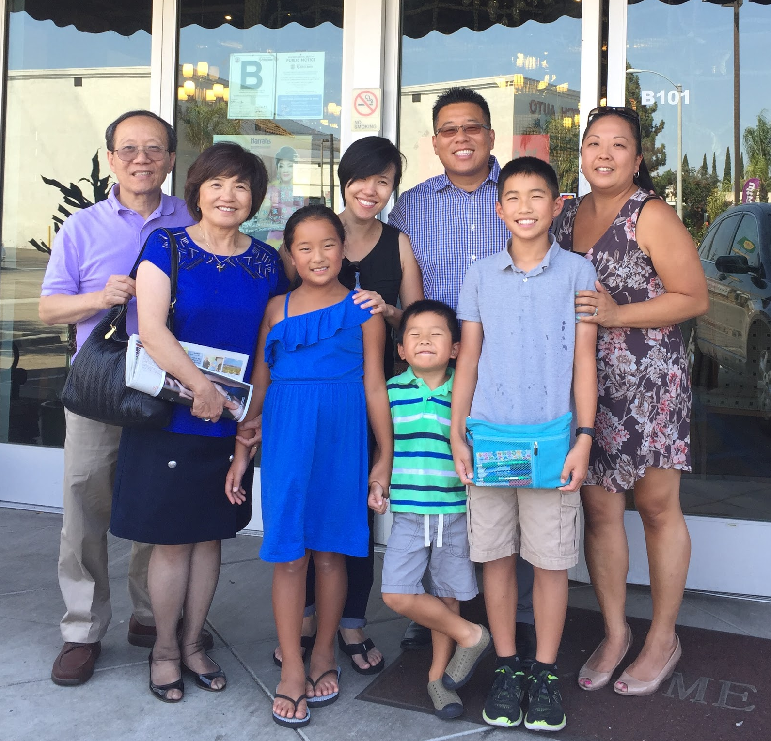
INTRODUCTION
Personal
Pastoral
Setting expectations
Principles
Priorities

Slide 4
THE GREAT COMMISSION: CHURCH

Slide 5
THE PRINCIPLE OF PROXIMITY
“Since you cannot do good to all, pay special regard to those who, by the opportunities of location, time, or circumstance, are brought into closer connection with you.”
- St. Augustine of Hippo

Slide 6
THE GREAT COMMISSION: FAMILY
“Hear, O Israel: The LORD our God, the LORD is one. You shall love the LORD your God with all your heart and with all your soul and with all your might.
And these words that I command you today
shall be on your heart.
You shall teach them diligently to your children...”
- Deuteronomy 6:4-7a (ESV)

Slide 7
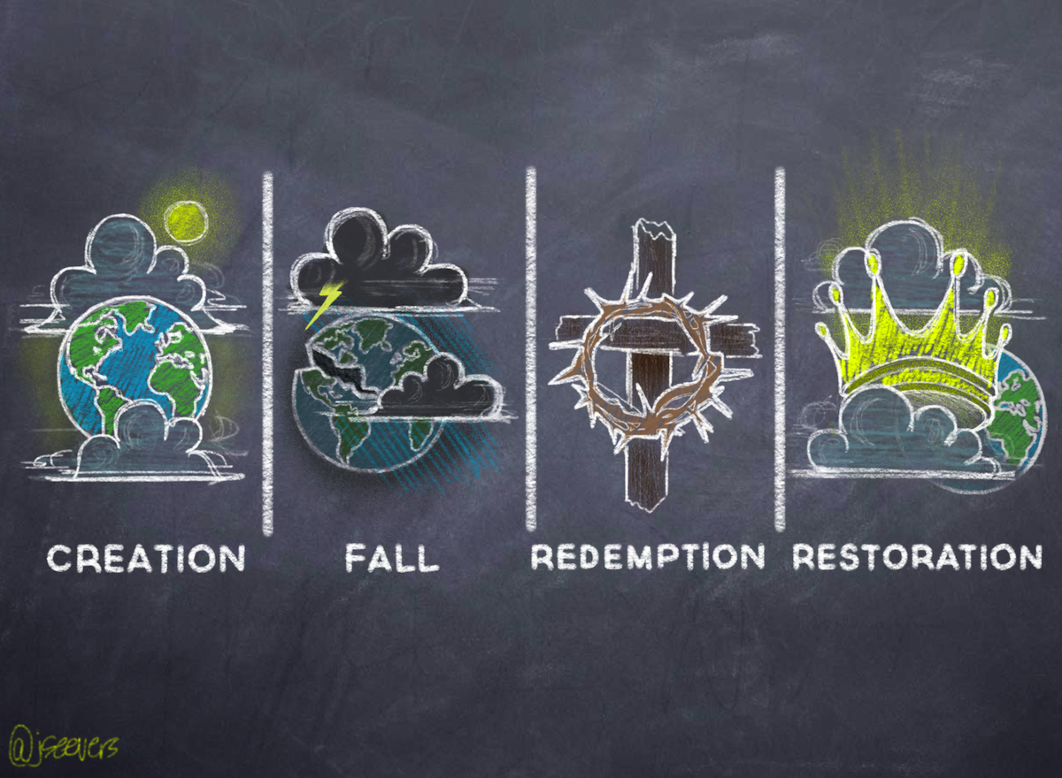
THE STORYLINE OF THE BIBLE

Slide 8
THE STORYLINE OF THE BIBLE: FAMILY
CHILDREN:
Gifts from God
PARENTS:
Fill the earth

Slide 9
THE STORYLINE OF THE BIBLE: FAMILY
CHILDREN:
Sinners
PARENTS:
Train children
to know God and His laws

Slide 10
THE STORYLINE OF THE BIBLE: FAMILY
CHILDREN:
Need a Savior
PARENTS:
Nurture children
in the Gospel

Slide 11
THE STORYLINE OF THE BIBLE: FAMILY
CHILDREN:
Eternal
PARENTS:
Prepare for eternity

Slide 12
REFLECTIONS: LIFEWAY SURVEY
Notes:
A recent LifeWay Research study (2009) asked parents to define their purpose in parenting. What this study discovered was the most common definitions of successful parenting include children having good values (25 percent), being happy adults (25 percent), finding success in life (22 percent), being a good person (19 percent), graduating from college (17 percent), and living independently (15 percent). Being godly or having faith in God is mentioned by 9 percent of respondents out of 1,200.

Slide 13
THE SPLIT IN THE STORYLINE

Slide 14
KEEPING THE MAIN THING THE MAIN THING
Split in storyline => False/Futile expectations
Creation/Fall: Physical
Redemption/Restoration: Spiritual
Central Identity: Potential/Actual brother or sister in Christ

Slide 15
PRACTICE: MAKE ROOM FOR FAMILY
Communicate/Connect with parents
Collaborate with pastoral staff and leaders
Philosophy/Vision, Calendar, Opportunities
Invest in your home/ministry leaders

Slide 16
CLOSING/Q & A
“…Children are far more than a gift for this life. They are bearers of the gospel to generations yet unborn...”
- Timothy Paul Jones

