Slide 1
The World is full of all kinds of People!
And no one is exactly alike!
THAT IS FANTASTIC !

Slide 2
EVERYONE HAS
SOMETHING TO
TEACH US!
THAT INCLUDES YOU!

Slide 3
What are we going to talk about today?
*How we are alike and how we are different
*What is Down syndrome?
*What does it mean to be a good friend at church?

Slide 4
Are you the same as everyone in your church? Or Are you different?
Let’s find out!
Notes:
Ask the kids what they like and dislike?

Slide 5
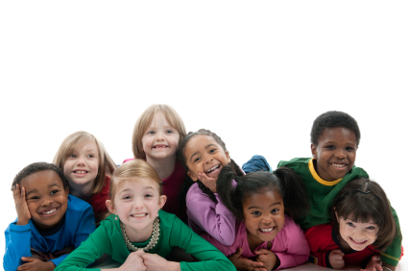
So, guess what?
We are NOT the same!

Slide 6
But… we can be friends with people who are different than us!

Slide 7
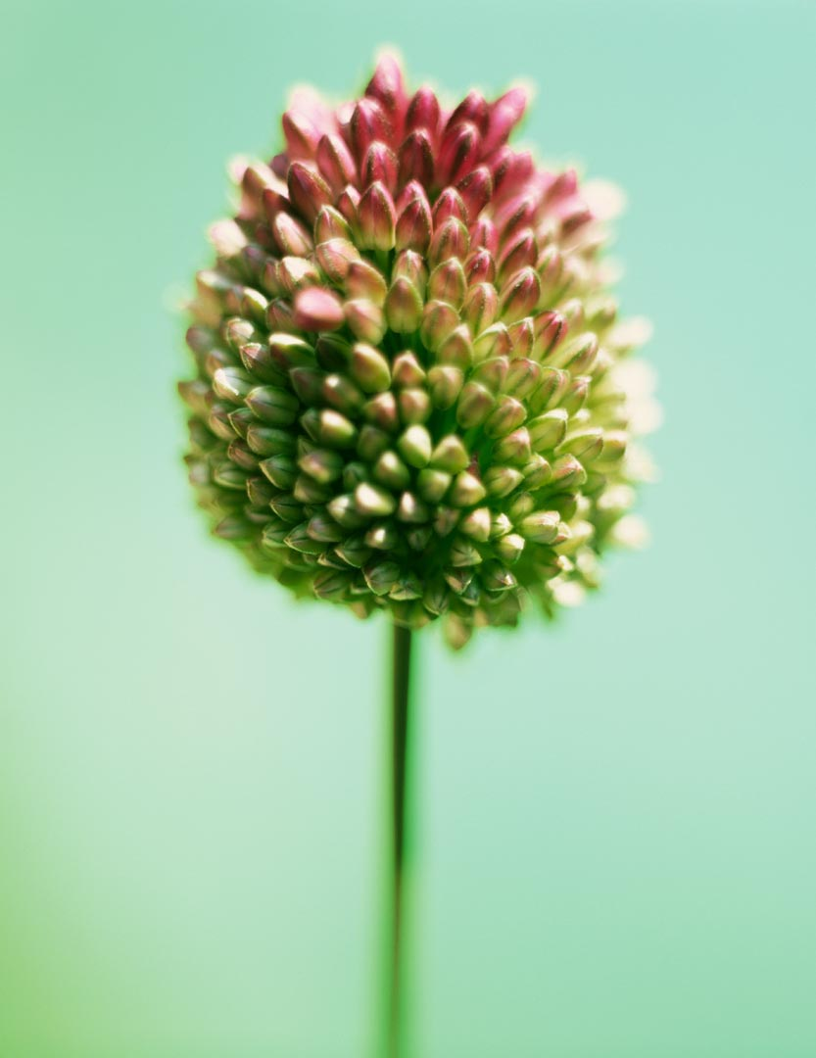
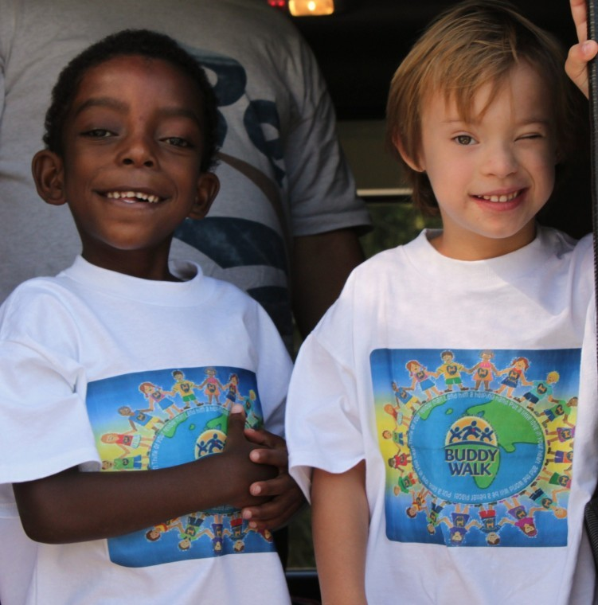
There might be some kids at church who you think are so different
that you can’t be friends with them.
Is that true?

Slide 8
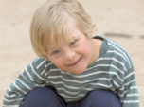
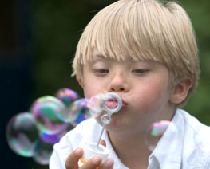
Someone in your church has something different.
It is called Down syndrome!

Slide 9
And that person is Nathan Chan!

Slide 10
What is Down syndrome?
Let’s find out!

Slide 11
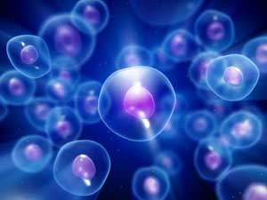
YOUR BODY HAS MILLIONS OF CELLS
In each of those cells are chromosomes.

Slide 12
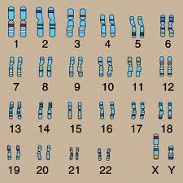
What are Chromosomes?
They are tiny tiny tiny DNA that tell your body what you will look like and what you will be like.

Slide 13
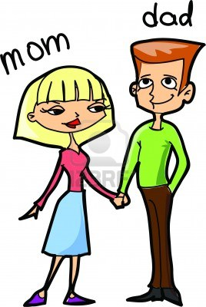
Most people have 46 chromosomes.
23 from your dad
23 from your mom

Slide 14
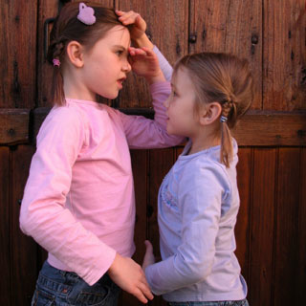
Chromosomes give directions to your body
*Chromosomes tell your body to be tall or short

Slide 15
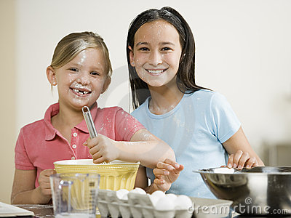
Chromosomes tell your body if:
You will have blonde or brown hair?

Slide 16
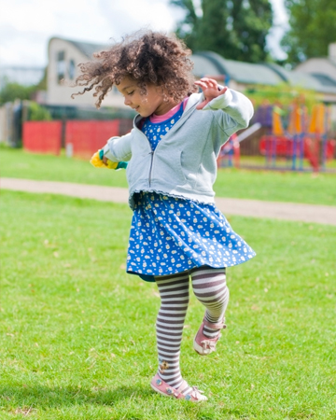
Chromosomes tell your body
If you will be a good dancer or not?

Slide 17
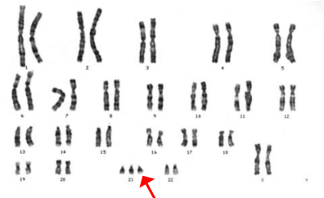
But …. Sometimes
Someone gets an extra chromosome, and they have 47 chromosomes

Slide 18
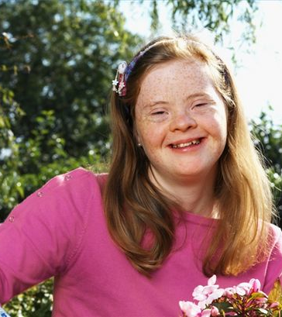
When you have 47 chromosomes
YOU have Down syndrome

Slide 19
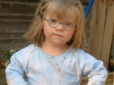
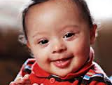
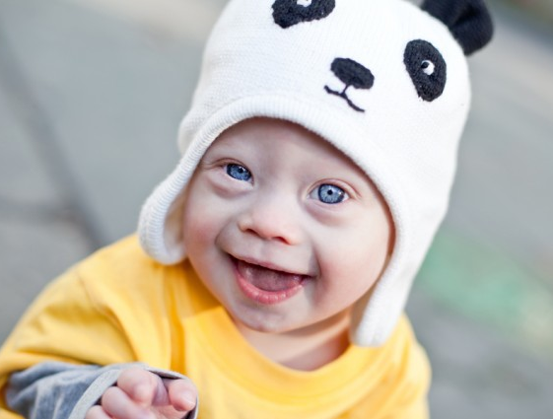
Down syndrome happens when you have an extra chromosome

Slide 20
What happens to your body when you have Down syndrome?
Sometimes you have weak muscles
Sometimes it takes you longer to learn things

Slide 21
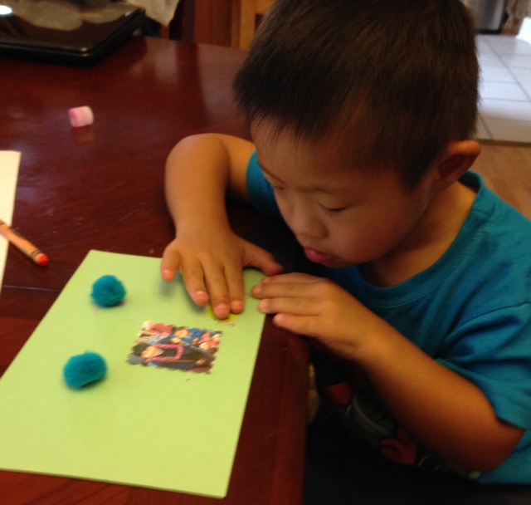
When you have Down syndrome you have to
work harder AND it will sometimes take longer to learn things

Slide 22
* longer to learn to walk
*longer to learn to speak
*longer to learn to read

Slide 23
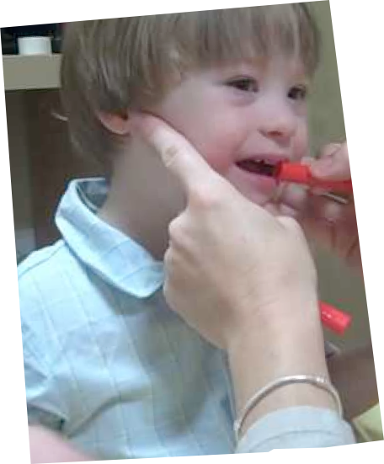
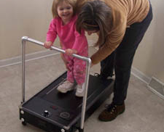

Slide 24
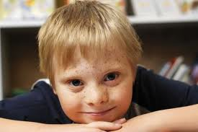
Kids with Down syndrome are the hardest working people I know.
*

Slide 25
It might take them longer but they will get there!

Slide 26
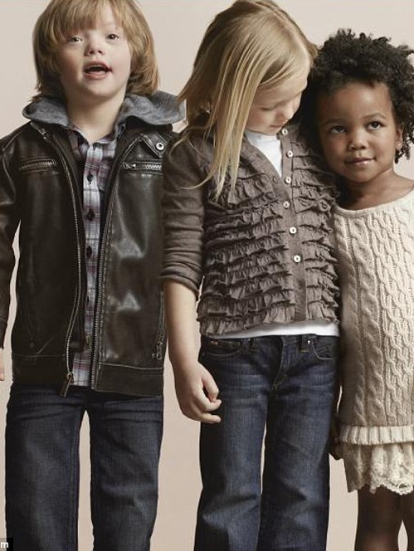
Sometimes people with Down syndrome need a little help
How can you help someone with Down syndrome?

Slide 27
First, BE a true Friend!
*You are kind to friends
*You talk to your friend
*You include friends in activities
* You learn what your friends like
*You think your friend is important

Slide 28
1.Remember that Nathan has gifts to offer you!!
1. He is brave and help you be brave!
2. He is loyal! He will be a good friend to you!
3. He loves to be wild and crazy
4. He knows that life is better with a buddy!
5. He is up for adventures!
6. He will share and will always watch your back!

Slide 29
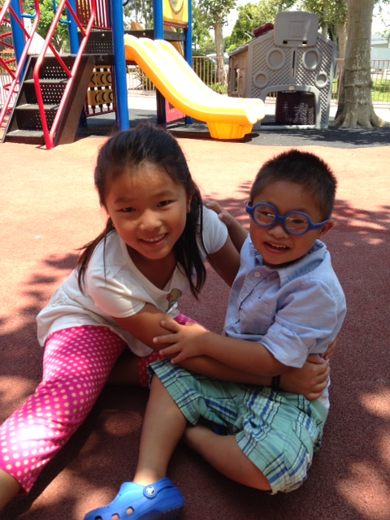
2. Remember …Nathan is just like you !
He just has
one extra
chromosome.

Slide 30
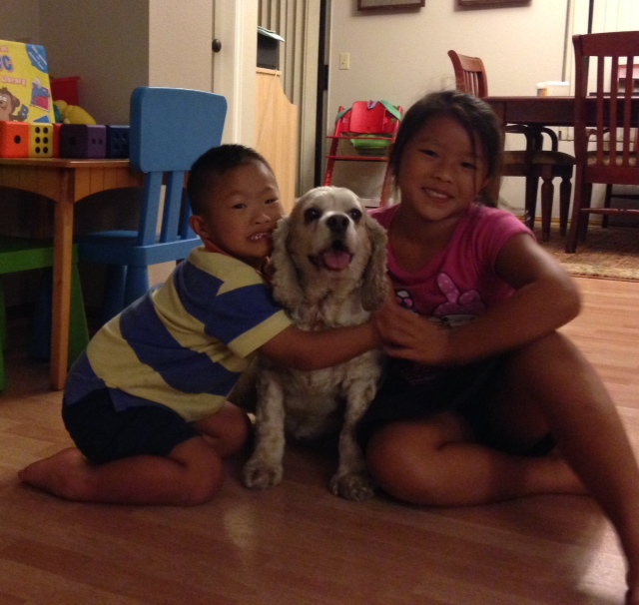
He is a good brother, student and friend!

Slide 31
3. Remember People with Down syndrome
are just like you!
they work hard!
they want friends!
they want to be a part of your life here at church!

Slide 32
You are so blessed!
Everyone in your church is valued, belongs and is appreciated for their unique gifts!

Slide 33
The world is a better place when we play and are friends with each other. Together is better!
Together is Better!

Slide 34
The World is full of all kinds of People!
And no one is exactly alike!
THAT IS FANTASTIC !

