Slide 1
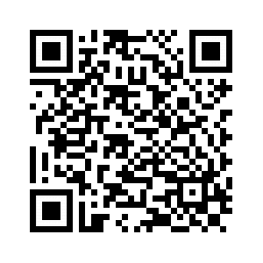
雙贏 的管家
馬太25:20-21
Mindy Ying李敏華, President & CEO
Pillar Pacific Capital Management

Slide 2
前言
聖經中談論到金錢、財富, 比提到天堂、地獄的事更多.
主耶穌曾說過38個比喻, 其中是有16個是與錢財有關.
新舊約聖經中文和合本譯本共有1,189章, 31,124節, 談到最多的主題是什麼? 聖經中約有500節經文談到禱告, 約有500節經文提到信心.
你可知道？聖經有多少經節, 論及”金錢、財富”? 有超過2350節經文, 是與錢財有關.

Slide 3
「按才受托」的比喻 (馬太25: 14-19)
14 “天国又好比一个人要往外国去，就叫了仆人来，把他的家业交给他们，
15 按着各人的才干，给他们银子，一个给了五千，一个给了二千，一个给了一千，就往外国去了。16 那领五千的随即拿去作买卖，另外赚了五千；17 那领二千的也照样另赚了二千；
18 但那领一千的去掘开地，把主人的银子埋藏了。
19 过了许久，那些仆人的主人来了，和他们算账。

Slide 4
要承認神的主權
那领五千银子的又带着那另外的五千来，说
：主啊，你交给我五千银子，请看，我又
赚了五千 (馬太25:20)
「看哪，天和天上的天，地和地上所有的，都
屬耶和華 ─ 你的神。」(申命記 10:14)
「地和其中所充滿的，世界和住在其間的，都
屬耶和 華。」（詩 24：1）
神給我們很多，神要我們負責，「因為多給誰，就向誰多取；多託誰，就向誰多要。」（路12：48）

Slide 5
神的心意 & 命令
要明白
主人说：‘好，你这又良善又忠心的仆人，你在不多的事上有忠心，我要把许多事派你管理，可以进来享受你主人的快乐。(馬太25:21)
「神就賜福給他們，又 對他們說：要生養眾多，
遍滿地面，治理這地，也要管理海裡的魚、空中
的鳥，和地上各樣行動的活物。」(創 1:28)
「誰是那忠心有見識的管家，主人派他管理家裡
的人，按時分糧給他們呢﹖」（路12：42）

Slide 6
要會管理神的資源
工作努力/儘量賺錢 Work Hard:
  總要勞力、親手作正經事、就可有餘、分給那缺少的人。(弗 4:28)
  手懶的、要受貧窮．手勤的、卻要富足（箴10:4）
主耶穌對將一千兩藏在地底下的说：‘你这又恶又懒的仆人...28 夺过他这一千来，给那有一万的。29 因为凡有的，还要加给他，叫他有余；没有的，连他所有的也要夺过来。30 把这无用的仆人丢在外面黑暗里，在那里必要哀哭切齿了。 (太25:26-30)

Slide 7
要會管理神的資源
儘量省錢: Save More 當省則省、當用則用、 節約開銷 :
  且因我心中愛慕我 神的殿、就在豫備建造聖殿的材料之外、又將我自己積蓄的金銀獻上、建造我 神的殿．（歷代志上29:3）
  「我知道怎樣處卑賤，也知道怎樣處豐富，或飽足、或飢餓、或有餘、或缺乏，隨事隨在，我都得了秘訣。 」(腓4:12)

Slide 8
要會管理神的資源
聰慧的理財 Invest Intelligently
  理財與發財，有什麼不同呢？
  基督徒理財的動力既不是為遺產，
  為發財, 也不是為破產，那麼是為
  什麼呢？
  投資計劃重要因素﹕素質/平衡/
  多元化/合理的期望

Slide 9

作個好管家!
遺產計劃
借貸
儲存投資
經由與各個專業人士合作可獲得整體財富管理之好處
教育計劃
稅務計劃
退休計劃
風險管理
Notes:
9

Slide 10
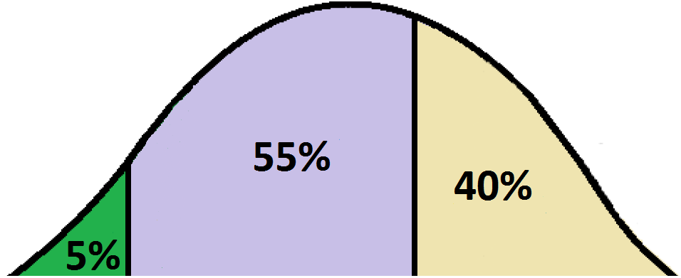
U.S. Economic Scenarios: NEXT FIVE YEARS
Deflation
Negative Growth
Gradual Higher Inflation
Slower Growth
Anticipated Higher
Inflation
Corrective Monetary Policy

Slide 11
Drivers of U.S. Economic Growth
  Increased Earnings Growth Expected
Consensus Estimates
Earnings Recession
Q4’14 to Q3’16
Data Source: FactSet Research Systems. Quarterly growth (1 yr % change), capped at 50%, estimates Q3’18 – Q3’19.
11

Slide 12
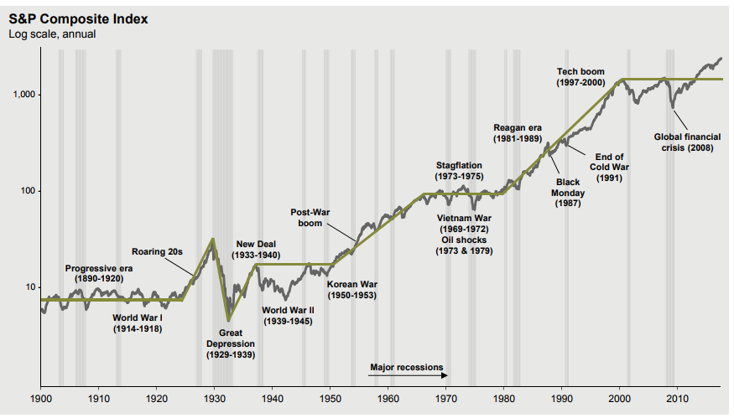
The Stock Market Since 1900
Data Source: FactSet, NBER, Robert Schiller, J.P. Morgan Asset Management.
12

Slide 13
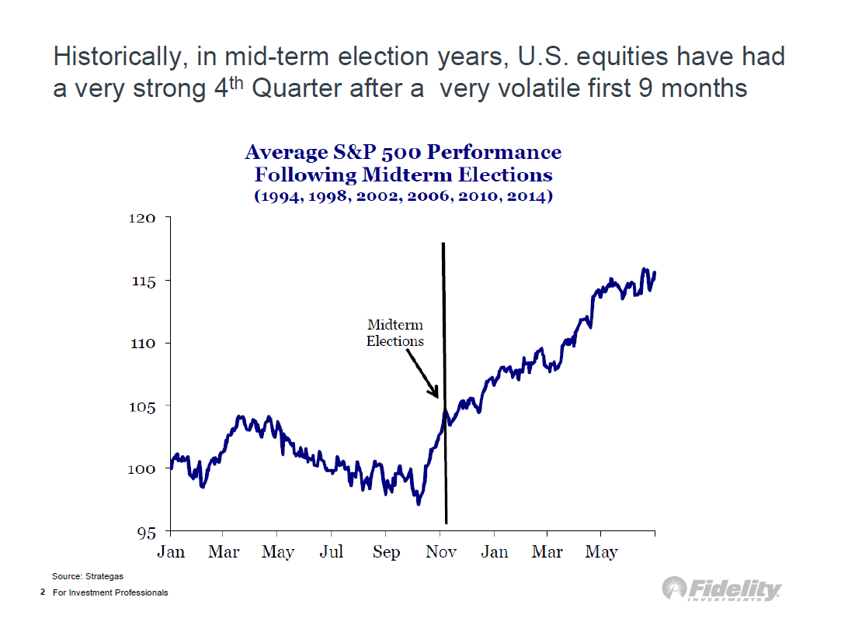

Slide 14

Inflation Currently Near Sweet Spot for P/Es
1958-2016
Inflation | Average P/E | Highest P/E | Lowest P/E
0 - 1% | 16.3 | 20.9 | 11.7
1 - 2% | 17.0 | 20.6 | 13.1
2 - 3% | 17.6 | 26.7 | 10.8
3 - 4% | 16.0 | 20.7 | 10.1
4 - 5% | 14.0 | 21.0 | 9.5
5 - 6% | 14.9 | 20.2 | 8.2
6 - 7% | 11.6 | 17.9 | 7.2
>7% | 8.4 | 11.5 | 6.6
Current S&P 500 forward P/E @ 16.4
Data Source: 1958-12/16. Current P/E as of 06/21/18. P/Es based on forward 12-month as reported earnings (1958-1988) and operating earnings starting in 1989. Based on consensus estimates starting in 9/95 and actual earnings prior. Inflation is y/y % change based on core CPI. Source: Bureau of Labor Statistics, Standard and Poor’s, FactSet Research Systems.
14

Slide 15
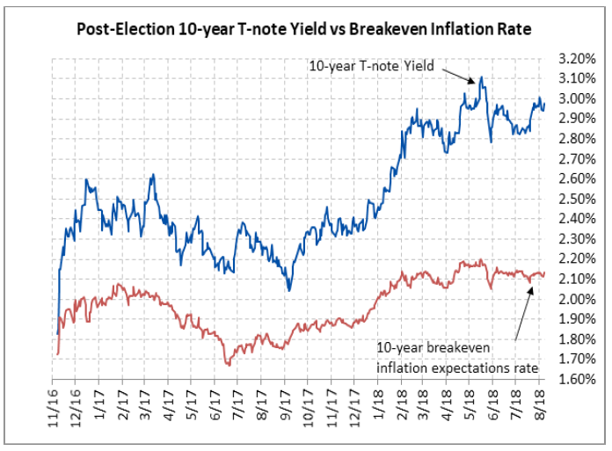
Long-Term Interest Rates & Inflation
Inflation expectations have pushed long-term rates upward
Data Source: Global Market Drivers

Slide 16
Asset Allocation:
Risk vs. Reward
Data Source: Vestek.
16

Slide 17
稅務規劃和策略
你是否利用了所有合法的減稅方案﹖
退休計劃基金
教育計劃基金
捐贈教會和其它對你重要的機構
有效地管理規劃各種稅務
由於稅的影響﹐以致作出錯誤的財務決策

Slide 18
Overview of Tax Cuts & Jobs Act
Areas of Reform | Before | After
Tax Bracket | 10%, 15%, 25%, 28%, 33%, 35%, 39.6% | 10%, 12%, 22.5%, 25%, 32.5% , 35%, 37% (couple >$600K/single >$500K) Till end of 2025
Itemized Deductions (including charitable deductions) | 50% AGI, with some limitations beginning at $259,400 AGI | Up to $10K for SALT. New mortgage interest deduction capped to $750K. Home equity loan interest is not allowed. Out of pocket medical bills > 7.5% AGI. No Individual Mandate (the Affordable Care Act – 2019) No change for charitable deductions.
Standard Deduction (single/joint filing) | $6,350 / $12,700 | $12,000 / $24,000 (till end of 2025) Adding $300 credit for elder care; increase child tax credit to $2k (phase-out provided)
Highest Capital Gains Rate | 23.8% (includes NIIT) | No change
Estate/Gift Tax | Estate tax and “step-up”. Exemption at $5.49mm/PP | (1) Double the exemptions. (2) Die after 12/31 but before 1/1/2026. Keep Step-up cost base provision
Alternative Minimum Tax | $54,300/$84,500 | $70,300/$109,400 (till end of 2025)
Corporate Tax | 15%, 25%, 34%, 35%, 38%, 39% | Permanent: Corporate: 21% max rate Pass through: 20% tax deduction (phase out > $315K). Capital expenditure/interest on loan write-offs. Eliminate Corp AMT. One time 15.5% tax on overseas liquid assets. 8% for illiquid assets.
18

Slide 19
合法延稅和免稅策略
Advanced
Irrevocable
Trust
CRT’s & Private Foundations
Potential Reward Risk
Technique Reliability
Roth IRA Conversion
Income Shifting / Annual Gifting
Qualified Retirement Plan
Loss Harvesting
Basic
19
19

Slide 20
Charitable Remainder Trust (CRT)
Living Trust
$20,000,000
Gift
CRT
$10,000,000
Income &
Tax Deduction
Annual Gift
Tax Free
IRR
$10,000,000
Heirs

Slide 21
Problems with Probate
Time Consuming
Loss of Privacy
Costly

Slide 22
有效減稅的投資工具
HIGH
Individual Stock / Bond Portfolio
(Customized & Actively Managed)
Pros: Tax efficient
Diversification
Transparent
Cheaper than Mutual Funds
Strong long term Performance
Cons: Not suitable for small account
高
Annuity Contracts
Pros: Deferred tax / Available to small accounts
Cons: Low tax efficiency
Surrender term & charges
Layers of fees
Not transparent / Complicated
Mutual Funds (MFs)
Pros: Diversification
Good for small accounts
Cons: Not tax efficient
Expensive
Not transparent
Weak Performance
No support
Exchange Traded Funds (ETFs)
Pros: Diversification /Good for small
Cheaper than MFs
Cons: Not tax efficient
Not transparent
Index Performance
No support
低
Low
22

Slide 23
Equities vs. Housing
Data Source: FactSet Research Systems; Case-Shiller as of 5/31/18.

Slide 24
要會管理神的資源
慷概的捐贈 Give Generously
  聖經教導我們 要將收入的10% 當作「十一納稅」
  給神, 另外90% 神看重我們如何管理和運用.
  耶和華所賜的福, 使人富足,並不加上憂慮
  (箴 10:22)
  你要以財物和一切初熟的土產、尊榮耶和華
  (箴3:9)

Slide 25
R- I- C-H 富有
  Receiving 接受,有信心
  Intelligence 知識
  Changing 改變
  Habits 習性
P-O-O-R 貧窮
  Pass 通過
  Over 錯過
  Opportunities 機會
  Repeatedly 重複

Slide 26

基督徒又怎麼富有呢？
慷概的捐贈
  聖經教導我們 要將收入的10% 當作「十
  一納稅」給神, 另外90% 神看重我們如何
  管理和運用.
  我算甚麼、我的民算甚麼、竟能如此樂
  意奉獻．因為萬物都從祢而來
  耶和華所賜的福, 使人富足,並不加上憂
  慮. (箴言 10:22)
見証

Slide 27
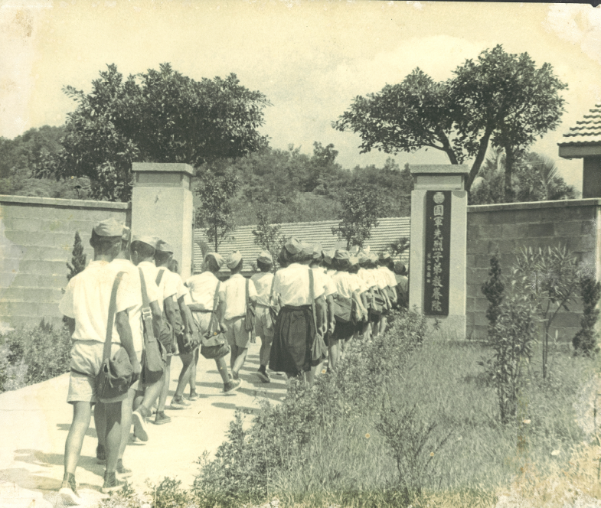
生命中試煉
  失父,自卑,無望
  失婚,失業, 失母
  被算命 &佛教挾制

Slide 28
生命中最好的導師 C O A C H
C -- Catch Vision 抓住神的旨意
O -- Obey 順服/忠心神
A -- Affiliate with God 住在基督𥚃
C -- Confirmation 確認/管家
H -- Hallelujah 讚美神

Slide 29
講員簡介
Mindy Ying: President & CEO of Pillar Pacific Capital Management (currently managing over $1.1 billion for both institutional and private clients)
Mindy has over 36 years of experience in investment, financial management and wealth management.
Prior to President & CEO of Pillar Pacific in 2007, Mindy was President, co-founder and Portfolio Manager for PacWest Financial Management, Inc. for 10 years.
Previously, she was Managing Director for Barclays International Private Banking, and Vice President for First Interstate Bank’s Trust and Investment Management Group.
As a Christian, Mindy currently serves as an Elder for First Evangelical Church San Gabriel, Treasurer for Logos’ New Dawn Christian Family Services (prior Asian American Christian Counseling Service), President Circle member for CESNAC (北美中華福音神學院), and an advisory member of Pasadena Symphony.
She was the Treasurer for First Evangelical Church Association, Trustee for San Marino School Foundation; a board member for Financial Planning Association of Los Angeles.
She holds a BS and an MBA from the University of Texas.
www.pillarpacific.com

