Slide 1
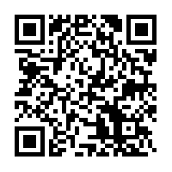
從神的屬性看無限創造者與有限宇宙
Understanding Infinite Creator and Finite Universe
through God’s attributes
https://www.dropbox.com/sh/v3qarvftpo8jk65/AABnK0QC9CTSIg3kQAH3AG7ca?dl=0

Slide 2
從神的屬性看無限創造者與有限宇宙
Understanding Infinite Creator and Finite Universe
through God’s attributes

Slide 3
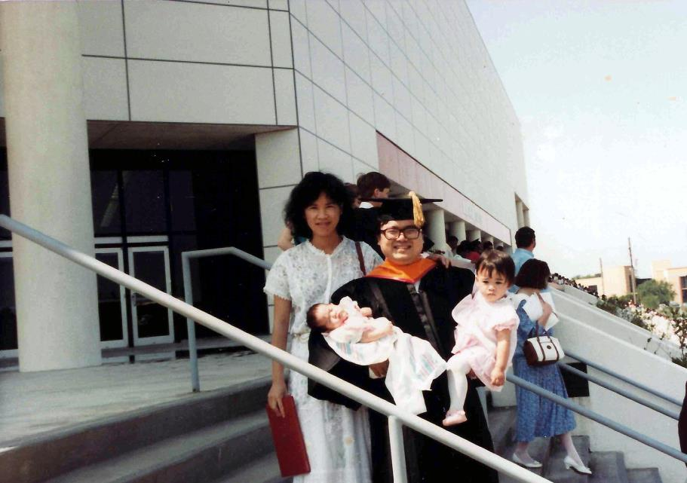

Slide 4
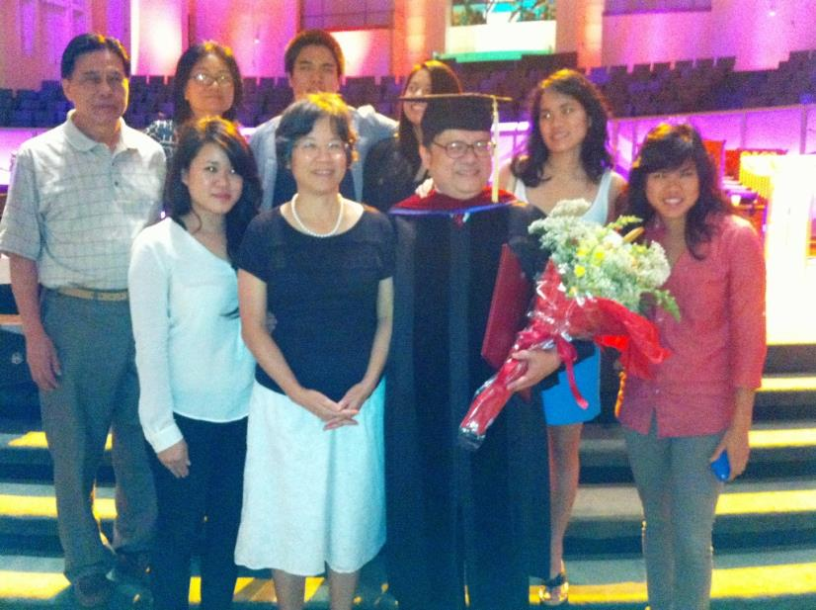

Slide 5
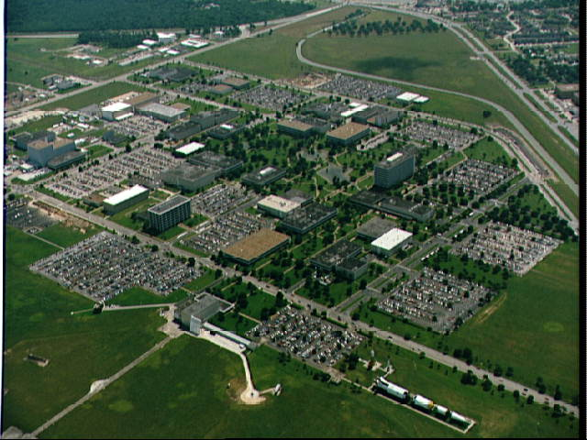
Astronaut Training
Mission Control
Administration
Rocket Park
休士頓 太空中心 JSC,NASA

Slide 6
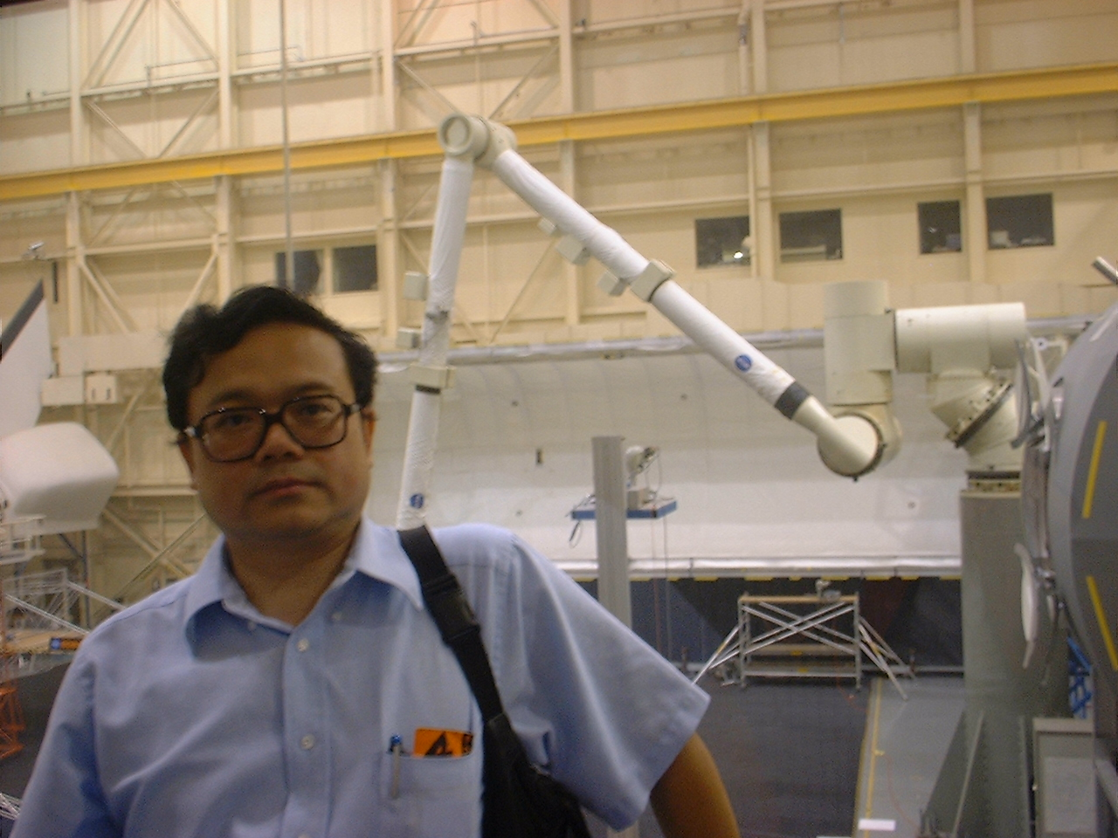

Slide 7
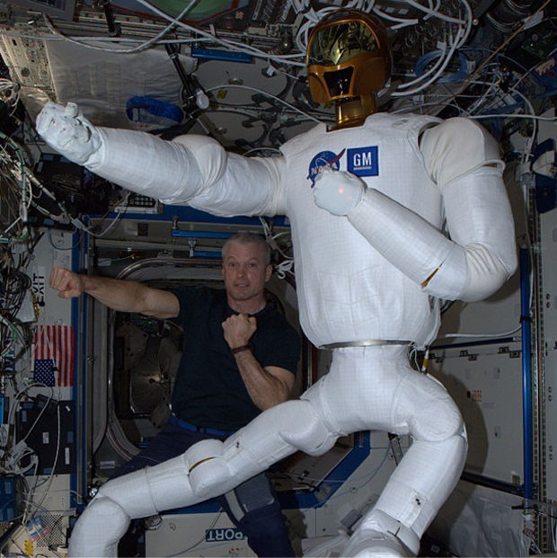
Steve Swanson and Robonaut 2 with new Legs in ISS

Slide 8
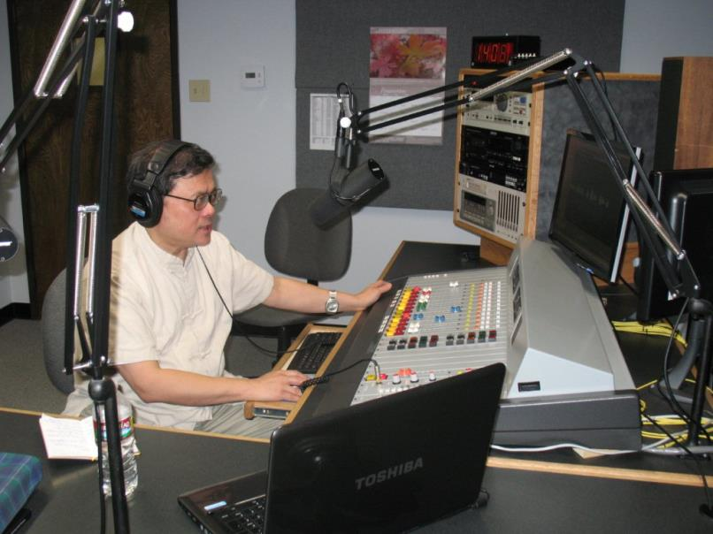

Slide 9



Slide 10
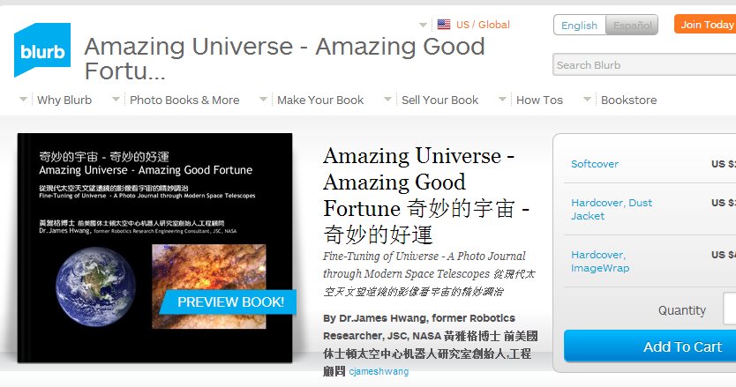

Slide 11
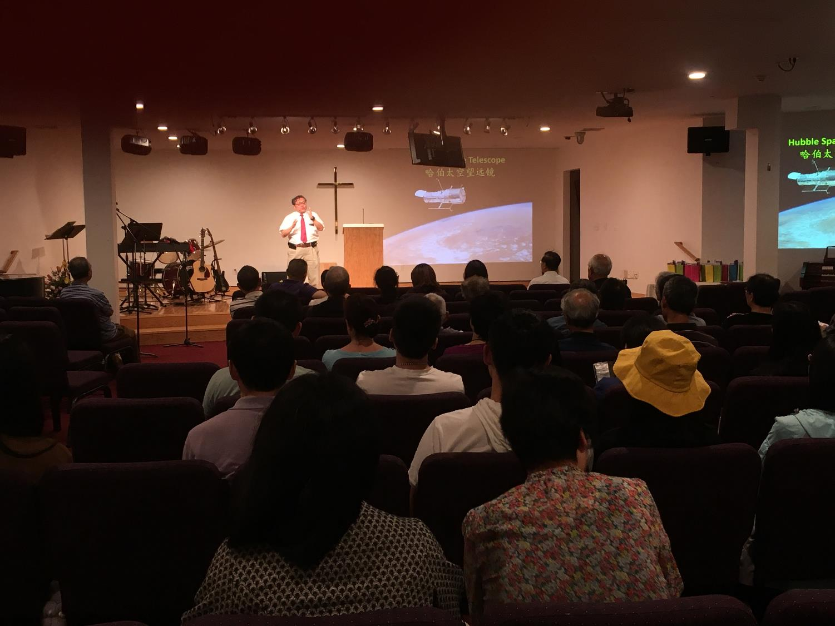

Slide 12
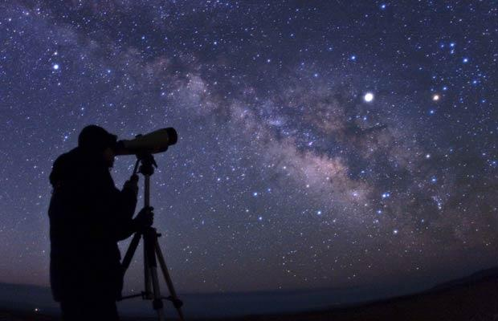
何为永恒？
What is Eternity?
仰望星空,看浩瀚宇宙,是否为永恒?
Is Heaven Eternal?

Slide 13
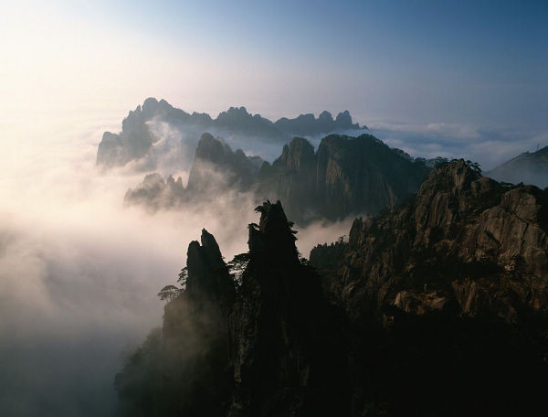
何为永恒?
What is Eternity?
又看山岳江海,巍峨浩荡,是否为永恒?
Is Earth Eternal?

Slide 14
何为永恒?
What is Eternity?
地老天荒,海枯石烂
此情不渝！是否为永恒?
Is love eternal?

Slide 15
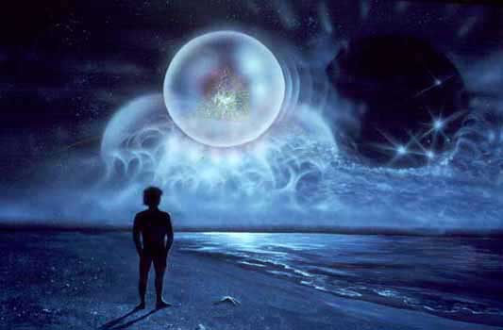
诗人感念: “念天地之悠悠,独怆然而涕下。”
人生刹那,意义何在?目的何在?
Purpose of Universe? Purpose of Life?

Slide 16
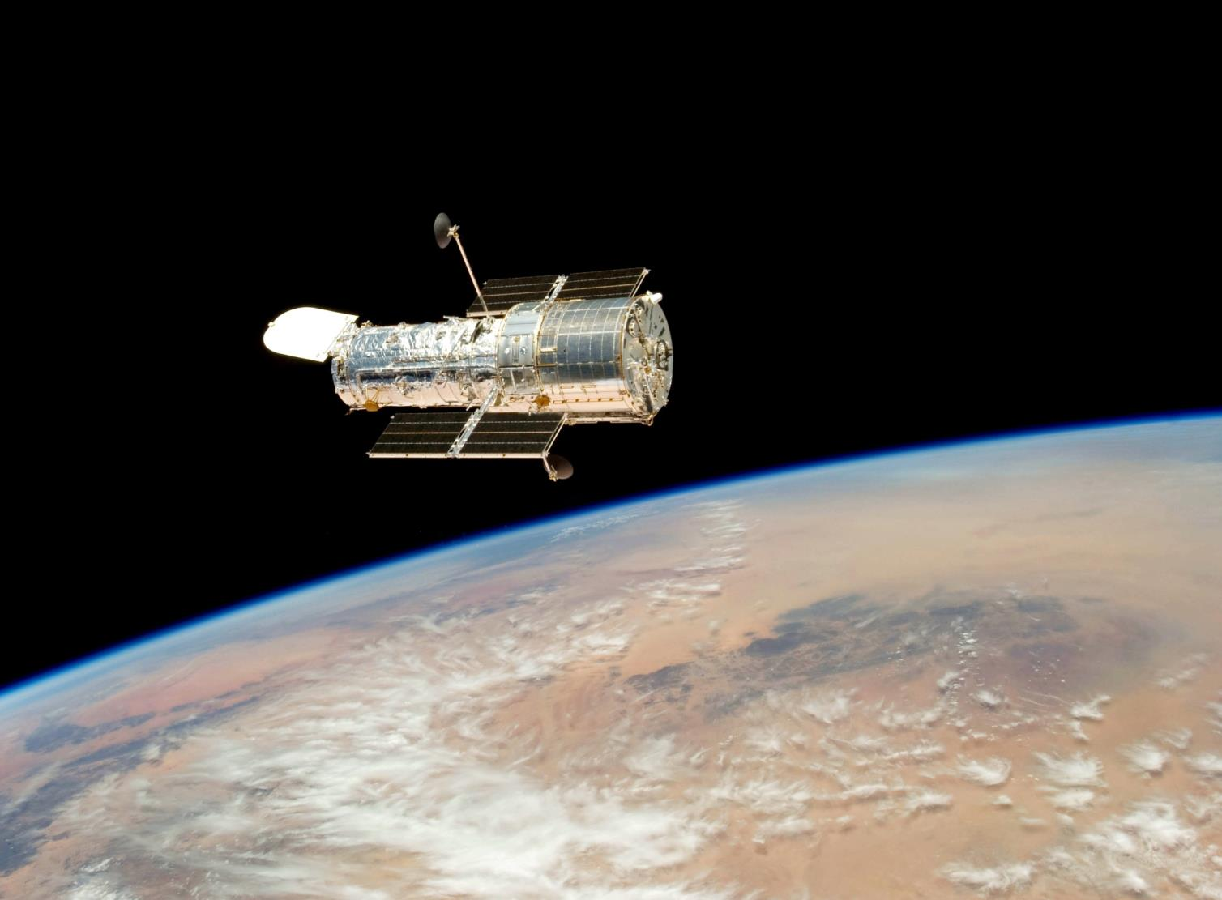
21世纪的天文物理学探索：
宇宙有没有大小,年龄?無限?有限?
Quest of 21th Century – Is there an
age of Universe? How about its size?

Slide 17
Hubble Space Telescope
哈伯太空望远镜

Slide 18
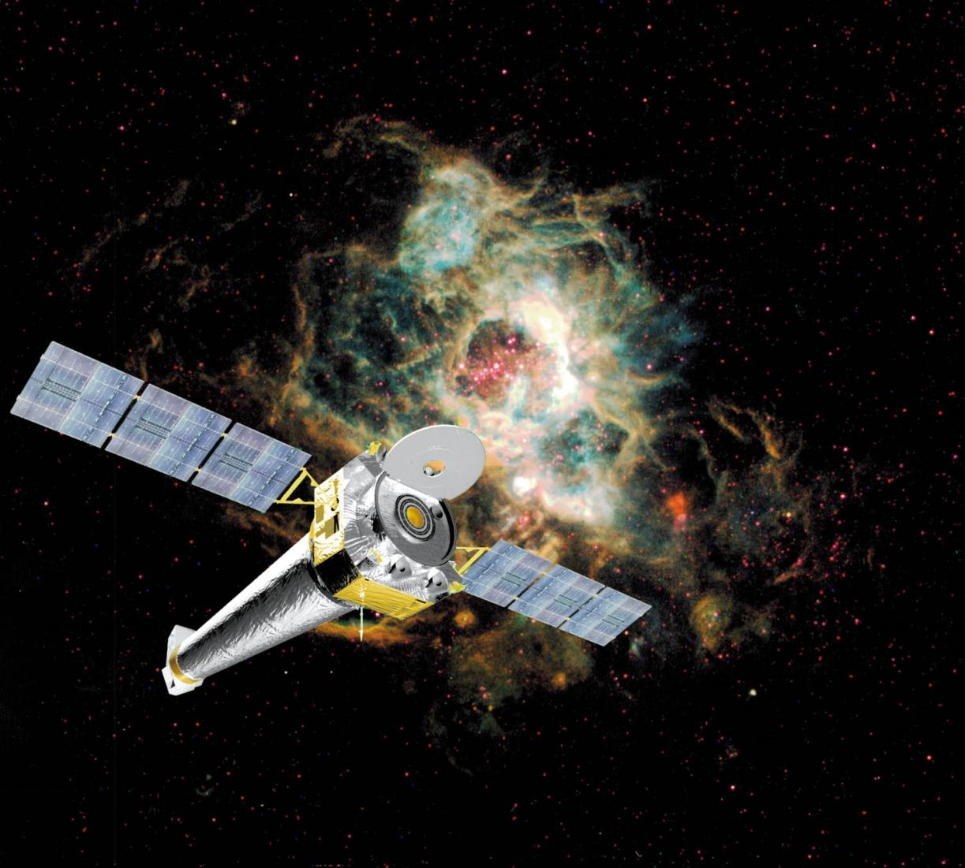
Chandra X-ray Observatory
錢卓拉X射線太空望远镜

Slide 19
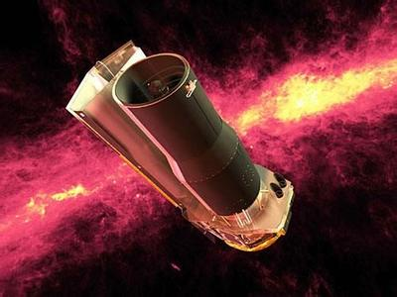
Spitzer Space Observatory
斯皮策太空望远镜

Slide 20
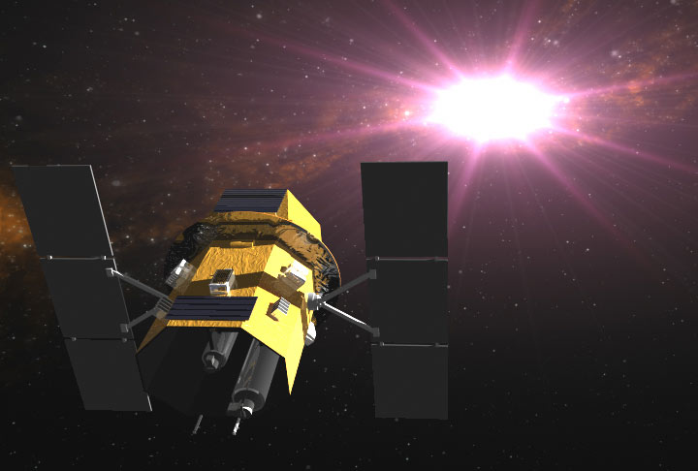
The Swift Gamma-Ray Probe
伽瑪暴快速反應探測器

Slide 21
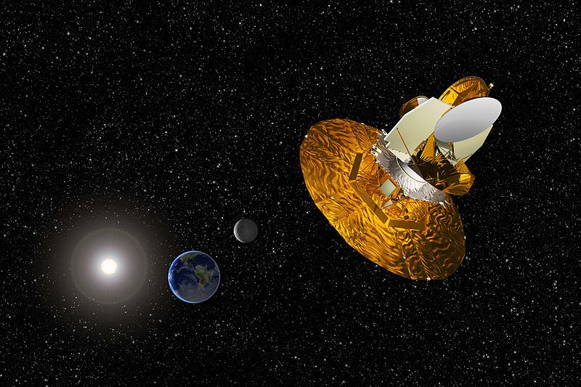
Wilkinson Microwave Anisotropy Probe
(WMAP) 威尔金森微波各向异性探测器

Slide 22
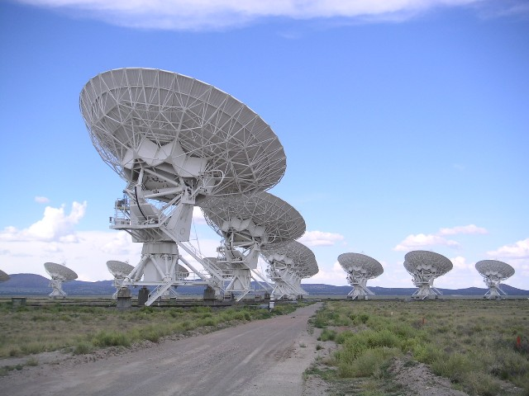
National Radio Astronomy Observatory
(WMAP) 无线电天文观测望远镜

Slide 23
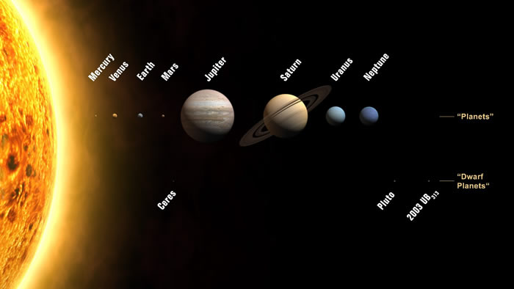
Eris

Slide 24
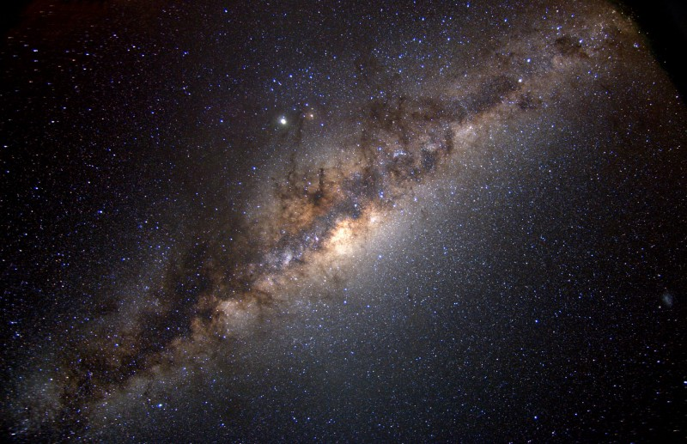
Milky Way Galaxy 银河星系

Slide 25
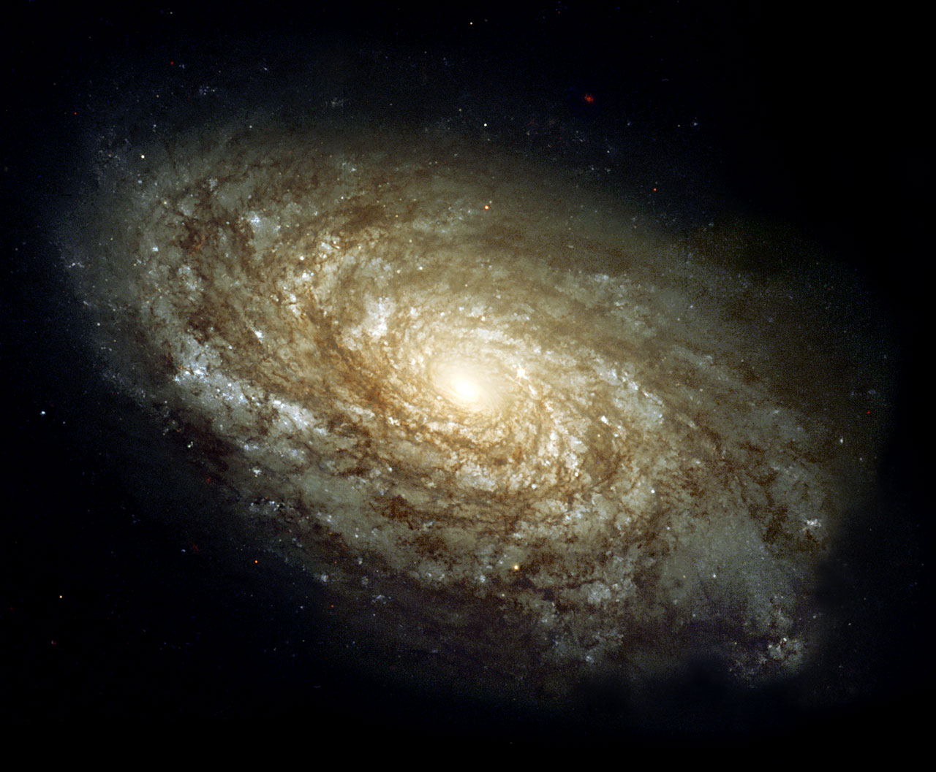
Spiral Galaxy NGC 4414

Slide 26
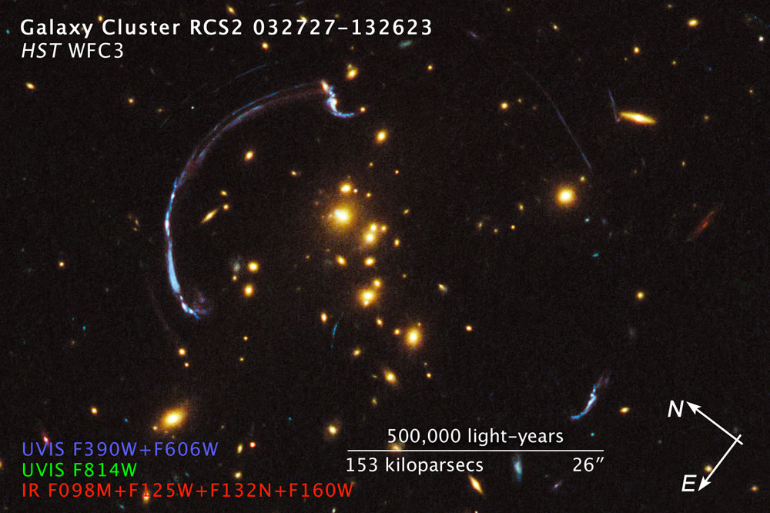

Slide 27
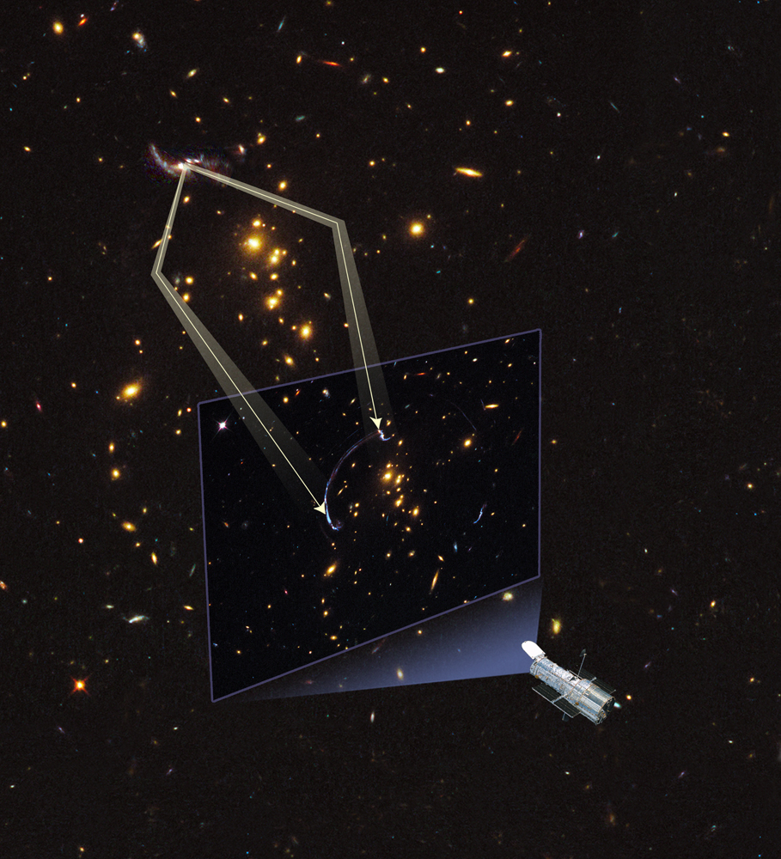

Slide 28
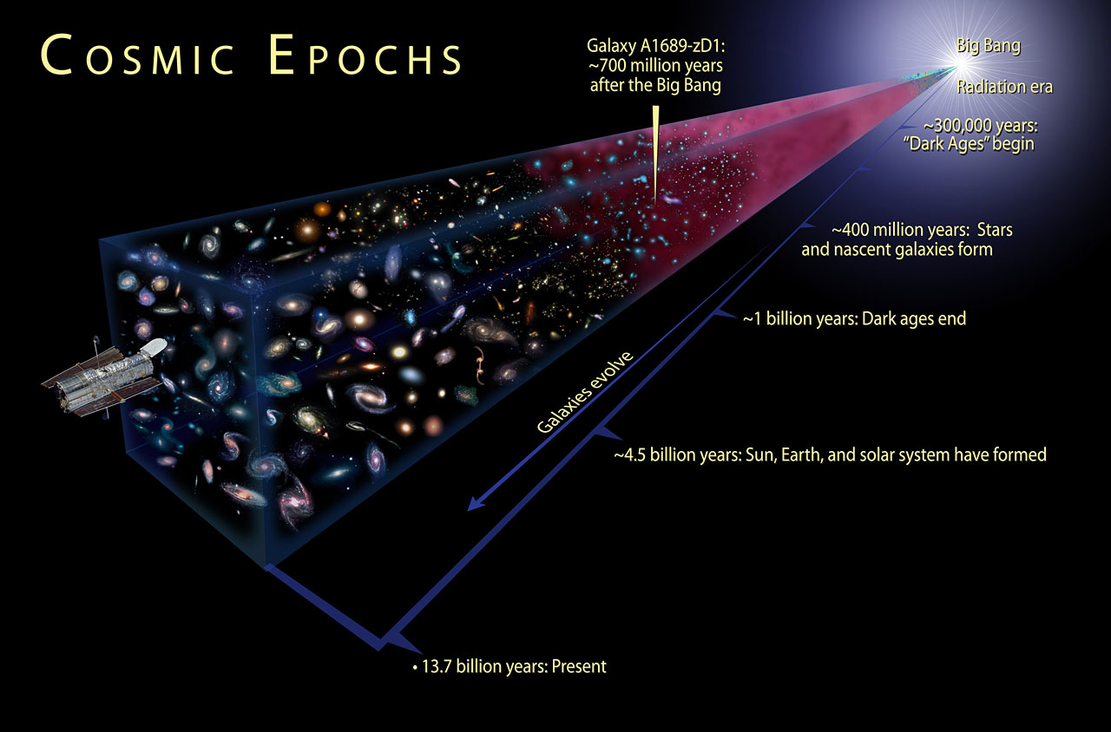
宇宙有多久？
How big is Universe? Its age?
137.7亿年

Slide 29

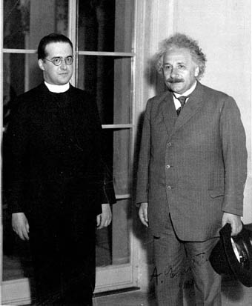
宇宙有开始吗？请问喬治·勒梅特神父！
Ask Father George LeMaitre – Father of Big Bang

Slide 30
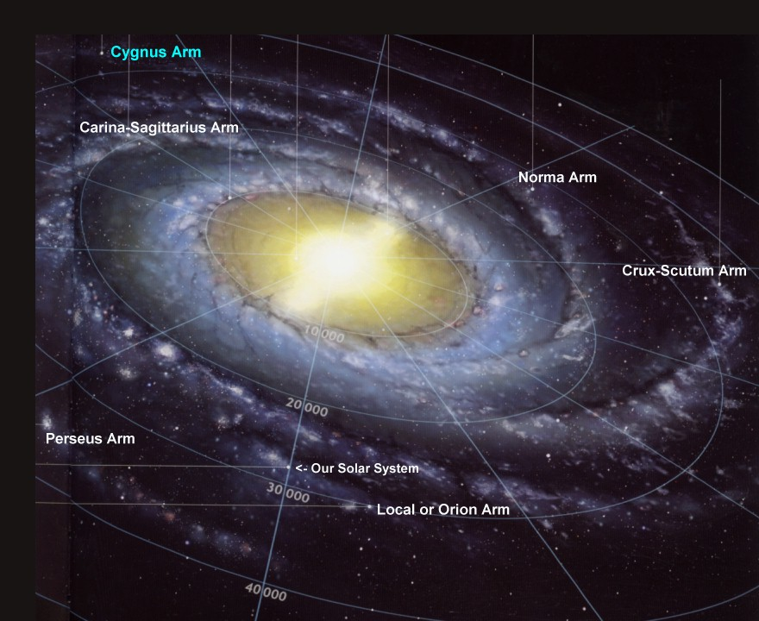

Slide 31
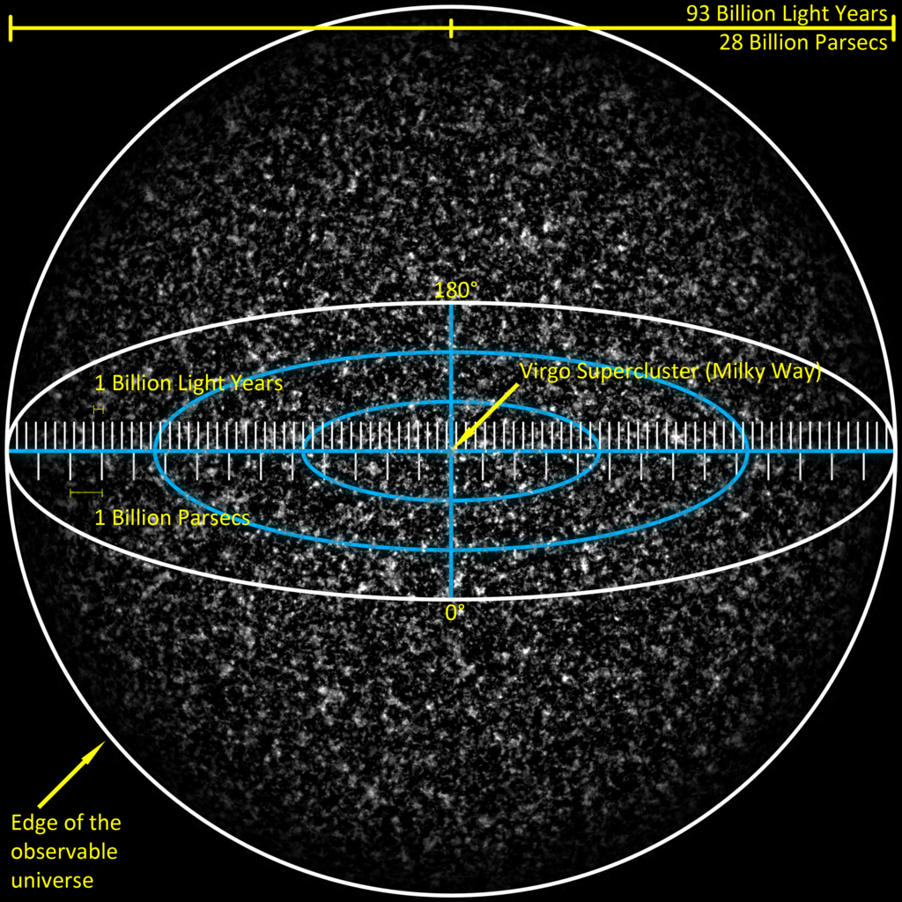
宇宙有多大？
How Big?

Slide 32
苍生有多小？How small is a life?

Slide 33
A 70 kg body would have approximately 7*10²⁷ atoms.
That is, 7 followed by 27 zeros:
70公斤体重的一个人大约含有7*10²⁷个原子
7,000,000,000,000,000,000,000,000,000个原子
4.7*10²⁷ would be hydrogen atoms氢原子
1.8*10²⁷ would be oxygen atoms氧原子
7.0*10²⁶ carbon atoms碳原子
An estimate of about 10⁸⁰ atoms
in the observable universe.
整个可观察宇宙大约有个10⁸⁰原子
100,000,000,000,000,000,000,000,000,000,
000,000,000,000,000,000,000,000,000,000,
000,000,000,000,000,000,000.
人/宇宙～
1/10,000,000,000,000,000,000,000,000,000,000,000,000,000,000,000,000,000.

Slide 34
人生有意义吗？
Purpose of Life?

Slide 35
宇宙有意义吗？
Purpose of Universe?

Slide 36
宇宙的起始状态
Initial Condition of Universe

Slide 37
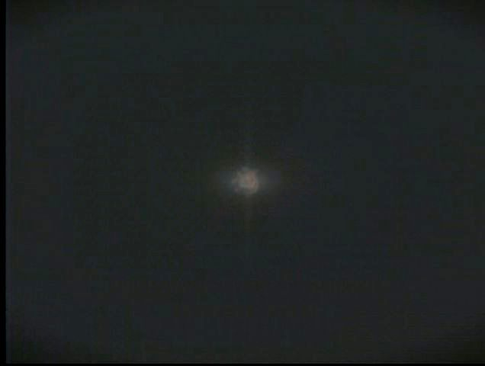

Slide 38
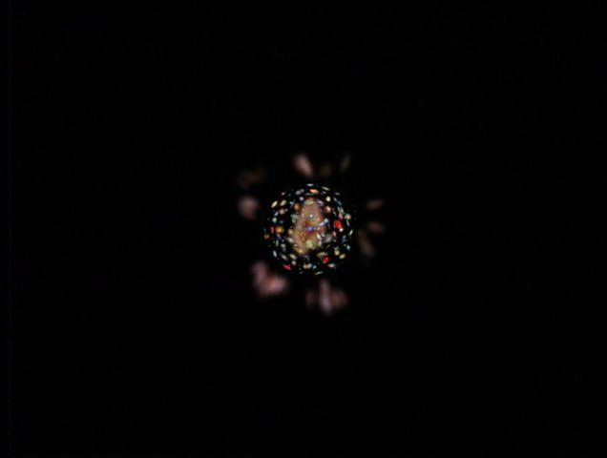

Slide 39
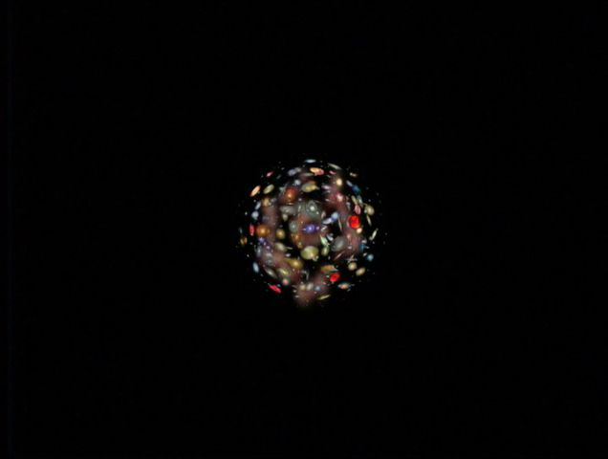

Slide 40
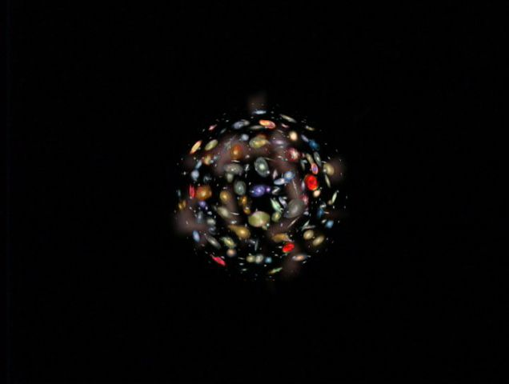

Slide 41
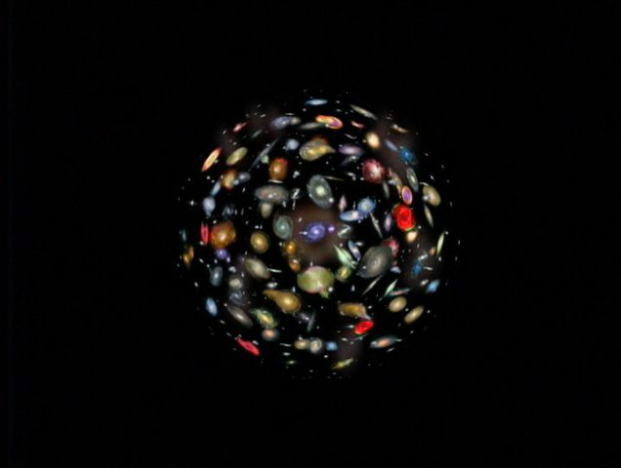

Slide 42
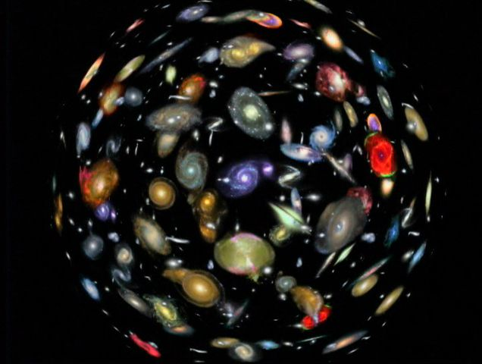

Slide 43
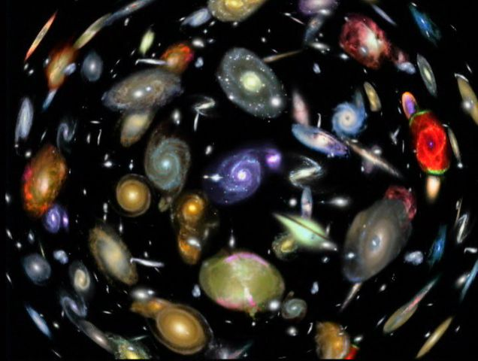

Slide 44
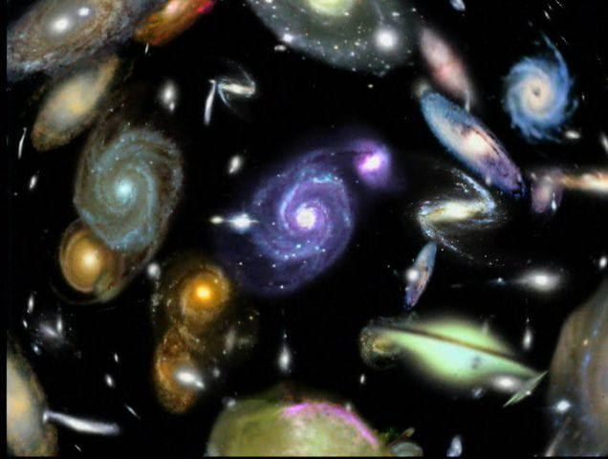

Slide 45
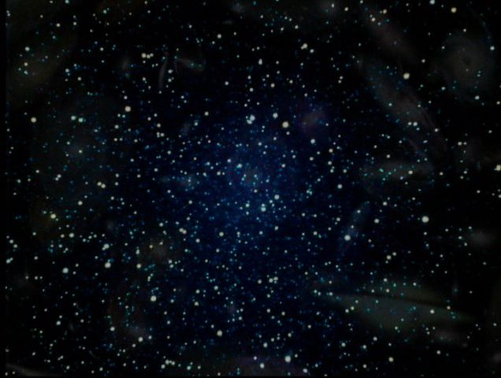

Slide 47
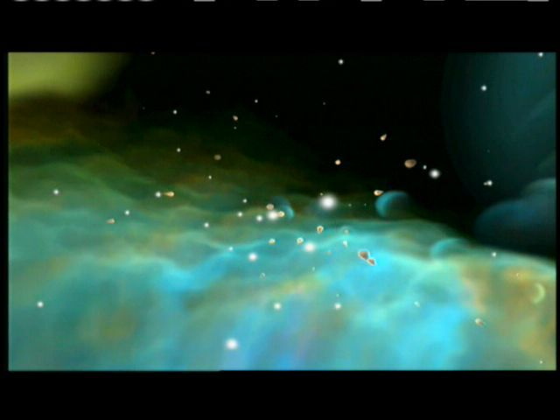

Slide 48
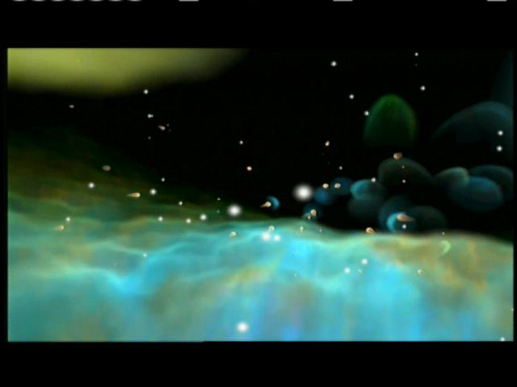

Slide 49
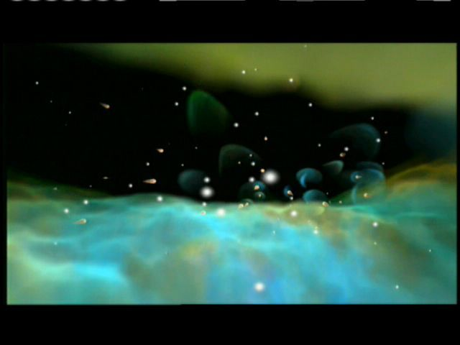

Slide 50
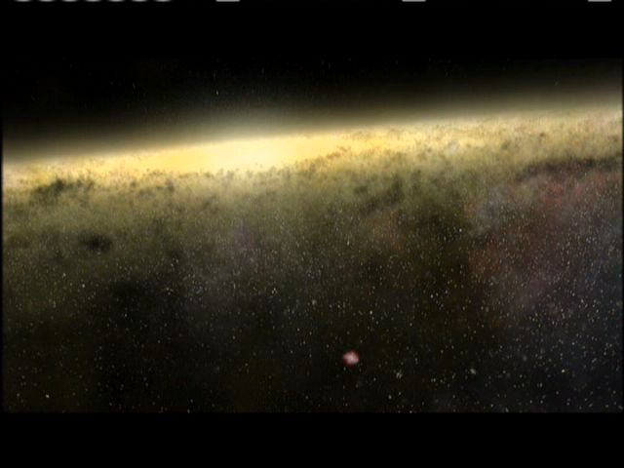

Slide 51
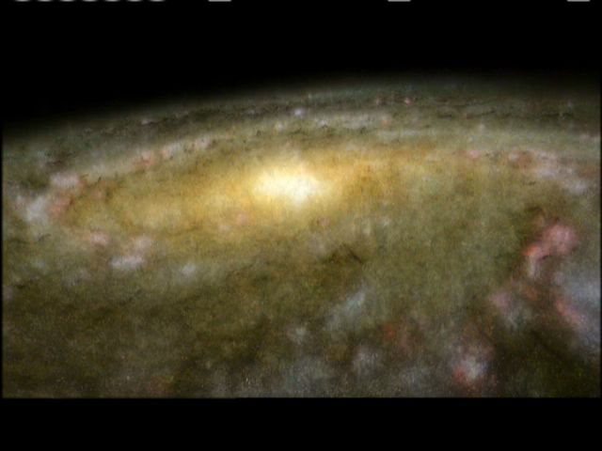

Slide 52
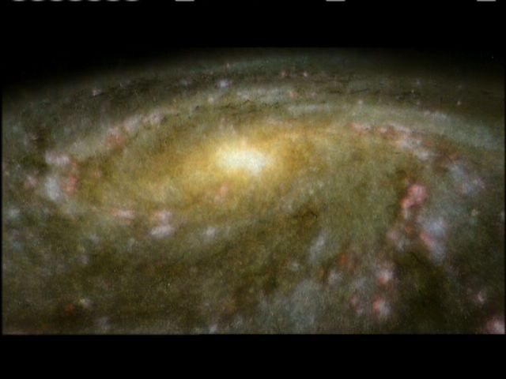

Slide 53
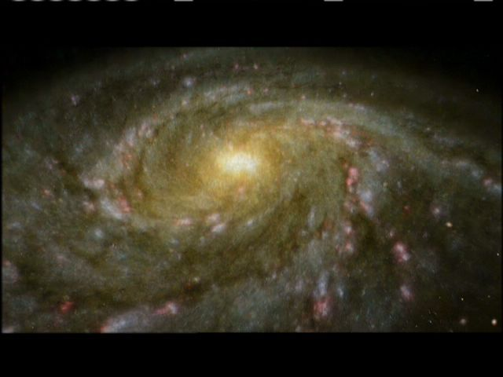

Slide 54
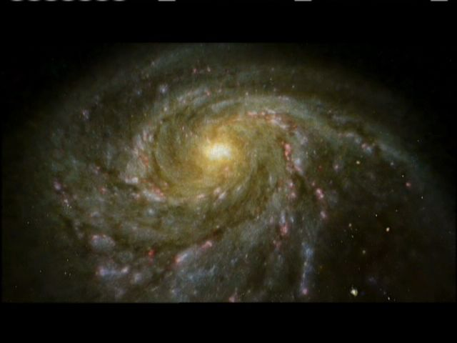

Slide 55
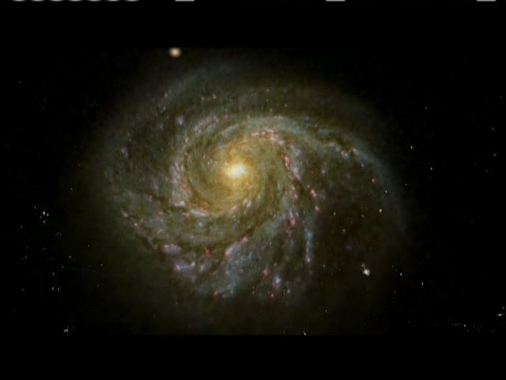

Slide 56
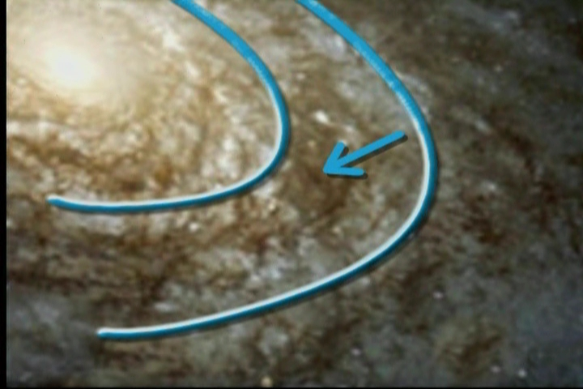
Galactic Habitable zone

Slide 57
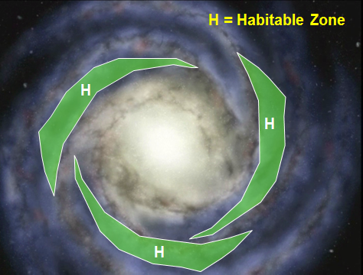

Slide 58
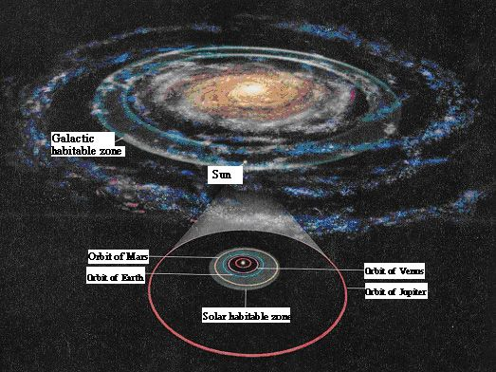

Slide 59
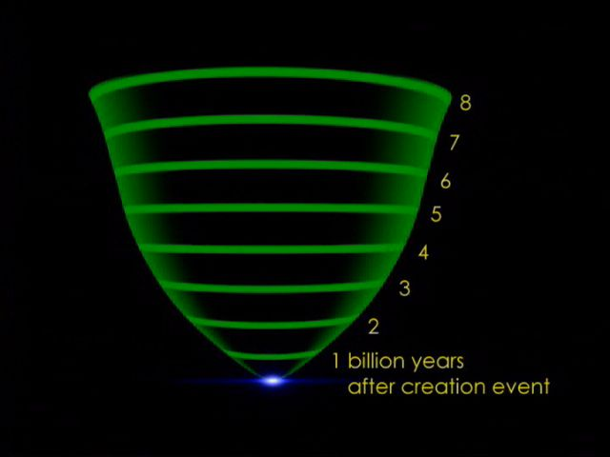

Slide 60
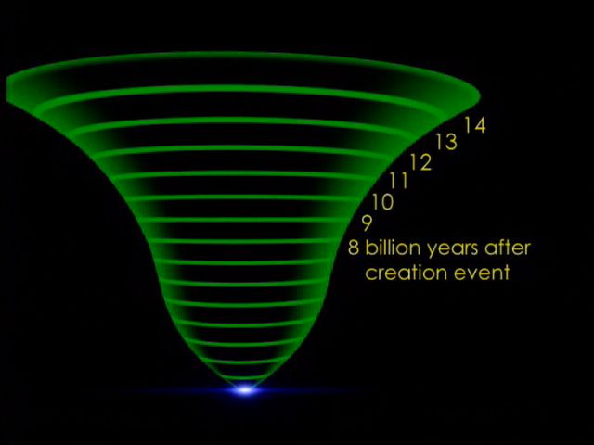

Slide 61

精密调治，不可思议
Unimaginable Exquisite Fine Tuning

Slide 62


Slide 63


Slide 64


Slide 65

1978年诺贝尔物理奖得主

Slide 66

天文学领我们到一个独一的事件：就是宇宙从无中创造出来…

Slide 67

必须得有精密的调制平衡，才能有生命生存…

Slide 68

这背后必须要有一个计划（或者可以说是“超自然”的计划吧）

Slide 69

这宇宙为什么会如此的开始，实在很难解释 -除非是有一位神特意要创造像我们这样的人类！
-霍金斯

Slide 70

若真是造物主，是不是像這樣？

Slide 71

還是像這樣？

Slide 72

還是像這樣？

Slide 73
聖經中呢？
伯 9:8 他獨自鋪張蒼天，步行在海浪之上。9:9 他造北斗、參星、昴星，並南方的密宮。
Job 9:8-9 (NASB) 8 Who alone stretches out the heavens And tramples down the waves of the sea; 9 Who makes the Bear, Orion and the Pleiades, And the chambers of the south;

Slide 74
賽 44:24 “從你出胎，造就你的救贖主耶和華如此說：我耶和華是創造萬物的，是獨自鋪張諸天、鋪開大地的。誰與我同在呢？
Isaiah 44:24 (NASB)
24 Thus says the LORD, your Redeemer, and the one who formed you from the womb, "I, the LORD, am the maker of all things, Stretching out the heavens by Myself And spreading out the earth all alone, …

Slide 75
创 1:1 起初 神创造天地。
Ge. 1:1 In the beginning God created the heavens and the earth.
诗 8:3 我观看你指头所造的天,并你所陈设的月亮星宿，
诗 8:4 便说,人算甚么,你竟顾念他?世人算甚么,你竟眷顾他?
Ps. 8:3 When I consider your heavens, the work of your fingers, the moon and the stars, which you have set in place,
Ps. 8:4 what is man that you are mindful of him, the son of man that you care for him?

Slide 95
Galactic Habitable zone

Slide 98
创造
Creation
Universe = Matter +Energy +Space + Time
Out of Nothing!
创造不是製造Creation is not “Manufacture”
创造是從無中生有 It must out of nothing
创造的开始可以观察得到 It is observable
時間同時在宇宙的开始才被造 Time was created
宇宙 = 物质+能量+空间+时间
宇宙的创造必须有 Creation of Universe
不可思议的精密调制 Must be fine tuned
有创造,谁是创造者? Who did it?

Slide 99
创造有目的吗?Purpose of the Creation?
诗 8:3 我观看你指头所造的天,并你所陈设的月亮星宿, 诗 8:4 便说,人算甚么,你竟顾念他?世人算甚么,你竟眷顾他?
Ps. 8:3 When I consider your heavens, the work of your fingers, the moon and the stars, which you have set in place,
Ps. 8:4 what is man that you are mindful of him, the son of man that you care for him?
诗 8:5 你叫他比天使微小一点,并赐他荣耀尊贵为冠冕。 诗 8:6,7,8 你派他管理你手所造的,使万物,就是一切的牛羊、田野的兽、空中的鸟、 海里的鱼,凡经行海道的,都服在他的脚下。Ps. 8:5 You made him a little lower than the heavenly beings and crowned him with glory and honour. 8:6 You made him ruler over the works of your hands; you put everything under his feet:

Slide 100

氮氣
氧氣
二氧化碳

Slide 101


Slide 102

Dr. Fred Down, Father of Space Suit Fabric
据美国星岛日报报道，美国三十年来的太空服都出自“太空服之父”华人唐鑫源，其中专利转为民用“尿不湿”。
已去世的美国太空总署华人总工程师唐鑫源的传奇往事，由他的亲属日前向美国华文媒体披露。唐鑫源出生于中国江苏无锡著名的唐氏纺织家庭，长在上海，一九三六年赴美留学获双硕士学位，回国后出任协新毛纺厂厂长和中国纺织学院教授及副院长等职，一九四九年携家人再度来美国深造获得博士学位，之后在休 斯顿美国太空总署工作并担任总工程师，是当时太空总署的唯一中国人。

Slide 103
这么一个著名的高科技中国科学家，他对信仰的看法是什么呢？唐鑫源博士说∶“神是又真又活的神。他不仅赐给了我们生命气息，还成为我们随时的帮助。记得阿波罗第一次发生不幸事件之后，我因任务紧急须要日以继夜的工作，加上当时太空中心只有我一个中国人及主管，希望自己一定做得比美国人好，由于太劳累，突然整个人中风，成了半生不遂，连喝水也会流出来，幸亏神医治了我。每次做研究决定以前，一定恭敬地在主前祷告。所以我的成功都是神的恩典。我感谢赞美神，不是耶和华建造房屋，建造的人就枉然劳力。也正因为神特别恩典与代领，我才能有今天这一点地小成就，愿一切荣耀都归给神。” - 星岛日报

Slide 104

A reminder
月亮的提醒

Slide 105


Slide 106

CHELYABINSK, Russia February 15, 2013

Slide 107

A meteor streaks over the city of Chelyabinsk in Russia’s Ural Mountains on Friday morning, February 15, 2013, producing a blast that injured thousands.

Slide 108

Protection of Air
大氣層的保護

Slide 109

木星的保護

Slide 110


Slide 111

In 1995, fragments from the comet Shoemaker-Levy 9 “bombarded” Jupiter and left several “scars” that Hubble studied in detail.

Slide 112


Slide 113


Slide 114

液態水 Liquid Water

Slide 115

氣態水 Vapor

Slide 116

固態水 Ice

Slide 117


Slide 118


Slide 119


Slide 120


Slide 121


Slide 123


Slide 124

类似于地球
的环境少於
之一的机率
容許高等生物生存必須有>120個條件

Slide 125
创造有目的吗?Purpose of the Creation?
诗 8:3 我观看你指头所造的天,并你所陈设的月亮星宿, 诗 8:4 便说,人算甚么,你竟顾念他?世人算甚么,你竟眷顾他?
Ps. 8:3 When I consider your heavens, the work of your fingers, the moon and the stars, which you have set in place,
Ps. 8:4 what is man that you are mindful of him, the son of man that you care for him?
诗 8:5 你叫他比天使微小一点,并赐他荣耀尊贵为冠冕。 诗 8:6,7,8 你派他管理你手所造的,使万物,就是一切的牛羊、田野的兽、空中的鸟、 海里的鱼,凡经行海道的,都服在他的脚下。Ps. 8:5 You made him a little lower than the heavenly beings and crowned him with glory and honour. 8:6 You made him ruler over the works of your hands; you put everything under his feet:

Slide 126
人有目的吗？Purpose of Mankind
创 1:1 起初 上帝创造天地。
26 上帝说：“我们要照着我们的形像，按着我们的样式造人，使他们管理海里的鱼、天空的鸟、地上的牲畜和全地，以及地上爬的一切爬行动物。” 27 上帝就照着他的形像创造人，照着上帝的形像创造他们；他创造了他们，有男有女。
Ge. 1:1 In the beginning God created the heavens and the earth. Ge. 1:26 Then God said, “Let us make man in our image, in our likeness, and let them rule over the fish of the sea and the birds of the air, over the livestock, over all the earth, and over all the creatures that move along the ground.” Ge. 1:27 So God created man in his own image, in the image of God he created him; male and female he created them.

Slide 127
人有目的吗?Purpose of Mankind
5 你使他比天使微小一点， 赐他荣耀尊贵为冠冕。
6-8 你派他管理你手所造的， 使万物，就是一切的牛羊、 田野的牲畜、空中的鸟、海里的鱼,凡游在水里的, 都服在他的脚下。
Ps. 8:5 You made him a little lower than the heavenly beings and crowned him with glory and honor. 8:6 You made him ruler over the works of your hands; you put everything under his feet:

Slide 128

什么是永恒的爱?
What is Eternal Love then?

Slide 129
什么是永恒的爱?
What is Eternal Love then?
羅 8:35 誰能使我們與基督的愛隔絕呢？難道是患難嗎？是困苦嗎？是逼迫嗎？是飢餓嗎？是赤身露體嗎？是危險嗎？是刀劍嗎？…
羅 8:39 是高處的、是低處的，是別的受造之物，都不能叫我們與 神的愛隔絕；這愛是在我們的主基督耶穌裡的。Ro. 8:35 Who shall separate us from the love of Christ? Shall trouble or hardship or persecution or famine or nakedness or danger or sword?... 39 neither height nor depth, nor anything else in all creation, will
be able to separate us from the love of God that is in Christ Jesus our Lord.

Slide 130
永恒的爱
“上帝爱世人，甚至赐下他的独子，要使所有信他的人不致灭亡，反得永恒的生命”（约翰福音3:16)
God's Eternal Love
"For God so loved the world, that He gave His only begotten Son, that whoever believes in Him should not perish, but have eternal life" (John 3:16).

Slide 131
科学家也相信这位神？
Do Scientists believe in God?
五位当代科学的鼻祖:
Five Founding Fathers of Science:

Slide 132

Philosophiae Naturalis
Principia Mathematica
F = ma
牛頓
Newton, Sir Isaac (1642-1727)

Slide 133

Michael Faraday (1791-1867) was a leading scientist of his generation,one of the greatest experimenters ever. He is known for his pioneering work in electricity and magnetism, including the concept of electric fields. He is honored by having the unit of capacitance named after himþthe farad. He was also a fully committed Christian who based his religion on a literal interpretation of the Bible (Cantor, p.10).
法拉第
Michael Faraday (1791-1867)

Slide 134



麥克斯韋爾
A Treatise on
Electricity and
Magnetism
Maxwell, James (1831-1879)

Slide 135

Blaise Pascal, One of the greatest early mathematicians, laid the foundations for hydrostatics, hydrodynamics, differential calculus, and the theory of probability.
Became a devout Christian at age 31. He carried with him all his life a description of that experience. In his Pensees he has some valuable insights into the relation between science and religion. God wishes to move the will rather than the mind.
巴斯克
Pascal, Blaise (1623-1662)

Slide 136

He saw second law of thermodynamics, that the dissipation of energy is a universal feature, was directly related to his theology. Here he unified two of his deepest commitments: universal natural law is created and governed by divine power, and the world is progressively developing toward an inevitable end. He summarized his belief by quoting Psalm 102:26, "all of them shall wax old like a garment". He believed that God alone could restore the original distribution or arrangement of energy in the created universe. (Smith/Wise, p.317,331,332,497; Clark, p.14) Related to this, Kelvin objected to evolution by blind chance. He believed that life proceeds only from life, that it is a mystery and a miracle, and was designed and guided by a Creator.
Kelvin, Lord William Thomson (1824-1907)
Scottish mathematician and physicist who
contributed to many branches of physics.
柯爾文

Slide 137
五位当代科学的创始者
5 Founding fathers of Science
五个物理单位以其命名5 Physics Units
五个虔诚的基督徒
5 Devout Christians

Slide 138

賈時超 Robert Jastrow, founder and director of the Institute for Space Studies at the Goddard Space Flight Center. In his book, God and the Astronomers, he says:
For the scientist who has lived by his faith in the power of reason, the story ends like a bad dream. He has scaled the mountains of ignorance; he is about to conquer the highest peak; as he pulls himself over the final rock, he is greeted by a band of theologians who have been sitting there for centuries. (Jastrow, p.116)
对科学家一生以理智的力量为信仰的依归，这故事的演变如同噩梦。
他登上一座座无知的高山，就即将到达最高峰。当他爬过最后一块岩石，往上一看：一群神学家已在那里等了几个世纪，恭候多时！

Slide 139

查爾斯·湯斯（Charles Townes，1915年7月28日南卡羅萊那州格林維爾），美國物理學家、教育家，1964年獲諾貝爾物理學獎。发明激光.
"science and religion [are] quite parallel, much more similar than most people think and that in the long run, they must converge"
科学与宗教（基督教）是相当平行前进的，比一般人想象的更相似，终究会融合一致。

Slide 140


Slide 141
Apollo 8 Transcript
William Anders:
"For all the people on Earth the crew of Apollo 8 has a message we would like to send you".
"In the beginning God created the heaven and the earth.
And the earth was without form, and void; and darkness was upon the face of the deep.
And the Spirit of God moved upon the face of the waters. And God said, Let there be light: and there was light.
And God saw the light, that it was good: and God divided the light from the darkness."
Jim Lovell:
"And God called the light Day, and the darkness he called Night. And the evening and the morning were the first day.
And God said, Let there be a firmament in the midst of the waters, and let it divide the waters from the waters.
And God made the firmament, and divided the waters which were under the firmament from the waters which were above the firmament: and it was so.
And God called the firmament Heaven. And the evening and the morning were the second day."
Frank Borman:
"And God said, Let the waters under the heavens be gathered together unto one place, and let the dry land appear: and it was so.
And God called the dry land Earth; and the gathering together of the waters called he Seas: and God saw that it was good."
Borman then added, "And from the crew of Apollo 8, we close with good night, good luck, a Merry Christmas, and God bless all of you - all of you on the good Earth."

Slide 142


Slide 143


Slide 144

http://www.blurb.com/bookstore/detail/1774065
https://vimeo.com/90289145

Slide 145



Roger Penrose
Predecessor and Coauthor of Penrose–Hawking singularity theorems Oxford U. Mathematical Physicist

Slide 146

Arizona State University Astrophysicist

Slide 147



Sir Rev Dr. John Polkinghorne
Retired President
Queen’s College, Cambridge

Slide 148

Cambridge University
Mathematical Physicist

Slide 149


Cambridge University
Astrophysicist

Slide 150

Astronomer
Astrobiologist
U. Of Washington

Slide 151

Charles H. Langmuir,
Wally Broecker
Harvard University Geologists

