Slide 1
生命的起源
The Origin of Life
陳祐生

Slide 2
起初
In The Beginning
「起初神創造天地。」
【創一1】

Slide 3
大爆炸理論簡說
整個物質宇宙，包括物質、能量，甚至是時空的四個度量，都是從那無限（或接近無限）密度、溫度與壓力的狀態中爆炸出來的。
宇宙從一個小於針點的體積開始，不斷膨脹，直到如今。
此大爆炸理論是最能解釋宇宙之源的理論

Slide 4
宇宙有一個開始
一百三十多億年前，開始了一個大爆炸，形成了宇宙，這段時間可以說是非常的長。
但是對倡導進化論的人來說，卻是不夠長。
因為沒有足夠的時間，讓『偶發機率』來進行
也沒有足夠的時間，讓生命體藉著自然過程中作重大的改變，
並且，適合生命化學的條件在漫長的過去中只佔一短暫的部分。

Slide 5
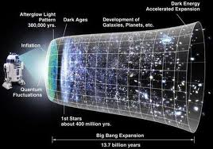
http://en.wikipedia.org/wiki/Big_Bang

Slide 6
17 times the Bible declares that God stretched the heavens
2 Sam 22:10 Job 37:18 Isaiah 51:13
Psalm 18:9 Isaiah 40:22 Jeremiah 10:12
Psalm 104:2 Isaiah 42:5 Jeremiah 51:15
Psalm 144:5 Isaiah 44:24 Ezekiel 1:22
Job 9:8 Isaiah 45:12 Zechariah 12:1
Job 26:7 Isaiah 48:13

Slide 7
^{CU5} Job 37:18 你豈能與 神同鋪穹蒼麼．這穹蒼堅硬、如同鑄成的鏡子。
^{CNV5} Job 37:18 你能與 神同鋪雲天嗎？這雲天堅硬如鑄成的鏡子。
^{ASV} Job 37:18 Canst thou with him spread out the sky, Which is strong as a molten mirror?
^{WTT} Job 37:18 תַּרְקִ֣יעַ עִ֭מּוֹ לִשְׁחָקִ֑ים חֲ֜זָקִ֗ים כִּרְאִ֥י מוּצָֽק׃

Slide 8
^{CU5} Isaiah 51:13 卻忘記鋪張諸天、立定地基、創造你的耶和華．又因欺壓者圖謀毀滅要發的暴怒、整天害怕．其實那欺壓者的暴怒在哪裡呢。
^{CNV5} Isaiah 51:13 你忘記了造你的耶和華，就是那展開諸天，奠定大地的根基的；又因那欺壓者準備行毀滅的時候所發的烈怒，你就終日不住懼怕呢？其實那欺壓者的烈怒在哪裡呢？
^{ASV} Isaiah 51:13 and hast forgotten Jehovah thy Maker, that stretched forth the heavens, and laid the foundations of the earth; and fearest continually all the day because of the fury of the oppressor, when he maketh ready to destroy? and where is the fury of the oppressor?
^{WTT} Isaiah 51:13 וַתִּשְׁכַּ֞ח יְהוָ֣ה עֹשֶׂ֗ךָ נוֹטֶ֣ה שָׁמַיִם֘ וְיֹסֵ֣ד אָרֶץ֒ וַתְּפַחֵ֙ד תָּמִ֜יד כָּל־הַיּ֗וֹם מִפְּנֵי֙ חֲמַ֣ת הַמֵּצִ֔יק כַּאֲשֶׁ֥ר כּוֹנֵ֖ן לְהַשְׁחִ֑ית וְאַיֵּ֖ה חֲמַ֥ת הַמֵּצִֽיק׃

Slide 9
Job 26:7
神將北極鋪(傾斜)在空中、將大地懸在虛空
他把北極鋪(傾斜)在空間，把地球掛在太空。

Slide 10
Big Bang vs. Creation
Order of Appearance (Evolution)
Sun/stars existed before the Earth
Sun is Earth’s first light
First life = marine organisms
Reptiles predate birds
Land mammals predate whales
Disease/death precede man’s sin
Order of Appearance (Bible)
Earth created before sun/stars
Light on Earth before sun
First life = land plants
Birds predate land reptiles
Whales predate land animals
Disease/death results from man’s sin

Slide 11
一個恰到好處的宇宙
電子與質子的數目相等必須精確到10³⁷分之一，否則電磁力會克服各種引力，以致星系、星體和行星都不能形成。
宇宙的膨脹速度必須精確的平衡（10⁵⁵分之一），使生命能存在。
其他如：宇宙的年齡、星體的距離、逃逸速度、電磁力常數與引力常數的比例等，都必須非常精確，才能使生命能存在。

Slide 12
一個恰到好處的宇宙？
宇宙中至少有五十多項的特點，其數值必須要精確到非常狹窄的範圍內，才有我們的生存機會。
William Paley 的『錶匠論據』
George Greenstein 說，『當我們勘察所有證據時，我們會想到…一個神聖者的必然參與過。…神是否曾經介入，又為我們親自斧鑿出這個宇宙？』

Slide 13
生命的起源
The Origin of Life

Slide 14
1.現狀永久說 | 生物原來就一直存在於地球上，而沒有起源的問題可談
2.星體起源說 （隕石說） | 生物可能自其他星球經隕石或宇宙塵帶到地球。 證據：科學家曾在某些隕石中，分析得到有機物
3.外星人帶來說 | 地球上最早的生物是由高智慧的外星人在太空旅遊造訪地球時，將生物（微生物）留在地球上
4.自然發生說 （無生源論） | 生物並非來自活的親代，而是自然形成的 →生物隨時能由地球上的無生命物質轉變而來 例如：亞里斯多德→認為腐肉可以生蛆
5.新自然發生說 （有機演化） | 最初的生命應該是自然發生的，自然界中存在的物質藉著物理和化學作用而合成第一個生命，自此以後演化出地球上多樣性的生物（但生命不是隨時可自然發生）

Slide 15
無生源論
又稱自生論或自然發生說:認為生物可以隨時由非生物發生，或由另一類截然不同的生物產生。
“腐草化螢”、“魚枯生蠹”《荀子·勸學》；
埃及人認為，太陽照在尼羅河的淤泥上就會產出黃鱔和青蛙；
亞里士多德認為，生物除了由自己的親代產生外，還可由非生物自然發生。

Slide 16
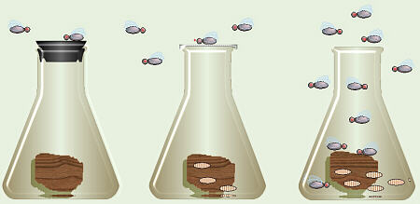
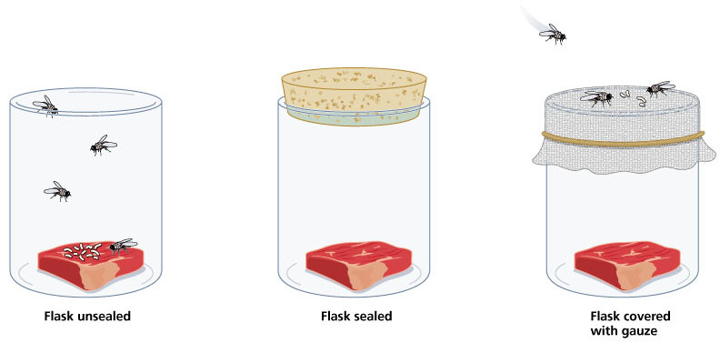
雷迪Francesco Redi (1668)
否定腐肉生蛆，並提出『生源論』
廣口瓶內放置牛肉，瓶口敞開→腐肉上有蛆出現
廣口瓶內放置牛肉，瓶口用紗布封住→腐肉上沒有蛆出現
結論：僅僅動物屍體不能生蛆，必須先有蒼蠅產卵於屍體上

Slide 17
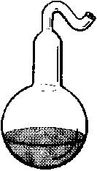
The Theory Finally Changes

Slide 18
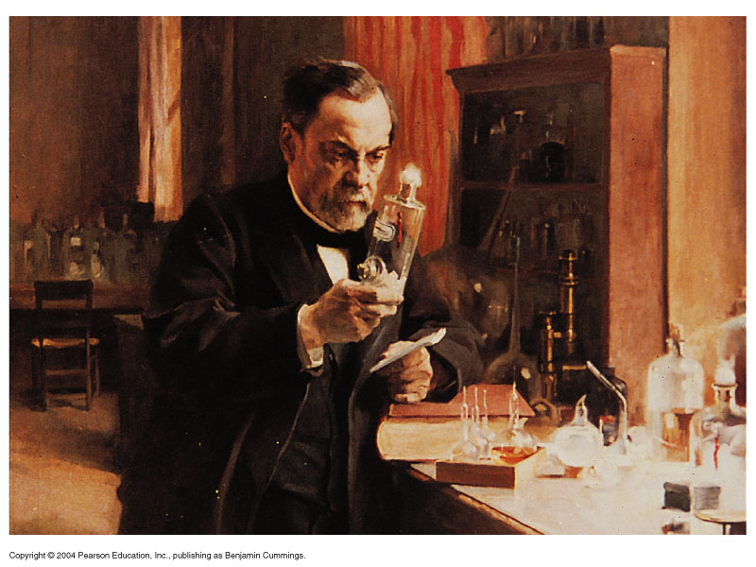
Louis Pasteur (1822-1895)

Slide 19
Pasteur's Experiment
鵝頸瓶實驗：否定自然發生說，支持生源論
(A)玻璃瓶中盛有肉汁、酵母及糖水的混合溶液，其瓶頸作成S型，
加熱至沸騰→將瓶中微生物殺死
(B)瓶中的混合溶液冷卻後，水汽凝結成的水聚集在S 型瓶頸底部（將瓶口封住）→瓶中無微生物出現
(C)將S型瓶頸折斷（外界空氣進入）→瓶中出現微生物
結論：生物不能無中生有，生物必須源自原先存在的生物
生源論目前已普遍被大部分科學家所接受

Slide 20
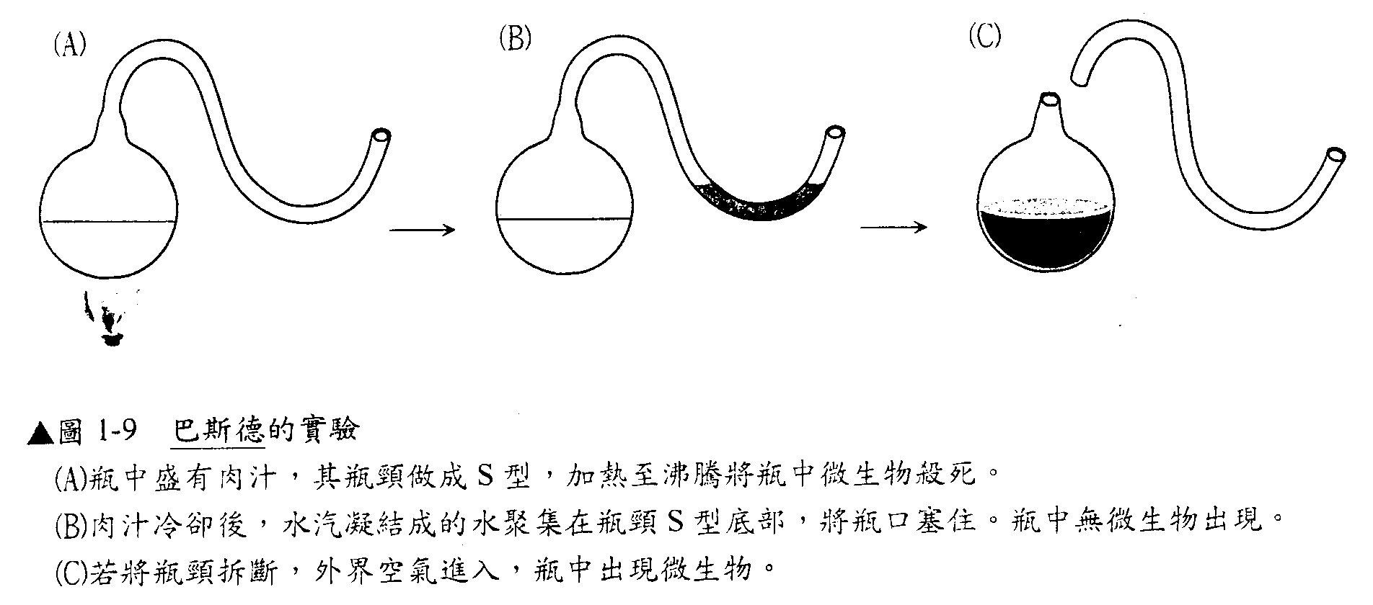
Pasteur's Experimental Results

Slide 21
生命起源順序
<1>火山爆發，噴出水蒸氣。
<2>水蒸氣在高空凝結，開始下雨造成海洋。
<3>雷電帶來巨大能量，擊打甲烷、氨等氣體。
<4>氣體發生化學變化，形成胺基酸，融入海洋。
<5>胺基酸組合形成蛋白質。
<6>蛋白質變成團聚體。
<7>團聚體會覓食，也會互相結合成新個體，或進行自我複製，分裂成2個個體。
<8>團聚體逐漸演進為原始細胞，如細菌和藍綠藻。

Slide 22
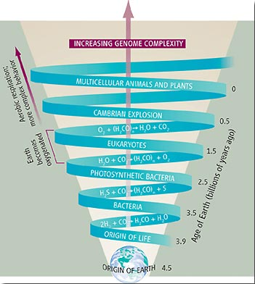
生命的起源
http://www.astrobio.net/pressrelease/1910/the-oxygen-imperative
Notes:
About 4.6 billion years ago the Earth formed. Origin of life theories typically involved Chance, Necessity (natural laws of molecular interaction), or a combination of these. Some assert a role of natural selection in molecular evolution, although selection would not be possible until a replicating molecule or cell existed. And of course lots of time.
Image source: LLNL (Copyright)
https://publicaffairs.llnl.gov/news/news_releases/2006/NR-06-03-09.html
Image caption:
The evolution of genomic complexity and metabolic pathways during Earth's history. The earliest origin of life is not known. However, assuming a single last universal common ancestor evolved in mid-Proterozoic, there is evidence of microbial life. When oxygenic photosynthesis evolved is not clear, but geochemical data suggest that between about 2.3 and 2.2.billion years ago, there was sufficient oxygen in the atmosphere to permit an ozone layer to form. That singular event appears to have precipitated a massive increase in genome and metabolic complexity, culminating in the rise of metazoans around 600 million years ago, and the rise of terrestrial plants around 430 million years ago. The feedbacks in the evolutionary trajectory have led to increasing genomic and metabolic complexity. (Image and caption courtesy ofScience.)

Slide 23
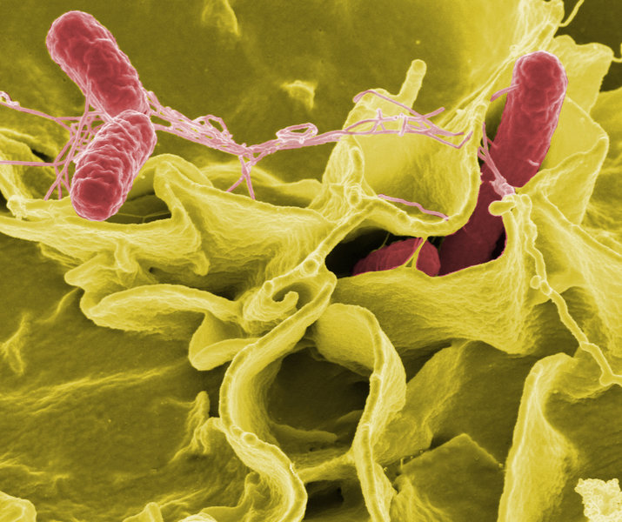
原核生物
Molecules formed in the “primordial soup” (amino acids, nucleotides, etc.).
Molecules spontaneously joined to form macromolecules (polymers).
Macromolecules aggregated together and formed the first cell.
Prokaryotes established symbiotic relationships and formed the first eukaryote.
Notes:
Color-enhanced scanning electron micrograph showing Salmonella typhimurium (red) invading cultured human cells
Image Source:
http://creationwiki.org/index.php/Image:Salmonella.jpg

Slide 24
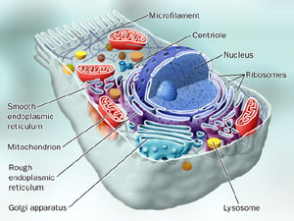
Cellular Complexity
Image Source:
http://www.daviddarling.info/encyclopedia/E/eukarycell.html
Eukaryote
Notes:
A eukaryote might be 25 microns across, and a nucleus is about 5 microns across. So, one cubic inch of flesh might hold a billion eukaryotes.
Image source: CreationWiki (public domain)
http://creationwiki.org/Cells

Slide 25
奧柏林（歐伯林，蘇俄人） (1)認為最初地球環境是一個無氧狀態
→到處充滿H2、CO2、N2、CH4、水蒸氣
(2)環境中的能量將無機物先形成簡單的有機物，再合成複雜有機物，
→再經長時間的組合與演變而產生第一個生物
荷頓（荷爾丹，英國人） 提出『原始湯』理論：
認為來自太陽的紫外線和宇宙射線，照射原始還原性大氣而形成胺基酸和醣類等化合物，再逐漸堆積在早期的海洋中，使當時的海水成為充滿有機物的液體（有如熱的高湯），生命就是這種熱的有機湯中形成。

Slide 26
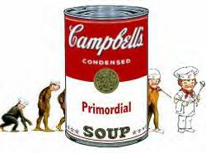
The Origin of Life
Molecules formed in the “primordial soup” (amino acids, nucleotides, etc.).
Image Source:
im-from-missouri.blogspot.com
Notes:
About 4.6 billion years ago the Earth formed. Origin of life theories typically involved Chance, Necessity (natural laws of molecular interaction), or a combination of these. Some assert a role of natural selection in molecular evolution, although selection would not be possible until a replicating molecule or cell existed. And of course lots of time.
Image source: LLNL (Copyright)
https://publicaffairs.llnl.gov/news/news_releases/2006/NR-06-03-09.html
Image caption:
The evolution of genomic complexity and metabolic pathways during Earth's history. The earliest origin of life is not known. However, assuming a single last universal common ancestor evolved in mid-Proterozoic, there is evidence of microbial life. When oxygenic photosynthesis evolved is not clear, but geochemical data suggest that between about 2.3 and 2.2.billion years ago, there was sufficient oxygen in the atmosphere to permit an ozone layer to form. That singular event appears to have precipitated a massive increase in genome and metabolic complexity, culminating in the rise of metazoans around 600 million years ago, and the rise of terrestrial plants around 430 million years ago. The feedbacks in the evolutionary trajectory have led to increasing genomic and metabolic complexity. (Image and caption courtesy ofScience.)

Slide 27
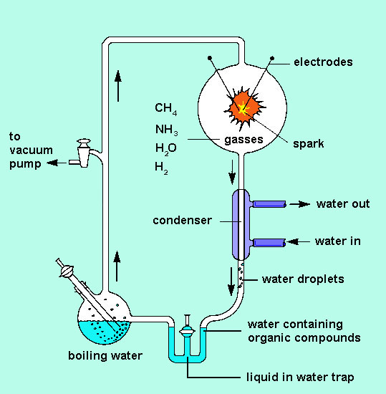
Early Attempts
Image Source:
danielafah.edu.glogster.com
Miller Experiment (1950s)
danielafah.edu.glogster.com
Notes:
danielafah.edu.glogster.com
Their apparatus contained Methane (CH4), Ammonium (NH3), Hydrogen (H2), and water vapor. They succeeded in isolating several amino acids.
Because amino acids react more readily with other molecules than amino acids, assembling a peptide (chain of amino acids is highly unlikely under such conditions) Only 2 percent of what Miller isolated consisted of amino acids. (The Case for Faith, p99)

Slide 28
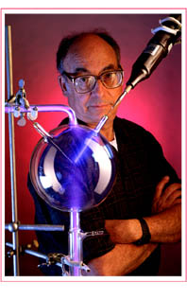
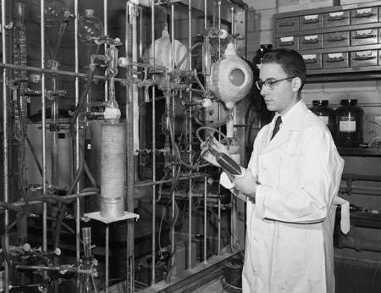
教科書上記著:
“Over a few days, several amino acids ─ the building blocks of proteins ─ began to accumulate. Miller and Urey’s experiments suggested how mixtures of the organic compounds necessary for life could have arisen from simpler compounds present on the primitive Earth.”
Stanley Miller
Biology, Miller, Levine. Prentice Hall. 2008, P424.
Image Source:
http://creationwiki.org/Stanley_Miller
Notes:
Prentice Hall Biology is the most widely used biology text in U.S. public schools.
Image Source:
http://creationwiki.org/Stanley_Miller

Slide 29
原始大氣（NH₃、H₂、H₂S、CO、CO₂、CH₄、水蒸氣，無氧氣）
↓輻射線、閃電、高溫
簡單有機物（胺基酸、脂肪酸、嘌呤、嘧啶）
↓輻射線、閃電、高溫
大分子有機物（醣類、脂質、蛋白質、核酸）
↓
原始生命（核苷酸、核酸的形成）
↓
原始細胞（原核、無氧呼吸、異營）
↓
自營生物（含葉綠素）
↓出現O₂
真核生物、有氧呼吸

Slide 30
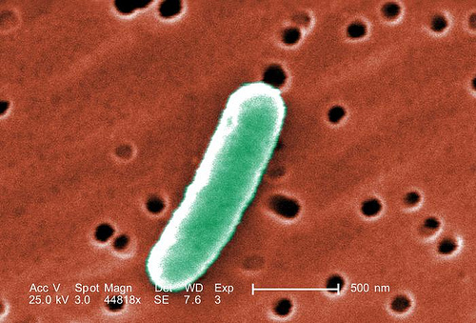
First Cell?
Store information
Process energy
Reproduce
Notes:
Definition for a living system – by Walter Bradley. The Case for Faith p97
Further reading: Signature in the Cell by Stephen Meyer p.201
http://store.nwcreation.net/siince.html
Image source: CreationWiki (public domain)
http://creationwiki.org/Escherichia_coli

Slide 31
Evolution Worldview
‘not composed of any organs at all, but consist entirely of shapeless, simple homogeneous matter … nothing more than a shapeless, mobile, little lump of mucus or slime, consisting of albuminous combination of carbon.’
Ernst Haeckel, The History of Creation, translated by E. Ray Lankester, Kegan Paul, Trench & Co., London, 1883, 3rd ed., Vol.1, p. 184.
Notes:
Protoplasm: (http://en.wikipedia.org/wiki/Protoplasm)
The concept of protoplasm was perceived as the essence of life ("vital force"), being something nearly sacred, induplicable by man as it can evolve into quite a number of other living creatures. Some also believed that the seabed was covered in an ooze of pure protoplasm, as the ocean was the ultimate origin of life.
Charles Darwin and his 19th century contemporaries viewed "protoplasm" as the holistic content of a cell; in other words, cells were composed of a mysterious "proto-plasm," a substance that had the ability of self replication.
This simplified view of cell biology circumvented the problem of the origin of life and protogenesis that Darwin and others struggled with, and was a part of the reason for the 30 years delay for Darwin's publication.. However, that problem was later introduced in the 1950s when the complex molecular structure of DNA was discovered with following research into the complex biochemistry of living things, that elucidated the mechanisms for self-replicating biological nano-machinery.

Slide 32
Cellular Complexity
Boeing 747
Over 5 million parts
Billions of parts
http://www.daviddarling.info/encyclopedia/E/eukarycell.html

Slide 33
後續發展
米勒教授在作了他的實驗四十多年後告訴《科學美國人》雜誌說：「生命起源的奧秘，原來比我和其他大部分人所估計的更難解開。」
其他科學家的想法也有同樣的轉變。例如早在1969年，生物學教授迪安·凱尼恩跟別人合著了《生化學預定論》[8]。但較近期的時候，他指出：「物質可以自行跟能量組織成生物系統，這件事根本是難以置信的。」

Slide 34
後續發展
凱尼恩認為：「目前所有用化學解釋生命起源的理論，都犯了根本上的錯誤。」實驗證明他的看法是對的。米勒和其他科學家合成了胺基酸後，科學家著手製造蛋白質和DNA；這兩種物質都是地上生物維持生命所必需的。科學家在生命起源以前的環境里進行了數千次試驗。
《生命起源的奧秘：再評目前各家理論》指出：「我們在合成胺基酸方面的成就有目共睹，但合成蛋白質和DNA卻始終失敗；兩者形成了強烈的對照。」科學家在合成蛋白質和DNA方面所作的努力，可以用「總是失敗」來形容。

Slide 35
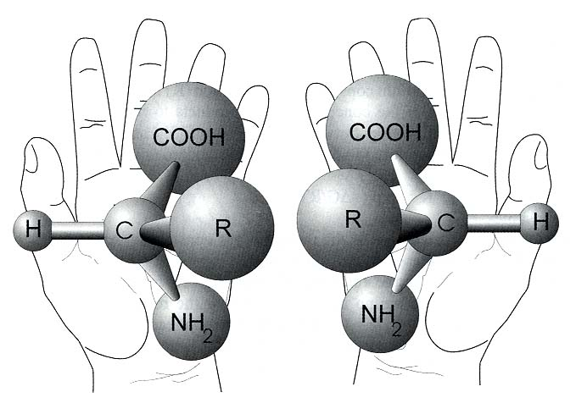
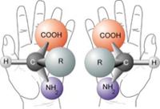
Racemization 消旋
jan.ucc.nau.edu
Only L-amino acids
are used in proteins.
Notes:
Amino acids exist as only the Levorotatory (L) form in proteins.
Ribose only exists as the Dextrorotatory form in DNA and RNA.
In Ben Stein’s movie Expelled, Ben asks Michael Ruse how life began – to which he responded “on the backs of crystals”. This answer was a reference to a proposed mechanism for how amino acids could form with only L forms.

Slide 36
對米勒試驗的質疑
很多人使用斯坦利·米勒在1953年進行的實驗作為證據，證明生命在最初可能是自然發生的。可是，他的解釋能否成立，卻基於一個假設，就是地球的原始大氣是「還原性」，而非「氧化性」的。那就是說，當時的大氣僅含有極微量的自由（未經化學結合的）氧氣。這一點是一個十分重要的前提。

Slide 37
對米勒試驗的質疑
《生命起源的奧秘：再評目前各家理論》一書指出，如果當時有許多自由氧存在，「胺基酸就不可能形成；即使有些胺基酸碰巧產生了，它們也會迅速分解」。
米勒完成了他的實驗後，過了兩年，發表了一篇經典的論文，其中指出：「當然，這些見解只是推測，因為我們根本不知道地球當初形成時，大氣是否處於還原狀態。……目前還沒有直接的證據證實這一點。」

Slide 38
對米勒試驗的質疑
大約二十五年後，科學作家羅伯特·考恩說：「科學家不得不重新評估他們的若干假設。……他們沒有找著什麼證據去支持他們的主張，證明最初的大氣是充滿氫而高度還原的，有些證據更顯示情形剛剛相反。」
1991年，約翰·霍根在《科學美國人》（Scientific American）發表的文章指出：「根據科學實驗及用電腦重現的大氣……顯示，當時來自太陽的紫外線輻射（現在受大氣中的臭氧層所阻隔）可以破壞大氣里含氫的分子。……這樣的大氣［二氧化碳和氮］對於形成胺基酸和別的生命要素十分不利。」

Slide 39
Where Then?
“Since Miller’s beguiling picture of a pond full of dissolved amino acids under a reducing atmosphere has been discredited, a new beguiling picture has come to take its place. The new picture has life originating in a hot, deep, dark little hole on the ocean floor.”
Freeman Dyson, Origins of Life, 1999, pp. 25-26.
Notes:
Dyson is a Professor at the Institute for Advanced Study in Princeton and a member of NAS.

Slide 40
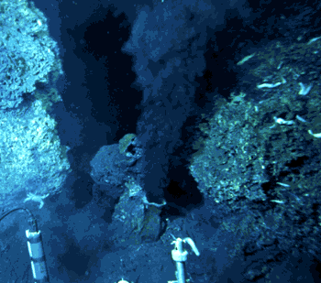
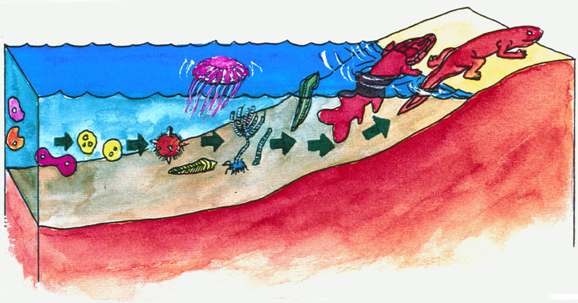
Did Life Start in the Ocean?
Notes:
Image source: CreationWiki (public domain)
http://creationwiki.org/Black_smoker

Slide 41
Polymer Puzzle
“The second limitation to Miller’s experiments was that he obtained no polymers of amino acids – no peptides or proteins.”
Johnjoe McFadden, Quantum Evolution, 2000, p. 87.
Notes:
Johnjoe McFadden is a Professor of Molecular Biology and Quantum Physics.

Slide 42
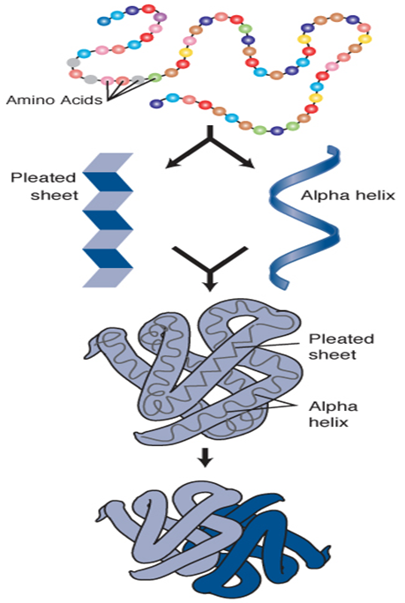
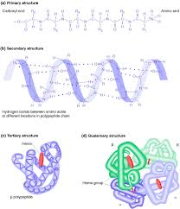
Protein
Structure
Proteins are chains of amino acids (peptides) that must first be folded and combined with other peptides before they are functional.
pharmapolis.ne
pharmapolis.net
Notes:
Proteins are chains of amino acids (peptides) that must first be folded and combined with other peptides before they are functional.
Image source: CreationWiki (public domain)
http://creationwiki.org/Protein

Slide 43
機率
What is the chances of getting heads every time a penny is flipped (1 in 2^{n})
2 heads in a row?
1 in 4
3 heads in a row?
1 in 8
8 heads in a row?
1 in 256
100 heads in a row?
2¹⁰⁰ or 10³⁰
Notes:
10³⁰ = (one in a thousand billion billion billion). To achieve 100 heads in a row you will need to flip the penny over 31 million times a sec for over 1-quadrillion years

Slide 44
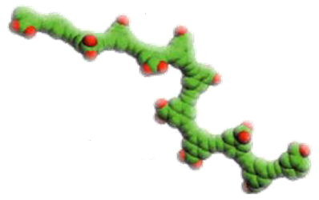
機率
What is the chances of getting a small protein 150 amino acids long?
Peptide bond
1 in 2^{150 or} 10⁴⁵
L-amino acid
1 in 2^{150 or} 10⁴⁵
Correct amino acids
1 in 20^{150 or} 10¹⁹⁵
Tolerance adjustment
1 in 10⁷⁴
150 amino acids
10⁴⁵ x 10⁴⁵ x 10⁷⁴
Notes:
Peptide Bond - amino acids when allowed to react will form peptide and nonpeptide bonds in about equal proportions, making the probability of getting one versus the other 1 out of 2.
L-amino acid – two forms of amino acids are possible (L & D), making the probability of getting one over the other also 1 out of 2.
Correct amino acid – there are twenty amino acids, making the probability of getting the correct one 1 out of 20.
Tolerance adjustment – some amino acids can be substituted for others and the protein still be functional. By doing mutagenesis studies on genes to determine tolerance limits for amino acid substitutions, it was estimated that the probability of obtaining a 150 AA protein was 1 in 10⁷⁴, a number exceedingly higher than the number of atoms in our galaxy = 10⁶⁵.
Multiplying the 3 values together will give you the probability of a 150 amino acid protein forming by chance.
Info source: Signature in the Cell p206-212
http://store.nwcreation.net/siince.html
Walter Bradeley (Ph.D. Materials science), Charles Thaxton (Ph.D. Chemistry) gave the number 10¹⁹¹ as the probability for a single protein forming by chance (cited in “A Case Against Self-organization” by Dean Overman p. 62.
David Coppedge (Ph.D., research analyst) 10¹²³ for just 410 left-handed amino acids. It does not take into account the right 20 in the right order. Protein with 400 correct amino acids = 10²⁴⁰

Slide 45
機率
Answer:
1 out of 10¹⁶⁴
Notes:
The probability of finding a functional protein by chance alone is 10¹⁶⁴ that’s a trillion, trillion, trillion, trillion, trillion, trillion, trillion times smaller than the odds of finding a single specific particle among all the particles in the universe.
ALSO NOTE THAT - RNA polymerase (the enzyme that transcribes DNA into RNA) has 3000 amino acids
Info source: Signature in the Cell p212.
http://store.nwcreation.net/siince.html
Walter Bradeley (Ph.D. Materials science), Charles Thaxton (Ph.D. Chemistry) gave the number 10¹⁹¹ as the probability for a single protein forming by chance (cited in “A Case Against Self-organization” by Dean Overman p. 62.
David Coppedge (Ph.D., research analyst) 10¹²³ for just 410 left-handed amino acids. It does not take into account the right 20 in the right order. Protein with 400 correct amino acids = 10²⁴⁰

Slide 46
Protein Probability
“If a particular amino acid sequence was selected by chance, how rare an event would this be?... The great majority of sequences can never have been synthesized at all, at any time.”
Francis Crick, Life Itself: Its Origin and Nature, 1981, pp. 51-52.
Notes:
Francis Crick is one of the co-discoverers of the structure of DNA (the helix).

Slide 47
Probabilistic Resources?
How many opportunities were there for events to occur?
How many particles are there to interact?
How much time was there for events to occur?
How many events could have taken place per second?
10⁸⁰
10¹⁶
10⁴³
Notes:
Bill Demski calculated the probabilistic resource of the universe to determine if there were sufficient resources for a protein or DNA to form, you must determine 3 things .
How many particle are there to interact? = the number of elementary particles in the universe.
How many events could have taken place per second? 10⁻⁴³ is a unit of time known as the Plank time. It’s the length of time required for light to traverse the Plank length of 10⁻⁴³ centimeters (an indivisible quanta of space). According to physicists a transition from one state to another can not happen any faster than the time required for light to travel this distance (Plant time).
How many seconds were there for events occur? Based on a 13.7 billion year universe
Info source: Signature in the Cell p216-217
http://store.nwcreation.net/siince.html
Image source: CreationWiki (pubic domain)
http://creationwiki.org/Universe

Slide 48
Probabilistic Resources?
How many opportunities were there for events to occur?
10¹³⁹
Probability of a protein forming with 150 amino acids
10¹⁶⁴
Notes:
When the 3 numbers are multiplied together, we have an estimate of the probabilistic resource of the universe.
Info source: Signature in the Cell p216-217
http://store.nwcreation.net/siince.html
Image source: CreationWiki (pubic domain)
http://creationwiki.org/Universe

Slide 49
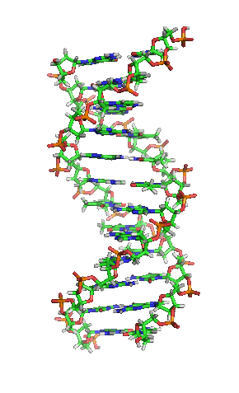
DNA Enigma
Notes:
The double helix structure of DNA was discovered by James Watson and Francis Crick in 1953. They and Maurice Wilkins were awarded the Nobel Prize in 1962.
Image source: CreationWiki (public domain)
http://creationwiki.org/Cells
Animated DNA image source:
http://commons.wikimedia.org/wiki/File:DNA_orbit_animated.gif
This file is licensed under the Creative Commons Attribution ShareAlike 3.0 License. In short: you are free to share and make derivative works of the file under the conditions that you appropriately attribute it, and that you distribute it only under a license identical to this one. Official license

Slide 50
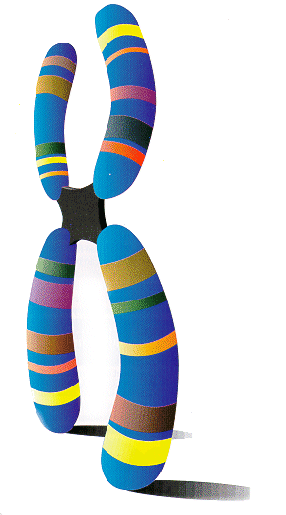

DNA Enigma
graphicshunt.com
Gene 1
Gene 2
DNA
Chromosome
Notes:
Chromosomes are one long chains of DNA that contains many genes (~1000 genes per chromosome in humans). Human chromosomes range in size from 1.7-8.5 cm in length.
It is the microscopic, rod-shaped, threadlike part of the cell that carries hereditary information in the form of genes. Every cell has chromosomes and all individuals in the same species have the same number of chromosomes. Within an individual, every cell has the same number of chromosomes and generally come in pairs (except in sex cells). Humans, for instance, have 23 pairs, or 46 chromosomes.
A gene can be defined as a region of DNA that controls a hereditary characteristic. It usually corresponds to a sequence used in the production of a specific protein or RNA.Genes can be as short as 1000 base pairs or as long as several hundred thousand base pairs. It can even be carried by more than one chromosome.
The estimate for the number of genes in humans has decreased as our knowledge has increased. As of 2001, humans are thought to have between 30,000 and 40,000 genes.

Slide 51
DNA Enigma
Genes - coded instructions that tell cells how to make protein.
Gene 1
Gene 2
DNA
Notes:
A gene can be defined as a region of DNA that controls a hereditary characteristic. It usually corresponds to a sequence used in the production of a specific protein or RNA. Genes can be as short as 1000 base pairs or as long as several hundred thousand base pairs. It can even be carried by more than one chromosome. The estimate for the number of genes in humans has decreased as our knowledge has increased. As of 2001, humans are thought to have between 30,000 and 40,000 genes.

Slide 52
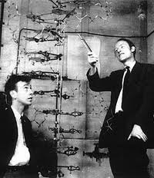

Slide 53
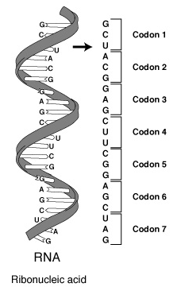
DNA Enigma
Codon
Amino Acid
UGC = Cystein
CUG = Leucine
AGU = Serine
GCA = Alanine
Notes:
300 billions nucleotides are found in each of our cells, with the simplest living thing having close to 600,000.
DNA is coded instructions telling cells how to make protein.
3 nucleotides comprise a coding unit called a codon, which specifies the amino acid used in assembly.

Slide 54
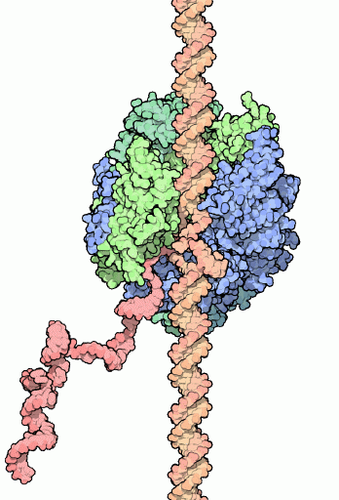
DNA Enigma
graphicshunt.com
Need Protein
Need DNA
DNA
Protein
Notes:
You need DNA to have protein – and protein to have DNA. The chicken or the egg conundrum abounds in molecular biology.
Not only is DNA required to make the proteins that are necessary to perform the many life processes within cells, and to make the basic building blocks of cellular life (sugars, lipids, nucleotides, amino acids), but proteins are required to replicate DNA and produce other protein – enzymes such as RNA polymerase (shown here), helicase, topoisomerases, DNA ligases.
DNA is required to make DNA, Protein is required to make protein, and ATP is required to make ATP.
Origin of life theories include DNA first, Protein first, and more recently RNA first models.
Info source: Signature in the Cell, pp. 131-132.
http://store.nwcreation.net/siince.html
Image source: CreationWiki (public domain)
http://creationwiki.org/DNA_transcription

Slide 55
DNA Enigma
To build RNA polymerase
Notes:
Remember that the probability of obtaining a functional protein (150 amino acids long) by chance alone is 20¹⁵⁰ or 10¹⁶⁴ and note that RNA polymerase (the enzyme that transcribes DNA into RNA) has 3000 amino acids.
Image source: CreationWiki (public domain)
http://creationwiki.org/DNA_transcription

Slide 56
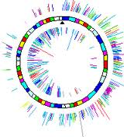
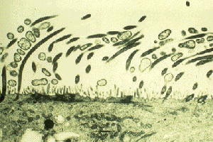
Simplest Cell
  Mycoplasma genitalium
  482 genes (256 minimum)
  580,000 nucleotides
  Obligate parasite
Notes:
Mycoplasma genitalium is a parasitic bacteria that inhabits the human urinary tract. By deleting genes from the Mycloplasm one at a time – researchers were able to reduce this required number of genes to 256. But it should be noted that this organism is a parasite and able to live with fewer genes only by inhabiting a fully functional cell.
Info Source:
Signature in the Cell by Stephen Meyer p.201
http://store.nwcreation.net/siince.html
Image Source: genome map (public domain)
http://en.wikipedia.org/wiki/File:Mycoplasma_genitalium.gif
Image Source: bacteria (public domain)
http://www.ncbi.nlm.nih.gov/genomeprj/97

Slide 57
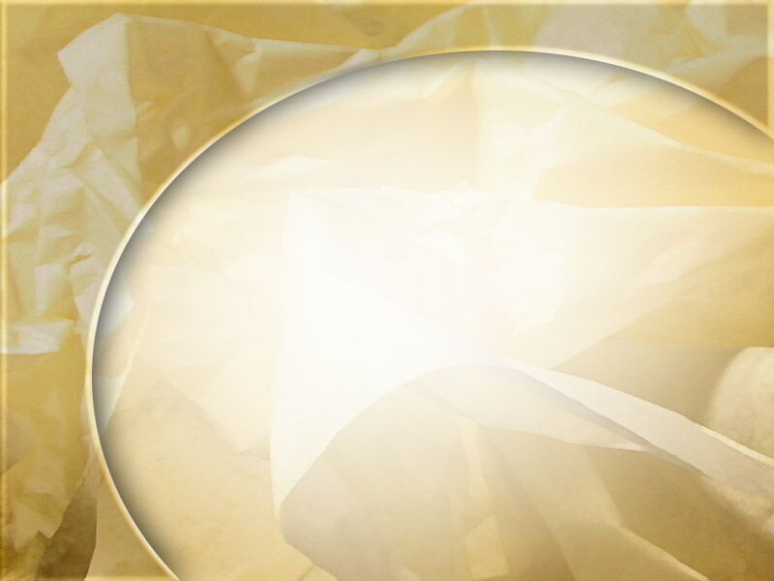
Probability of the first cell?
250 proteins X 10¹⁶⁴
Probability 1 out of 10^{41,000}
Notes:
A cell like Mycoplasma genitalium requires at least 250 genes to live – assuming then a minimum of 250 proteins that are 150 amino acids in length (each with a probability of 10¹⁶⁴) gives a probability of the first cell to be at least 1 out of 10^{41,000}
This number dwarfs the probabilistic resources in the universe = 10¹³⁹
Info source: Signature in the Cell p213.
http://store.nwcreation.net/siince.html
Sir Fred Hoyle (Ph.D. Astronomy) Chandra Wickramasinghe (professor of applied math and astronomy) 10^{40,000}
Atoms in universe:10⁸⁰
Dr. Emile Borel, one of the world's great experts on mathematical probability, formulated a basic law of probability. It states that the occurrence of any event where the chances are beyond one in 10⁵⁰ - a much smaller figure than what we have been dealing with - is an event which we can state with certainty will never happen - no matter how much time is allotted, no matter how many conceivable opportunities could exist for the event to take place.

Slide 58
Probability of the first cell?
Robert Gange, Ph.D. Origins and Destiny, 1986, p. 77.
“The likelihood of life having occurred through a chemical accident is, for all intents and purposes, zero.”
Notes:
Robert Gange is a research scientist with extensive research in the field of cryophysics and information systems.), Origins and Destiny, 1986, p. 77.

Slide 59
Johnjoe McFadden, Quantum Evolution, 2000, p. 85.
Probability of the first cell?
“The simplest living cell could not have arisen by chance.”
Notes:
Johnjoe McFadden is an Evolutionist & Professor of Molecular Biology and Quantum Physics, Quantum Evolution, 2000, p. 85.
“The simplest living cell could not have arisen by chance. Just like the eye, the proto-cell must have evolved from simpler ancestral cells, presumably by a process of natural selection. But this is where the first big problem with the origin of life arises. What were those simpler entities?”

Slide 60
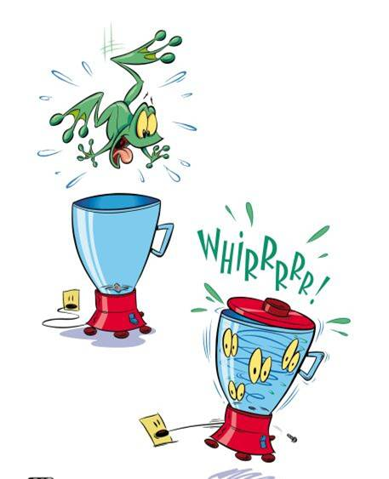
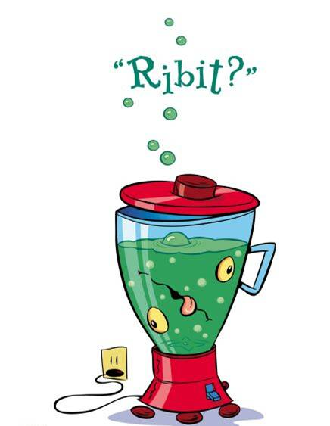


Slide 61
For the time will come when men will not put up with sound doctrine. Instead, to suit their own desires, they will gather around them a great number of teachers to say what their itching ears want to hear. They will turn their ears away from the truth and turn aside to myths.
³ 因為時候要到、人必厭煩純正的道理．耳朵發癢、就隨從自己的情慾、增添好些師傅．
⁴ 並且掩耳不聽真道、偏向荒渺的言語。
2 Timothy 4:3-4
Notes:
2 Timothy 4:3-4

Slide 62
For by him all things were created: things in heaven and on earth, visible and invisible, whether thrones or powers or rulers or authorities; all things were created by him and for him.
因為萬有都是靠他造的、無論是天上的、地上的、能看見的、不能看見的、或是有位的、主治的、執政的、掌權的、一概都是藉著他造的、又是為他造的．
Colossians 1:16

Slide 63
生物化學的證據﹕（生物化學的系統並不容許有逐步性的進化）
生物化學的系統是非常複雜的。如果整個系統缺少了一小部份的話﹐整個系統就不能運作。這被稱為「不能簡化的複雜性」。舉例﹕血液凝固的過程極為複雜﹐包括了超過12個步驟。一個人只要少了其中一種血凝固的因子就會患上血漏病﹐隨時會有血流不止的危險。如果血液凝固要經過長時間、一步一步的進化得來﹐生物早就會因為流血而死了。
其他的生物化學系統﹐例如人的視力﹐亦是「不能簡化的複雜」。它們不可能是逐步進化得來的﹐因為要整個器官能產生功效﹐必需要器官的每一部份都能運作。

Slide 64
化石的證據﹕（所有遺漏的「過渡生物」仍然是遺漏）
根據進化論﹐一種生物要進化至另外一種生物需要經過極多的小轉變而來﹐這些小轉變則經由基因突變而產生。達爾文認為世界上應該有數百萬種處於過渡形態的生物﹐因每一類生物進化至另一類應有數千種過渡形態。他也承認事實上在他那個時代所能發掘到的過渡生物的數目為零。他被這找不到過渡生物的事實困擾﹐只能盼望在將來的發掘中能夠找到。
然而經過了差不多150年後﹐雖經無數人試圖找出起碼一種的過渡生物化石﹐但是卻完全沒有成功。事實上﹐發掘到的化石證明的剛好相反﹕過渡生物比以前估計應該多上千千萬萬種﹐然而所有這些理論上存在的生物都沒有被發現。曾經有些化石被認為可能是過渡生物﹐但它們已經全部被證實是錯誤的。在今日﹐所有遺漏的過渡生物仍然是遺漏。

Slide 65
生物分類學的證據﹕（並沒有生物其形態為兩類的生物之間）
如果有進化發生﹐我們應該不會見到生物有明顯獨特的分類﹐而是應該見到正生存著處於類別之間的生物。進化論學者承認缺少「中間生物」的這個事實﹐但認為那些生物已經全部絕種了。可是事實上連一個這類生物的化石也沒有被發現。

Slide 66
分子生物學的證據﹕（不同種類的生物之間的分子結構上有極大的差距）
進化論者相信魚類進化為兩棲類動物﹐再進化為爬蟲類、脊椎類、哺乳類、靈長類、最後是人類。如果進化根據這個次序﹐魚類應該比人類更接近兩棲類動物。然而﹐經過對各種動物進行分子結構的研究後﹐顯示魚類和兩棲類的距離﹐就和魚類和人類的距離一樣大。

Slide 67
「物競天擇﹐適者生存」的理論不成立﹕（用適者生存來解釋進化論已不再被接納）
根據自然淘汰（適者生存）的論點﹐一種生物得到一種新的特徵是因為這特徵能夠加強這生物的生存機會。然而﹐許多的自然現象令這個理論不可置信﹕
o 能夠飛是明顯有利的。既然這是有益的﹐為何並非所有的高等生物都擁有能夠飛翔的能力﹖同樣的論點也可用在昆蟲的複眼上。
o 很多生物的存在和適應、跟自然淘汰的論點相違背。例如蛇生活在地面上﹐卻沒有吃草的蛇﹔雀鳥生活在樹上﹐卻沒有吃樹葉的鳥。
由於有這類事實﹐現代科學的觀點（包括進化論學者）認為掙扎求存的過程和進化論並沒有連帶關係。進化論者已經從自然淘汰的論點中撤退。

Slide 68
不足夠的時間﹕
（地球的歷史實在太短﹐進化需要的時間多過45億年）

Slide 69
二、化石無法證實進化論
1、造化史的四分之三是空白而沒有內容的，化石證據顯示生物像變魔術一般地出現。
2、從普遍存在化石缺環的現象，就足以說明並無中間型化石，可以證明已出土的化石生物，是由一連貫的進化產生的。
3、許多化石出現的次序彼此顛倒， 例：高等化石出現在較古老的地層。
4、生物化石的構造和特徵紛歧，難以尋索出演化上的共同關係。
5、活化石的存在，也常讓倡導「物競天擇，適者生存？」理論的進化論者，難以自圓其說。

Slide 70

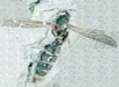

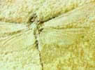

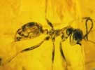
活 化 石
http://answertoantitze.vampire-legend.net/t322-topic
百萬年前的蜜蜂的化石與當今的蜜蜂毫無差異。
1,35億年前的蜻蜓的化石，與當今的蜻蜓相同。
比較一億年前的螞蟻化石與今天的活螞蟻，清楚地顯示：螞蟻絕沒有進化的歷史。

Slide 71
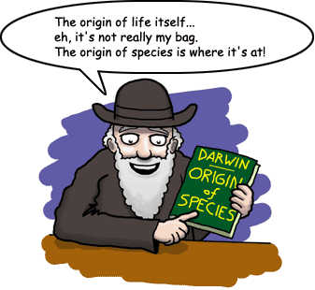
morriscourse.com

Slide 72
科學證據! 真的嗎?
Scientific Evidence! Really?

Slide 73
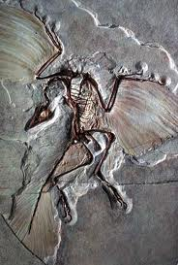
始祖鳥
https://encrypted-tbn1.gstatic.com/images?q=tbn:ANd9GcTMUgF_rnOkBQr74f7TPAD5n-na2eQK9UCfiJCYHmdv5fLVkurt2w
Notes:
進化論者試圖斷定，始祖鳥是一種過渡形式的鳥，進而宣稱鳥是從恐龍進化來的。但是，世界上最著名的鳥類學家之一、北卡羅來納大學的艾倫·費都加，儘管他自己是個進化論者，可反對鳥與恐龍有親緣關係的理論。費都加就此指出： “我研究鳥的頭顱已經25年了，然而，我沒有看出它們之間有任何相象之處，我只是看不見它們……。在我看來，獸腳亞目食肉恐龍是鳥的起源的理論，這將是二十世紀古生物學中最大的尷尬。”56
Prof. Alan Feduccia
拉裏·馬丁，堪薩斯大學的古代鳥類專家，也反對鳥類與恐龍具有相同血統的理論。在討論這一相互矛盾的進化論時，馬丁說：
“告訴你們實情吧，如果我必須支援具有恐龍特徵的鳥類起源於恐龍的話，每次我都陷入尷尬中，並且不得不站起來為之辯解。”57
總之，只依賴於始祖鳥而豎立的“鳥的進化”的假想，僅僅是懷有偏見者和進化論者想象力的產物。

Slide 74
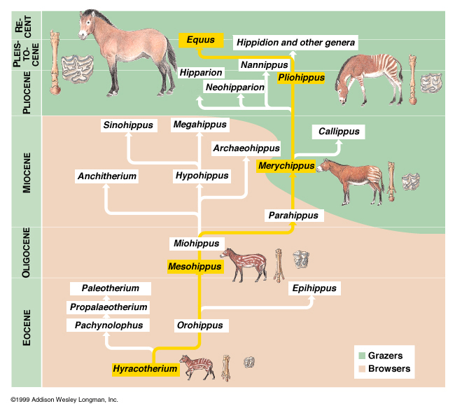
馬的進化?
brettparris.com
Orohippus 15
Pliohippus 19
Equus 18
brettparris.com
Notes:
馬的進化的神話
直到最近，按照一個虛構的順序推測，把馬的進化作為進化論學說主要的化石證據。但是，今天很多進化論者自己坦白地承認，馬的進化的假想已經破產。1980年，在芝加哥的菲爾德自然博物館召開了為期四天的專題座談會，有150位進化論者參加了這次會議。會議就沒有化石記錄、也沒有逐漸進化記載的假想作了討論--對馬的進化的假想。進化論者博伊斯·仁斯博格（Rensberger）在會上說："馬的進化的例子很流行：是由差不多5000萬年以前就有的四趾狐狸型生物，按照漸進順序，進化成今天比狐狸大得多的一趾蹄的馬；這早已是所周知的錯誤。與所謂逐漸變化相反，每個過渡形式的化石的出現，是截然不同、始終不變的，隨後絕種以及過渡的形式都是未知的。1
仁斯博格發表針對馬的進化假想的誠實觀點的同時，事實上也提出了該學說在地質記錄中所面臨的最大困境"過渡形式"。著名古生物學家、英國自然史博物館主任科林·帕特森，在博物館的底層仍然給公看的關於"馬的進化"展覽會上說："在究竟何謂那段生命（馬的進化史--譯注）的歷史方面，有太多的故事，其中一些比其他更具想象力。最著名的例子，就是仍在樓下展覽的、或許在50年以前就已經準備好的關於馬進化的展品。馬的進化已經作為真理不斷寫入教科書中。現在，我認為這種做法是不愉快的，尤其是提出這些故事的人們，他們自己也意識到這些材料中有投機的成分。"2 那么，"馬的進化"的假想的基礎是什麼？進化論者用豐富的想象力，通過對生活在印度、北美洲、南美洲及歐洲不同時期不同生物化石有序地排列，闡釋了這一騙人的假想圖表；由不同研究人員提供的、馬的進化的圖表達20多張。對這些彼此不同的譜系圖，進化論者之間並沒有達成共識。其中唯一的共同點是，5500萬年前生活在始新世時期的、類似於狗的一種被稱為"始祖馬"的動物，是馬的最初祖先。但是，這種虛構的從始祖馬到馬的進化聯繫，是完全矛盾的。這種馬與至今生活在非洲、甚至與馬沒有一點聯繫與相似之處的"蹄兔"是同類動物。3
有關馬的進化的毫無根據的斷言，從不斷發現的地質記錄中破滅了；始祖馬與現代馬種（西方馬種和內華達州馬種）的化石顯示，現代馬和他們所稱的馬的祖先，是在同一時期生存的物種。這清楚地說明馬的進化在任何時候都不存在。4
進化論者、作家戈登·R·泰勒，在《大進化秘密》一書中，對達爾文缺乏根據的觀點解釋道："也許，達爾文學說最大的弱點，是古生物學家沒能發現令人信服、演示生物體主要進化性變化的發育與順序的證據……。馬是經常用來解決這一問題的唯一例子。但是，實際上始祖馬與馬類的聯繫是不可思義的；他們聲稱馬的體型連續增加著，可一些變化顯示，它們卻比始祖馬變小了，而不是變大了。把不同來源的標本放到一起，就構成看似具有說服力的進化順序，但實際上並不存在按時、按序排列的證據。5
這些雄辯的事實證明，達爾文學說作為牢固的證據，來描繪馬進化的圖表，不過是荒謬和難以置信的故事而已。
1. 博伊斯·仁斯博格,《休斯頓編年史》，第四章，第15頁，1980年11月5日
2. 科林·帕特森，“哈珀”，1984年2月，第60頁
3. 弗朗西斯·赫廷，《長頸鹿的脖子：達爾文誤入歧途》,紐約Tick nor and Fields,1982年,第30-31頁
4. 弗朗西斯·赫廷,《長頸鹿的脖子：達爾文誤入歧途》,第30-31頁
5. 戈登·拉特雷·泰勒,《大進化秘密》,倫敦,天體書第230頁,1984年]
我們教會的幾個孩子最近問我一個關於進化論和聖經的問題﹕ “如果生命已經進化了數百萬年，聖經怎麼會是真實的呢﹖進化是事實。就看看馬發生的變化吧。” “馬發生了什麼變化﹖”我問道。
“嗯，經過六千萬年的時間，馬從只有 61 厘米高、小狐狸似的動物，長到現在高度超過兩米。而且它還失去了所有腳趾。”
“真的嗎﹖”我說。“那可是驚人的變化。能讓我看看你的教科書嗎﹖”
This article is also available in English: What happened to the horse? English answer…
教科書終於拿來了，它是這樣說的﹕ 馬並非一開始就象今天的樣子。下面一組圖畫顯示了馬的變化。馬的發展大約經過了六千萬年的時間。叫人吃驚的是，最早的馬只有大約61厘米（2英尺）高。
該頁的下面有這樣一種迷人的邏輯﹕ 老虎只吃肉。老虎的牙大都是尖的。最早的馬有尖的牙齒。這告訴我們它是吃什麼的呢﹖
我年輕的朋友已經填上了答案﹕ “肉。它曾是食肉動物。” 我吃驚不小。如果在六千萬年前舉辦墨爾本杯（賽馬），那可能就是聞特沃斯（Wentworth）公園的賽狗了。這能是真的嗎﹖為了我年輕的朋友，我要搞個水落石出。於是我直奔圖書館。在架子上翻來翻去，找到以下資料。
1841年，在倫敦附近的泥土中發現了最早的所謂“馬”的化石。發掘它的科學家理查德‧歐文（Richard Owen）找到了一具完整的頭骨，看似狐狸，幾個後牙與有蹄動物的後牙相似。他稱之為Hyracotherium（現中譯為“始行馬”。歐文當時認為它像現代岩狸hyrax，故命名Hyracotherium）。他沒有發現它與現代馬有什麼聯繫。
1874年，另一位科學家考瓦列夫斯基（Kovalevsky）, 試圖在這個他認為有七千萬年的狐狸似的小動物與現代馬之間建立聯繫。
1879年，一位美國化石專家馬什（O. C. Marsh）與著名的進化論者赫胥黎 （Thomas Huxley）協力，由赫胥黎在紐約作了一次公眾講座。馬什製作了一組概要圖畫，試圖解釋在（進化的）各個階段，馬的前後蹄，腿和牙的所謂發展。他將此進化圖表發表在1879 年的《美國科學學報》，後來這些圖表鑽進來許多其它刊物和教科書。這些圖表仍未改變。它按等級順序優美地展示了馬“進化”，沒有任何突然變化。這就是我們在學校教科書上看到的。
現在的問題是﹕“赫胥黎和馬什提出的圖表正確嗎﹖” 簡單的答案是“不正確”。這只是根據進化論的假設對化石所作的一個聰明編排，就連主要進化論學者喬治‧蓋洛德‧辛普森（George Gaylord Simpson）也敬而遠之。他說這是騙人的。
馬為進化論出了什麼難題呢﹖
如果這是真的，你會期望在最底下的岩層中找到最早的馬的化石。但你沒有在那裡找到。事實上，想象中“最早”的馬的骨骼是在地表層或臨近地表層發現的。有時就在現代馬的化石的旁邊找到它們。馬什評論過當時活著的有多個腳趾的馬，說在美國西南部有這樣的例子，“前後蹄都額外有兩個相當發達的腳趾，大小幾乎一樣，就像已滅絕的始祖馬一樣”。在《國家地理》雜誌上（National Geographic，1981年1月，74頁），有一張所謂早期馬鮮新馬（Pliohippus）的蹄子照片和一張現代馬的蹄子照片，它們是在內布拉斯加的同一個火山地點發現的。作者寫道﹕“曾有許許多多的有蹄動物生活在美洲平原上”。難道這不說明它們是兩種不同的動物，卻是同一種動物的不同進化階段嗎﹖
馬的進化過程無法在世界上任何一個地方看到。它是根據進化的假設從各個大陸蒐集來零散的化石，再用以支持該假設。這是循環論證，不能稱其為客觀科學。
馬進化的理論有嚴重的遺傳學方面的問題。在這想象的進化過程中，如何解釋肋骨和腰椎數目的變化呢﹖例如，“中間”形態的馬，肋骨數目從15變到19，最後停在18。腰椎數目也從6上昇到8，然後又會到6。
最後，當進化論者假定，經過數百萬年馬的個頭逐漸增大時，他們忘了現代馬在個頭上有極大的差異。今天最大的馬是克萊茨德爾（Clydesdale）﹔最小的是費拉拜勒（Fallabella），只有43厘米（17英寸）高。它們是同一種類，而不是一種從另一種進化而來。
我的調查使我困惑了。馬進化的整個圖解明顯是錯誤的，為什麼科學教科書仍然用它作為進化論的主要例子﹖為什麼他們繼續教授我們的孩子不符合科學的東西﹖美國自然歷史博物館館長奈爾斯‧埃爾德雷德（Niles Eldredge）博士，曾說過﹕ “我承認很多這類事情（虛構的故事）就象事實的一樣編入了教科書。例如，仍在（自然歷史館）樓下展出的最著名的例子，馬進化展覽，是大約50年前佈置的。一本又一本的教科書將它說成完全的真理。我認為這是可悲的…”。 我同意。
馬的化石序列常被引為進化論的證據。馬在想象的進化過程中，前後蹄的腳趾數目減少了，而身體從象狗一樣大小增大到現代大馬的個頭。然而，三趾馬和單趾馬被一起發現，表明它們曾在同期生活。此外，現在仍然生存著的矮種馬費拉拜勒（Fallabella）只有43厘米（17英寸）高。
參考文獻
O. C. Marsh, “Recent Polydactyle Horses”, American Journal of Science 43, 1892, pp. 339-354 - as quoted in Creation Research Society Quarterly correspondence, Vol. 30, December 1993, p. 125. O. C. 馬什，近期多趾馬，《美國科學學報》，43卷，1892年，339-354頁─引自《創造研究學會季刊》，通訊，30卷，1993年12月，125頁
Niles Eldredge, as quoted in: Luther D. Sunderland, Darwin's Enigma: Fossils and Other Problems, fourth edition (revised and expanded), Master Book Publishers, Santee (California),1988, p. 78. 奈爾斯‧埃爾德雷德，引自路得‧桑德蘭所著《達爾文難解之謎﹕化石及其它問題》，第四版，1988年，78頁
【如果這些信息對您有幫助，請認真考慮奉獻以幫助我們支付將此建造信仰的服事帶給您和您家人的費用。此奉獻是可以免稅的。】
作者﹕彼得‧海司提，創造雜誌，1995年9-11月，17卷4期14-16頁
創世紀問答提供
版權© 1997，創造論科學基金會，版權所有─附頁“使用和版權”標明的賦予基督教問答網絡的用戶將本頁用于家庭，個人見證，教會和學校的大量權力除外。

Slide 75
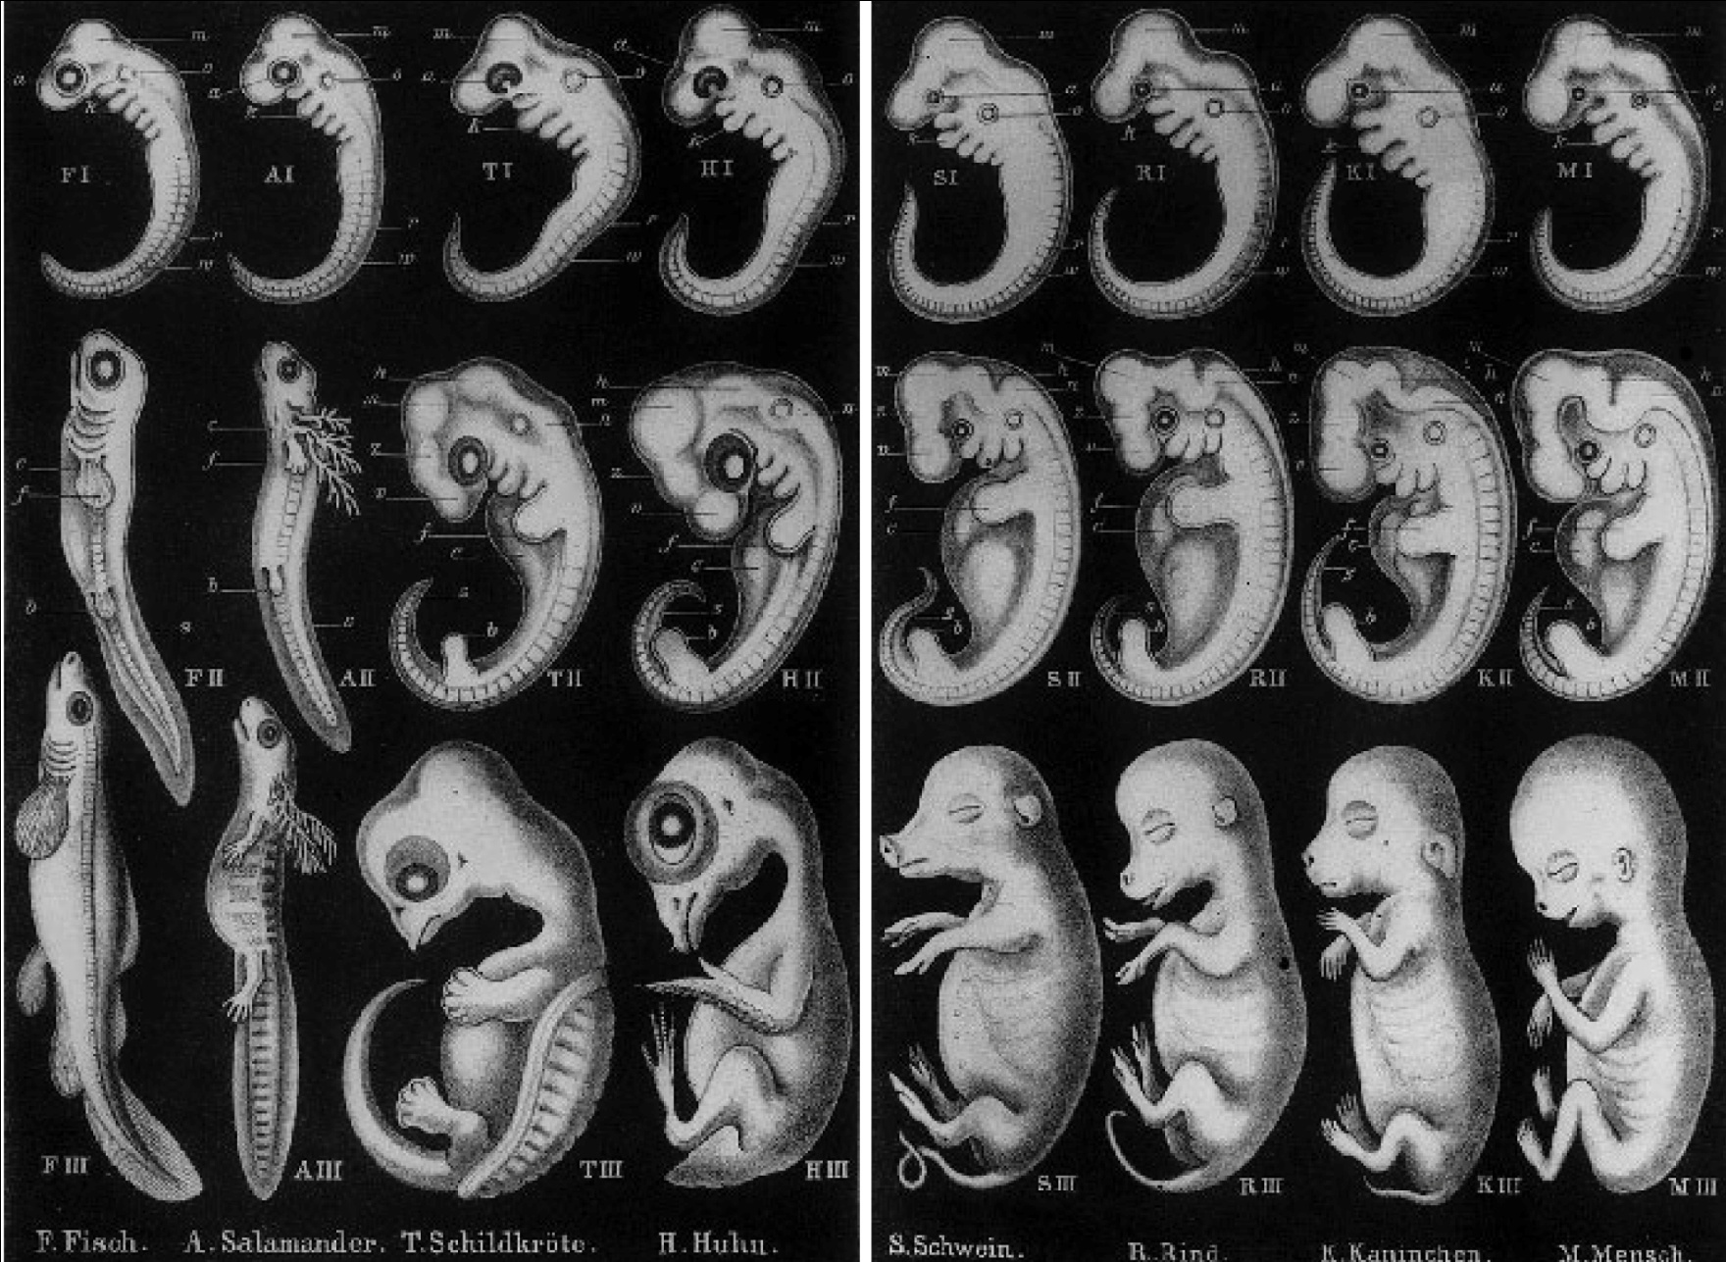
Fish Salamander Turtle Chicken Pig Cow Rabbit Human
(by Ernst Haeckel, Bodleian Library, University of Oxford, Plates 4 & 5 from 18917d.25)
Notes:
这是一幅高中生物学教科书中讲述进化论时所用的图形，它的作者是19世纪德国Jena大学的生物学教授Ernst Haeckel，收藏在London大学Bodleian图书馆。该图说明，虽然这些动物成年后各不相同，但是由于它们是由共同的祖先进化而来，所以在胚胎发育过程中均有一个形态相似的时期（即上排）。

Slide 76
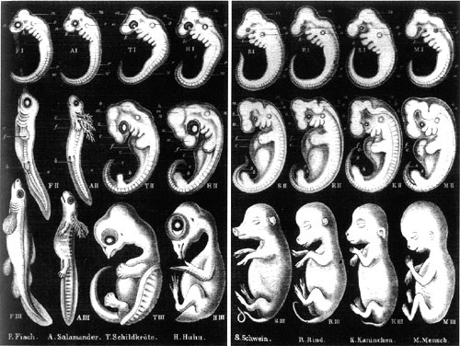
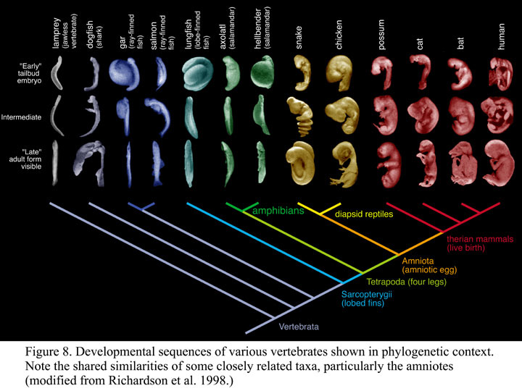
胚胎
Notes:
海克尔有意选择形态上比较相近的动物胚胎，水生的蝾螈代表两栖类，而不用青蛙，因为蝾螈本身更象鱼。
又如早期鸡的胚胎其眼球是没有色素的，但海克尔把它涂黑，使得鸡的胚胎和其它动物胚胎更相似。
海克尔特别对人的胚胎图作了艺术加工，去掉了人胚胎的内脏部分和腿，就成了一个有尾巴，类似鱼的胚胎。
他（海克尔）先就着自然界的观察画了个草图，然后又根据他心中所看见的画了一张理想的（胚胎）图。”

Slide 77
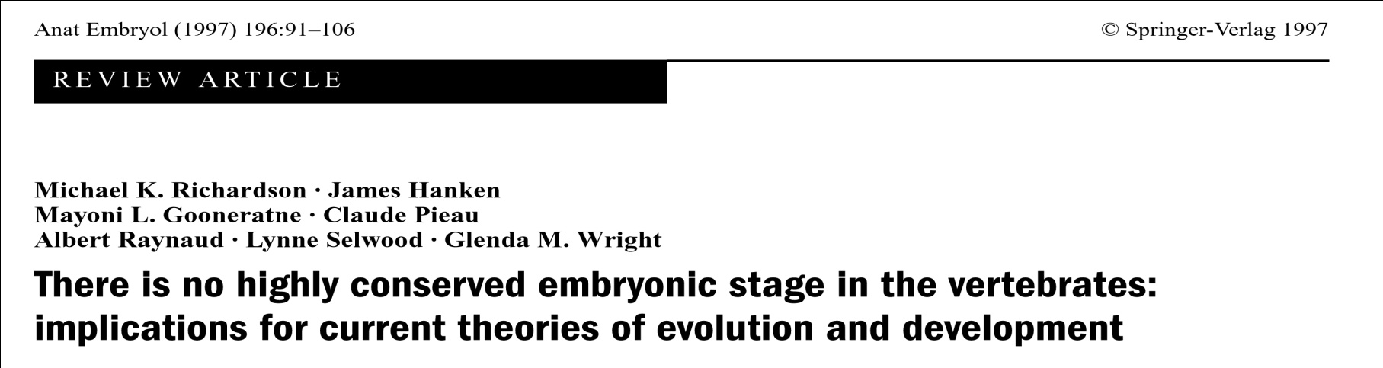
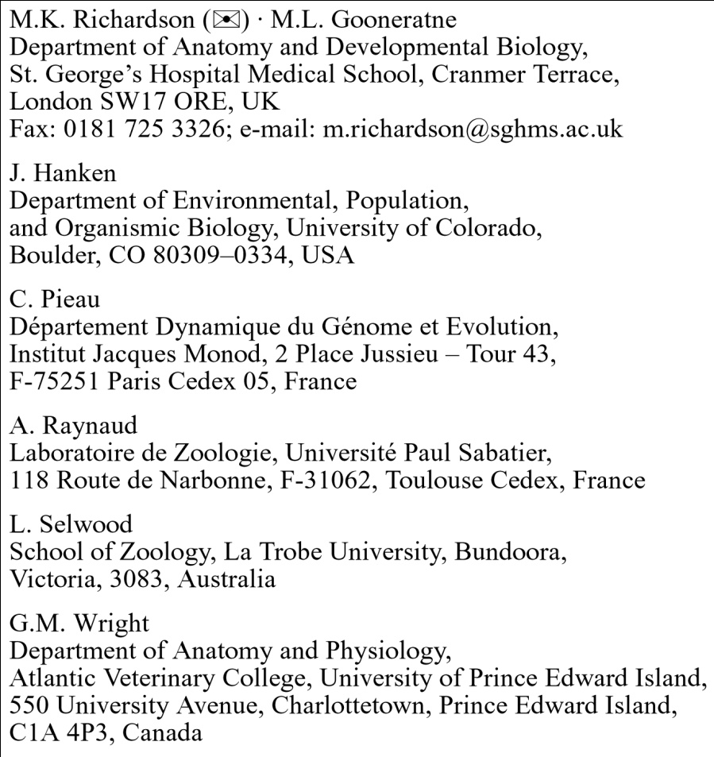
“Contrary to recent claims that all vertebrate embryos pass through a stage when they are the same size, we find a greater than 10-fold variation in greatest length at the tailbud stage. Our survey seriously undermines the credibility of Haeckel’s drawings, which depicts not a conserved stage for vertebrates, but a stylised amniote embryo. ”
Notes:
但是，1997年英国人Michael K. Richardson在《解剖学和胚胎学》杂志上发表了一篇论文，完全推翻了Haeckel的结论。为了验证胚胎重演论，Richardson和多家实验室合作，除了Haeckel所提到的动物种系外，他们收集多个种系动物，观察它们在各个胚胎发育期的形态，他们发现，
[读标题]
[动画]
[读字幕]

Slide 78
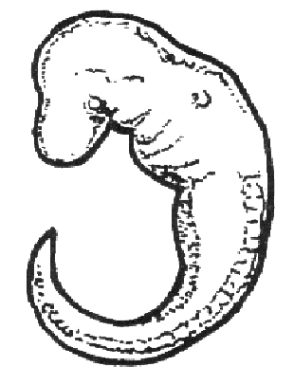
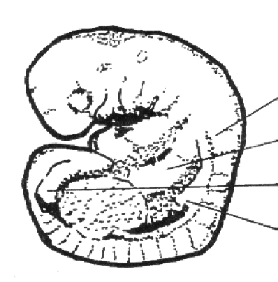
脊柱
内脏
腿
臂
Haeckel的人胚胎
人的胚胎
Notes:
原来Haeckel对他的胚胎图作了艺术加工。比如人的胚胎应该是这样，有脊柱、内脏、手臂、腿等器官的原型，但是Haeckel去掉了人胚胎的内脏部分和腿，
[动画]
就成了一个有尾巴，类似鱼的胚胎。
不止如此，Haeckel还有意选择较相近的动物胚胎，比如他用水生的蝾螈代表两栖类，而不用青蛙，因为蝾螈本身更象鱼。又如鸡的胚胎在这个时期眼球是没有色素的，但Haeckel把它涂黑，使得鸡的胚胎和其他动物胚胎更相似。

Slide 79
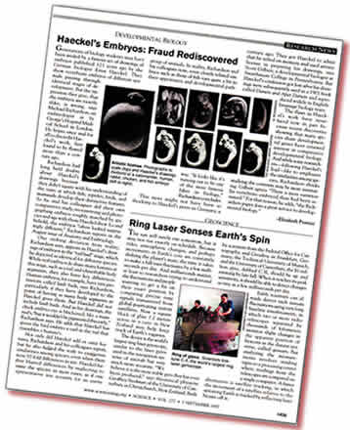
Article in “Science” Magazine –
Haeckel’s Embryos: Fraud Rediscovered

Slide 80
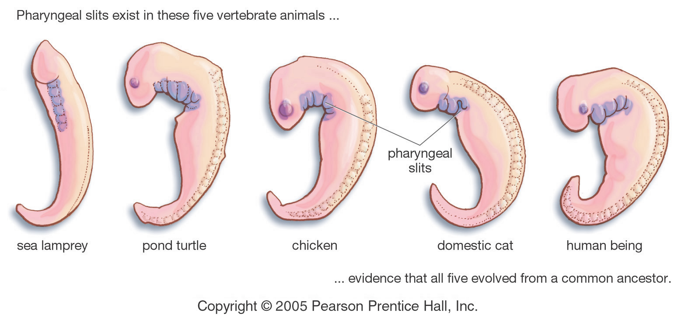
Evidence for Evolution - Comparative Embryology
Why do embryos of different animals pass through a similar
developmental stage?
Recent discoveries of the conservation of molecular mechanisms of development are even more compelling.

Slide 81
科學界烏龍事件
科學的假設有錯誤的可能。
例如曾被當成科學真理，超過一千三百年拖勒密的「地球中心說」即是歷史殷鑑。
除此之外「科學界的烏龍事件」，曾發生以動物骨頭拼湊、謊報又缺乏道德勇氣去澄清，種種偽科學的憾事。

Slide 82
一、歷史上「科學界烏龍事件」的舉例
1.拖勒密的「地心說」
「諸天訴說祂的榮耀，穹蒼傳揚祂的手段。」古代人最感興趣的是每天看得見的-----日月星辰是怎樣運轉的呢?拖勒密生於第一世紀(西元90~168年)，主要著作為『天文大全』，將前人提出的「地心說」的觀點，進一步發揮。
拖勒密博學多才，是一位大學問家，有許多著作流傳後世。但其「地球為宇宙中心說」的錯誤理論，曾統治歐洲思想達1320年之久。

Slide 83
一、歷史上「科學界烏龍事件」的舉例(續)
哥白尼(西元1473~1543) ----是業餘天文學家與真基督徒----教會服事者，他從小就熱愛科學，大學時代萌發了「地球在運轉著」的念頭。哥白尼大部份時間在大教堂當教士，他的著名天文學說是在業餘時間完成的。
既然人們所深信達1320年，的「地心說」，被哥白尼證實為錯誤，那麼
影響全球數以十億計以上人口的「進化論」，誰又能保證它就是人類起源的真理呢？

Slide 84
一、歷史上「科學界烏龍事件」的舉例(續)
2.英國「皮爾當人」事件(續)
到了1950 年代，英國科學家 重新檢視皮爾當人，發現非常可疑的地方 ：皮爾當人的牙齒上方有整齊的刮痕。這些刮痕不是吃東西留下來的，我們吃東西，咀嚼方式不同，牙齒磨損的程定一定不同。皮爾當人每顆牙齒磨損的情況都一樣，既不是吃東西造成的，也不是磨損。這些牙齒是裝上去的，有人造了模子，假造牙齒，這到底為什麼？

Slide 85
一、歷史上「科學界烏龍事件」的舉例(續)
2.英國「皮爾當人」事件(續)
科學家測試皮爾當人的化學成分，發現頭骨和下頷都染過色，讓化石看法來很像同種生物，再湊在一起。接著，科學家又發現頭骨根本不是史前人類的，只有幾百年歷史；下頷的年代也不久，而且根本是狒狒的，用模子造牙齒裝上去，讓下頜看起來像人類的。道森搞砸了！

Slide 86
一、歷史上「科學界烏龍事件」的舉例(續)
2.英國「皮爾當人」事件(續)
這次科學烏龍是個科學大騙局，
由於事隔多年，當事人已歿，以致真相將永遠是個謎，
到底是誰愚弄這麼多專家這麼久，沒有人知道。唯一可以理解的是：「撒但是一切說謊之人的父」在人類起源的問題上，更是會作假以誤導世人為樂。

Slide 87
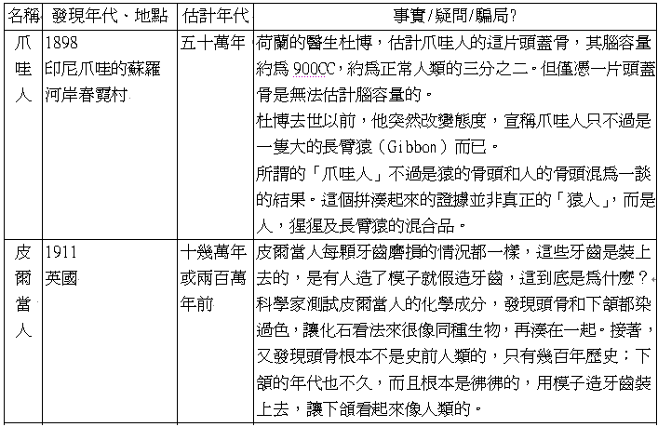
一、歷史上「科學界烏龍事件」的舉例(續)
以化石作為人類起源的鬧劇
http://www.tychurch.org.tw/bible/06-10.htm

Slide 88
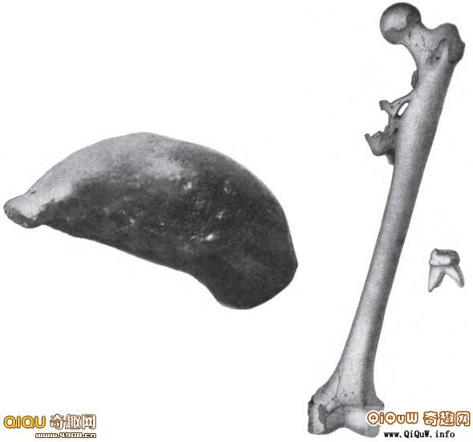
爪哇人

Slide 89
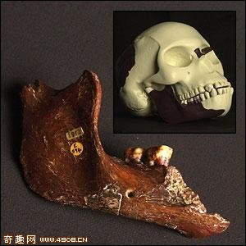
皮爾當人
皮尔当人化石骗局
1912年，律师兼业余古生物学家查尔斯·道森在英国苏塞克斯郡发现了所谓的皮尔当人化石，似乎是半人半猿的头骨和颚骨。这一发现被誉为猿和人类之间进化链条中缺少的一环。1953年，皮尔当人化石最终被证明是伪造的。实际上，这个头骨不过是用一名中世纪人的头盖骨和一只猩猩的颚骨拼凑的。
Notes:
1912年，律师兼业余古生物学家查尔斯·道森在英国苏塞克斯郡发现了所谓的皮尔当人化石，似乎是半人半猿的头骨和颚骨。这一发现被誉为猿和人类之间进化链条中缺少的一环。1953年，皮尔当人化石最终被证明是伪造的。实际上，这个头骨不过是用一名中世纪人的头盖骨和一只猩猩的颚骨拼凑的。

Slide 90
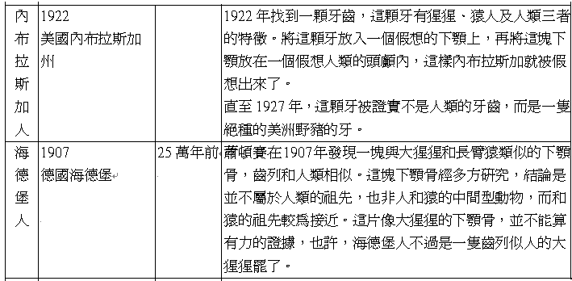
歷史上「科學界烏龍事件」的舉例(續)
以化石作為人類起源的鬧劇(續)

Slide 91

海德堡人

Slide 92

歷史上「科學界烏龍事件」的舉例(續)
以化石作為人類起源的鬧劇(續)

Slide 93
mtDNA Variation in the South African Kung and Khwe—and Their Genetic Relationships to Other African Populations
Yu-Sheng Chen^{1, *}, Antonel Olckers⁴, Theodore G. Schurr^{1, 2, †}, Andreas M. Kogelnik^{1, 3}, Kirsi Huoponen^{1, ‡} and Douglas C. Wallace^{1, 2, ,}
0.364% → giving an estimated age, for all African mtDNAs, of 125,500–165,500 years before the present
Based on 2.2%-2.9%/MYR

Slide 94

寒武紀大爆炸
在屬於寒武紀時期的地層裏的地質紀錄裏發現了類似蝸牛，三葉虫，海綿，蚯蚓，水母，海刺蝟和其他複雜的無脊椎動物。奇怪的是，這些彼此具有很大區別的物種全部在同一時期出現和都沒有先存的祖先。因此地質文學將這奇跡稱“寒武紀大爆炸”。

Slide 95


三 葉 蟲 的 眼
這眼睛是在5,3億年前的寒武紀時期，突然以極為複雜的形式產生的。當然，這樣的設計是進化論無法解釋的，這只能證明創造的存在。甚至，三葉蟲的眼睛的蜂巢結構至今仍未變化。例如，一些類似蜜蜂及蜻蜓的蟲類，依然擁有相同的眼睛結構。在這樣的情況下，進化論關於物種從初級到複雜結構發展的解釋，則是無效的。

Slide 96


Slide 97
 | 年輕地球創造論 (權威創造論) | 年老地球創造論 (漸進創造論) | 神導進化論 (全備天賦創造論)
神超自然介入嗎﹖ (科學哲學開放性) | 神超自然介入 (主張有神科學法) | 神超自然介入 (主張有神科學法) | 神超自然介入 (採納自然主義科學方法，但不否認人類救恩歷史中的神跡奇事)
神智慧設計的實施 | 連續六個二十四小時內完成創造 | 六個漫長年代內，逐步間歇性完成創造 | 神起初就賦予自然界全備的進化潛能。
生物進化的功用 | 僅限于生物種內的個体變異(微進化) | 有限度的生物種與屬之間的進化 | 進化是神實現創造的基本手段
亞當夏娃的歷史真實性和墮落後果 | 真實歷史 始祖墮落導致所有生命死亡現象 | 真實歷史 始祖墮落只導致人類死亡(身死靈死) | 部分人認為亞當夏娃被造屬詩意描繪；著重其屬靈涵義
挪亞時代大洪水事件歷史真實性 | 真人真事，水漫全球，導致地質岩石和化石的突然形成 | 真人真事，全球或局部事件，非地質岩石和化石之成因 | 著重這段聖經故事背後的屬靈涵義
宇宙和地球的年齡 | 短至數萬年之內 | 長達百億年上下 | 長達百億年上下

Slide 98
人類的演化???

