Slide 1

 | Second Generation English Ministry:
A Case Study
Presenter: Rick Cook
Logos Evangelical Seminary
Language of Presentation: English

Slide 2
 | Description
In February of 2016 a new church was born: Generations Church of Los Angeles. It was started by a core group from the English Ministry at EFCLA in El Monte. This session will tell the story of GCLA and consider the potential for second generation churches.

Slide 3
TIMELINE of Generations Church of Los Angeles
TIMELINE | Generations Church of Los Angeles
Year -2 | Crisis at First Generation Church
Year -1 | Expanding Vision for a New Church
 | **Birth of GCLA (February 7, 2016)**
Year 1 | Survival and Finding our Footing
Year 2 | Putting Down Roots
Year 3 | Independent Church: What Can We Become?

Slide 4
 | Introduction
Why am I involved?
First and Second generation
Honest people of good faith on both sides
Problems I have observed
Subtle Culturalism (Not malicious or intended, but real)
EM as a “ministry” of First Generation Church

Slide 5
Year -2 | Crisis at First Generation Church
Leaving EFCLA- Crisis
Elder Henry (insider in denomination) urges patience

Slide 6
Year -1 | Expanding Vision for a New Church
Planting a new ministry; born in prayer
Vision
Core leaders

Slide 7
Year -1 | Expanding Vision for a New Church
Mission (As church launched)
Our mission is for strong children's ministry, student/youth groups, family homegroups, and older families mentoring YA (young adults) and young couples. Our service will first begin with English only. Our focus on growing and spiritually nurturing the 2nd, 3rd, 4th+ gen kids growing up here in SGV.

Slide 8
Year -1 | Expanding Vision for a New Church
Our Mission (As stated on current webpage)
We would like to focus on nurturing families with second+ generation children. We want to prepare children and youth for the world and fulfilling the Great Commission through a strong children's ministry, strong youth ministry, strong families, and growing a strong young adult ministry.
Our target geography is the western San Gabriel Valley area in southern California. We want to equip our members to share the Good News, first to our Community, then to the greater LA Basin and around the world.

Slide 9
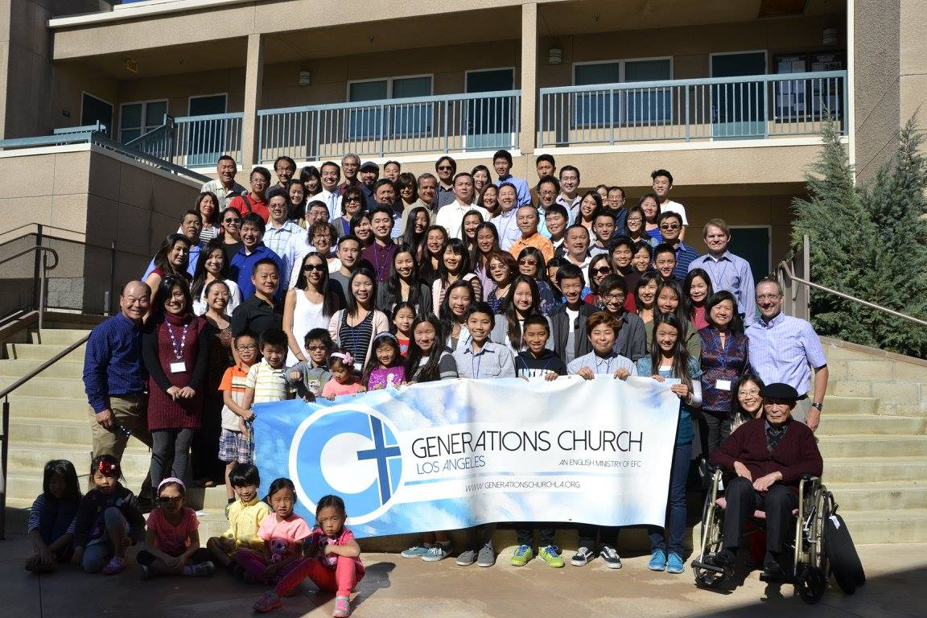
 | **Birth of GCLA (February 7, 2016)**
Feb 7, 2016- Celebration! First Service (Vertigo!)

Slide 10
Year 1 | Survival and Finding our Footing
My preaching- stability in pulpit
Add first pastor- Youth Pastor
Theological Challenge (More serious spiritual battle)
Crisis- (inevitable?)
Crisis maybe held us together
Great to be part of EFC-
Statement of Faith (we can’t change statement)

Slide 11
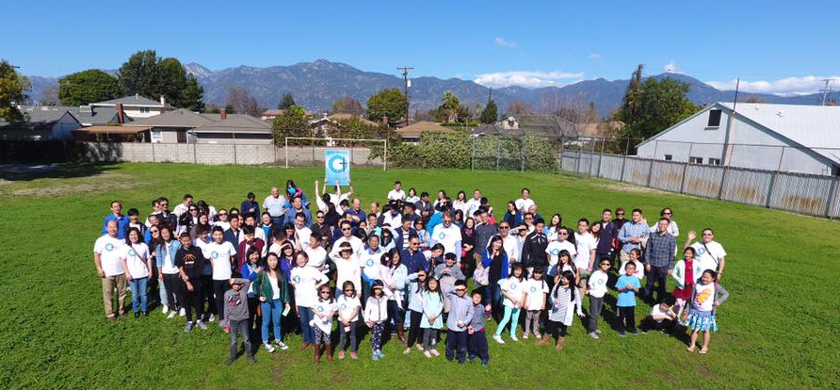
Year 2 | Putting Down Roots
Feb 12, 2017- One Year Anniversary

Slide 12
Year 2 | Putting Down Roots
Feb 12, 2017- One Year Anniversary
Stability: Pastoral search
Ordination of Women: Complementarian and Egalitarian
Denominational Challenge: Must sign SOF
Statement of Faith (we can’t change statement)
Value of EFC? DNA: Church planting, miracles, etc.

Slide 13
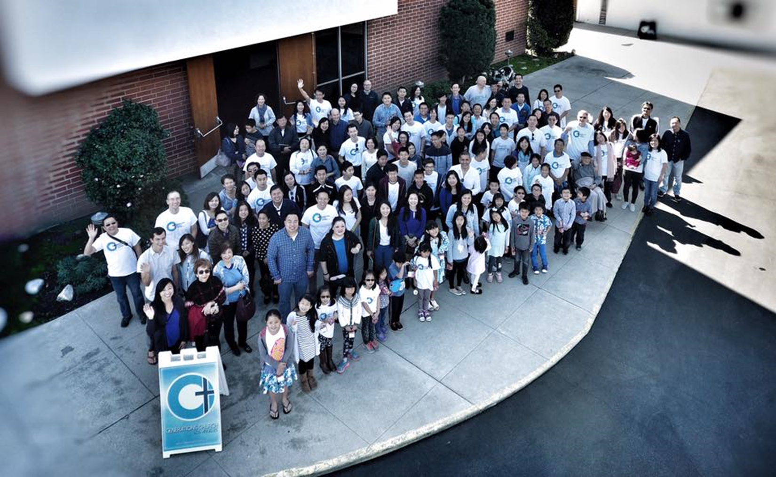
Year 3 | Independent Church: What Can We Become?
Third Year Feb 2018

Slide 14
Year 3 | Independent Church: What Can We Become?
Third Year Feb 2018
Declaration of Independence
May 6, 2018 Installation of Deacons and Elders
July 2018 Second FT pastor (move up from PT)
Challenge: Vision

Slide 15
 | Final Thoughts
Maybe we can think together about how to birth Asian-American churches without a crisis

Slide 16
 | Final Thoughts
My Sermon Series
Goal: Display the glory of God

Slide 17

OVERWHELMING
GENERATIONS
February and March, 2016

Slide 18

Knowledge of God
v.1-6 Theme: God’s intimate knowledge of us; The omniscience of the Lord
Presence with us
v.7-12 No place I can go to be hidden from God; The omnipresence of the Lord
Creation of us
v.13-18 You saw and loved me before I was born; The omnipotence of the Lord
Obsession with us
v.19-24 How precious are your thoughts; search me

Slide 19

Joshua 24:15
“But if serving the LORD seems undesirable to you, then choose for yourselves this day whom you will serve….
But as for me and my household, we will serve the LORD."

Slide 20
COURAGEOUS
Joshua 1-5

Slide 21
Joshua 1:1-9
Next Man Up (Next Mother Up!)

Slide 22

King David
Joshua
Moses

Slide 23


Rahab too,
and the Scarlet Cord
Joshua 2:1-24

Slide 24

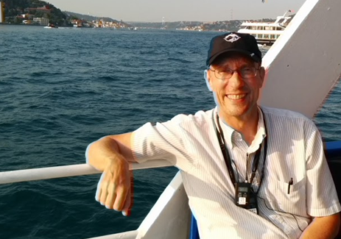
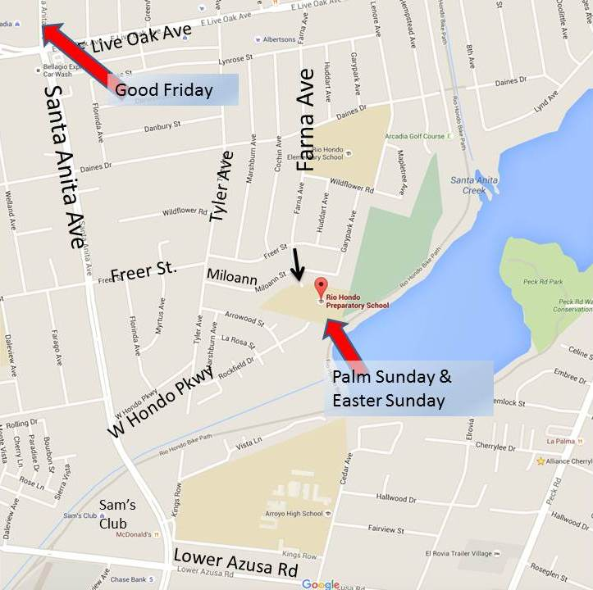

Palm Sunday
Dr. Richard Cook Logos Evangelical Seminary
“Passions Turned Red”
March 20th @ 11:30am.
Rio Hondo Prep School. 5150 Farna Ave., Arcadia.
Good Friday
HOLY WEEK
“Love Ran Red”
March 25th @ 8pm Service & Communion. 6:30 pm Dinner
Arcadia Congregational United Church of Christ. 2607 S. Santa Anita, Arcadia.
Easter Sunday
“Morning Glows Red”
March 27th @11:30am. Easter Egg Hunt (kids.) Lunch@1pm.
Rio Hondo Prep School. 5150 Farna Ave., Arcadia.

Slide 25


The Light
July-August 2016
Rick Cook
Generations Church LA

Slide 26
The Light
The Word Jn 1:1-5 July 17
The Witness Jn 1:6-8 Aug 14
The World Jn 1:9-13 Aug 21
Grace and Truth Jn 1:14-18 Sept 4

Slide 27


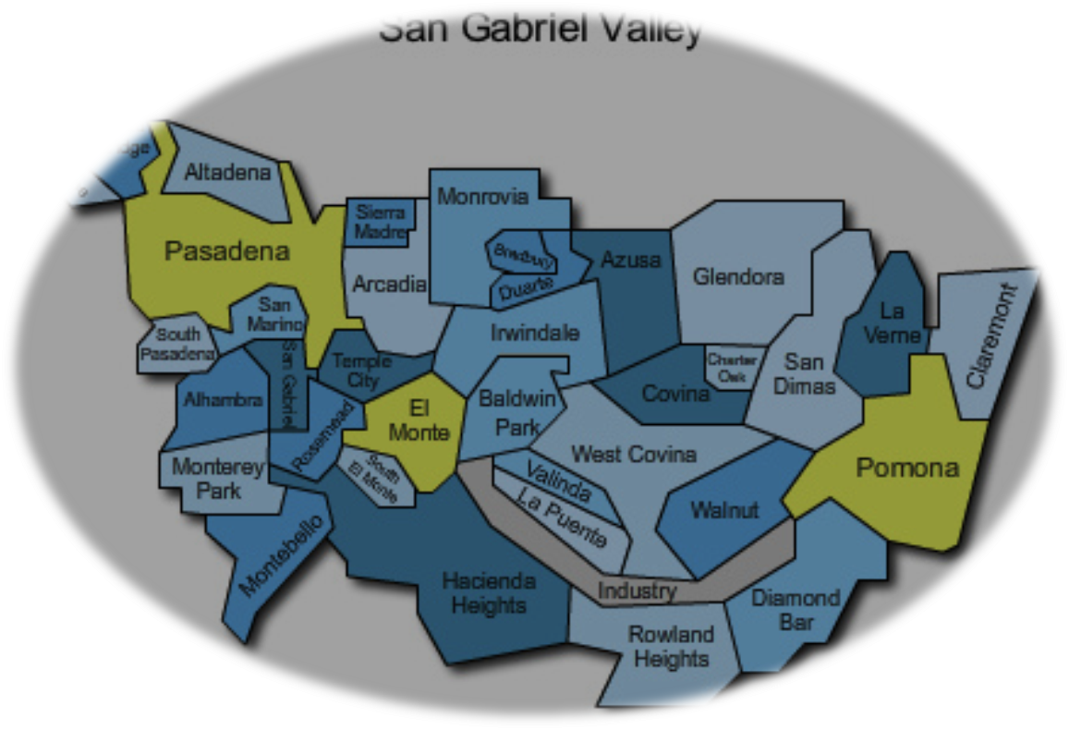
Hope
A Letter to the Elect in the SGV
October – November 2016
Rick Cook
Generations Church of LA

Slide 28

1 Peter 1-2 Sermon Series 2016
TITLE: HOPE
MAIN IDEA: The Church enjoys an exulted identity, not affected by suffering and hardship.
Part 1 “A Greeting to the Elect in SGV” 1 Peter 1:1-2
Part 2 “A Hope” (A Lens of Hope) 1 Peter 1:3-12
Part 3 “A Call” (A Call to Holiness) 1 Peter 1:13-25
Part 4 “A People” (A Chosen People) 1 Peter 2:1-12

Slide 29
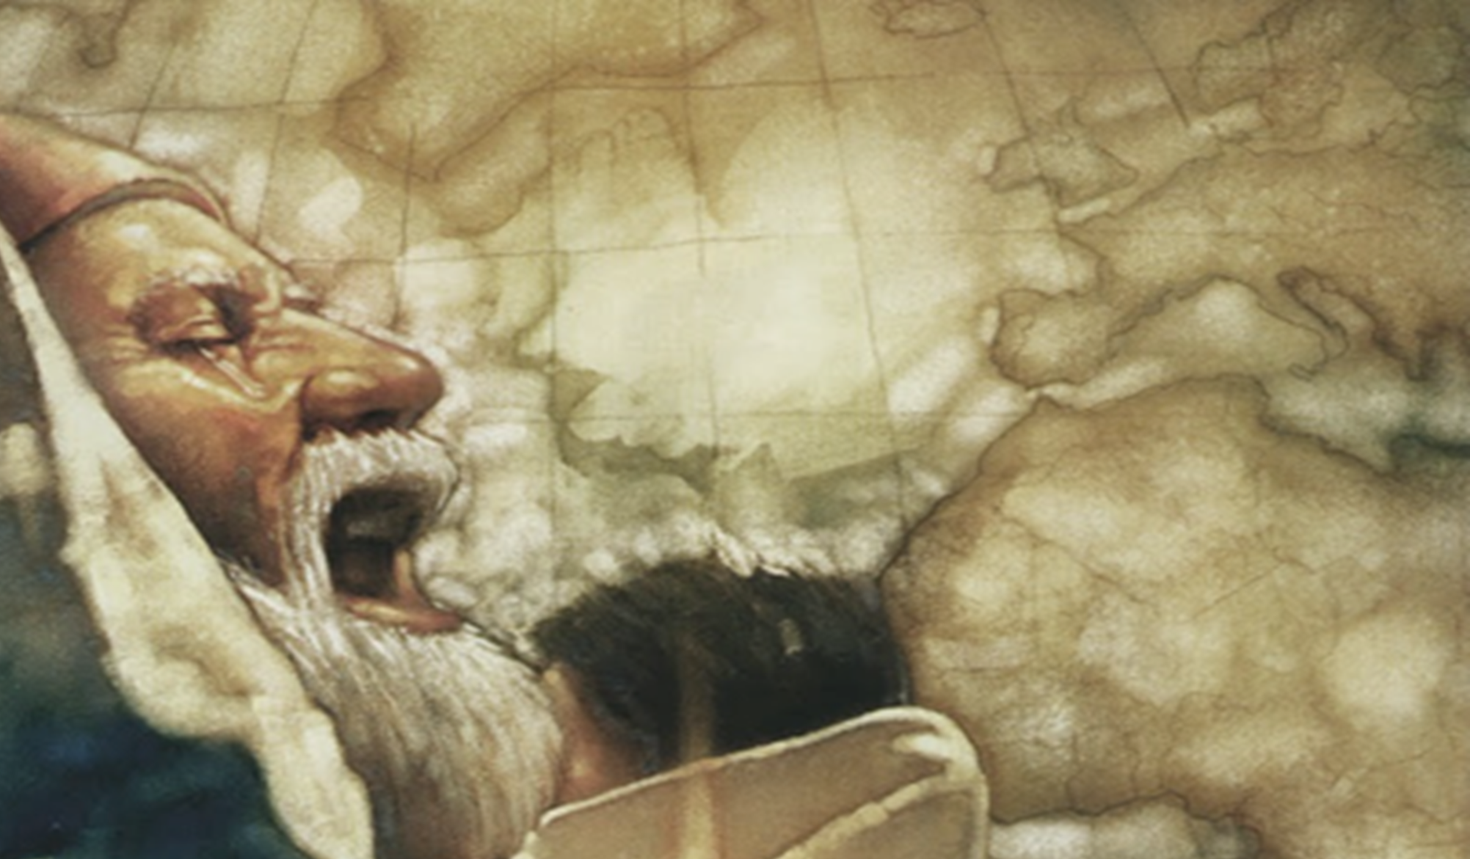
Christmas 2016
SIMEON
and God’s dwelling place among his people
Dr. Rick Cook
December 4
“God’s Dwelling Place”
December 25
“Simeon” Luke 2:22-33

Slide 30




The World Longs for…
transcendence
justice
beauty
community
Dr. Rick Cook
Four Topics Four Sermons
January and February 2017

Slide 31
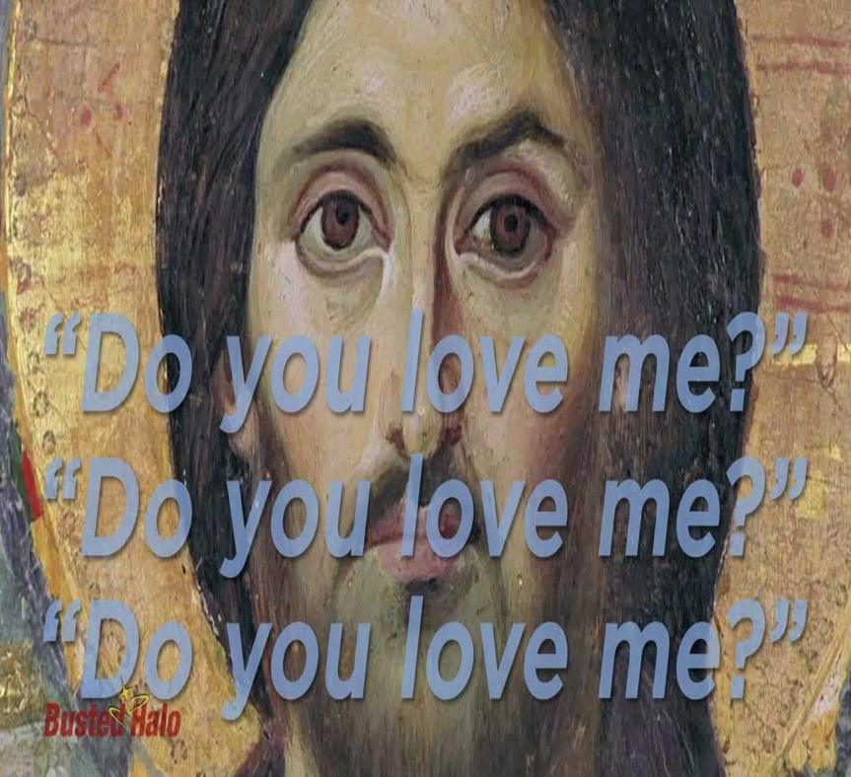

EASTER 2017
“Let us make this the best Easter ever”
“I do not know this man
of whom you speak”
Dr. Rick Cook
Four Sermons from Mark 14
March and April 2017

Slide 32





Slide 33
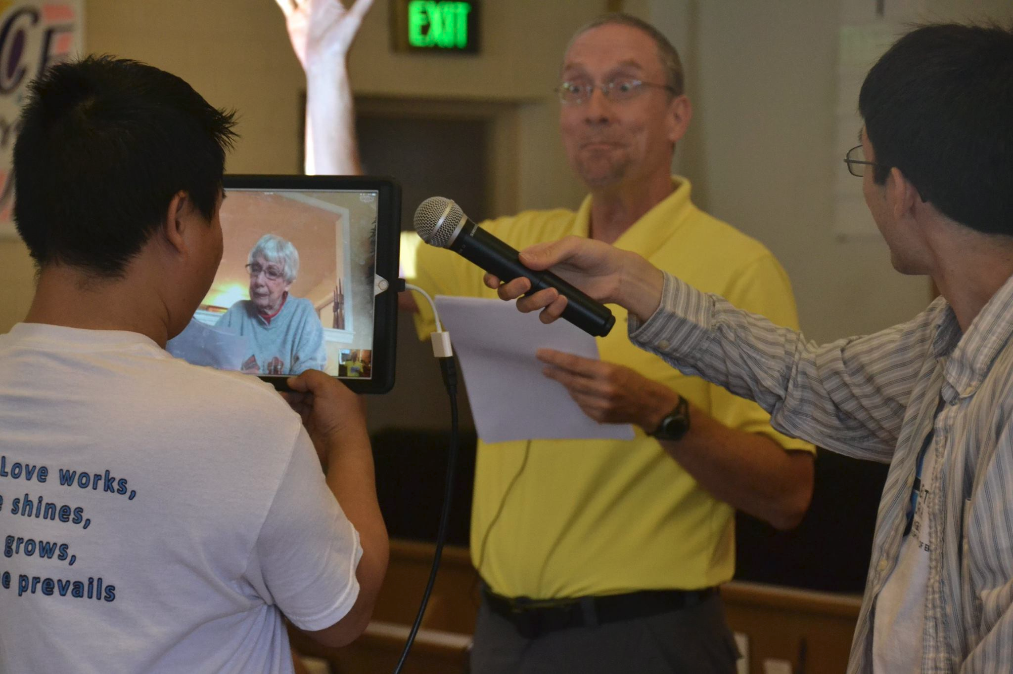

Slide 34




Revelation 2:1-7 Ephesus
Revelation 2:8-11 Smyrna
Revelation 2:12-17 Pergamum
Revelation 2:18-29 Thyatira
Revelation 3:1-6 Sardis
Revelation 3:7-13 Philadelphia
Revelation 3:14-22 Laodicea
Churches
Compromise
Dr. Rick Cook
Summer 2017
Generations Church of LA
A four part sermon series on Revelation 2-3

Slide 35
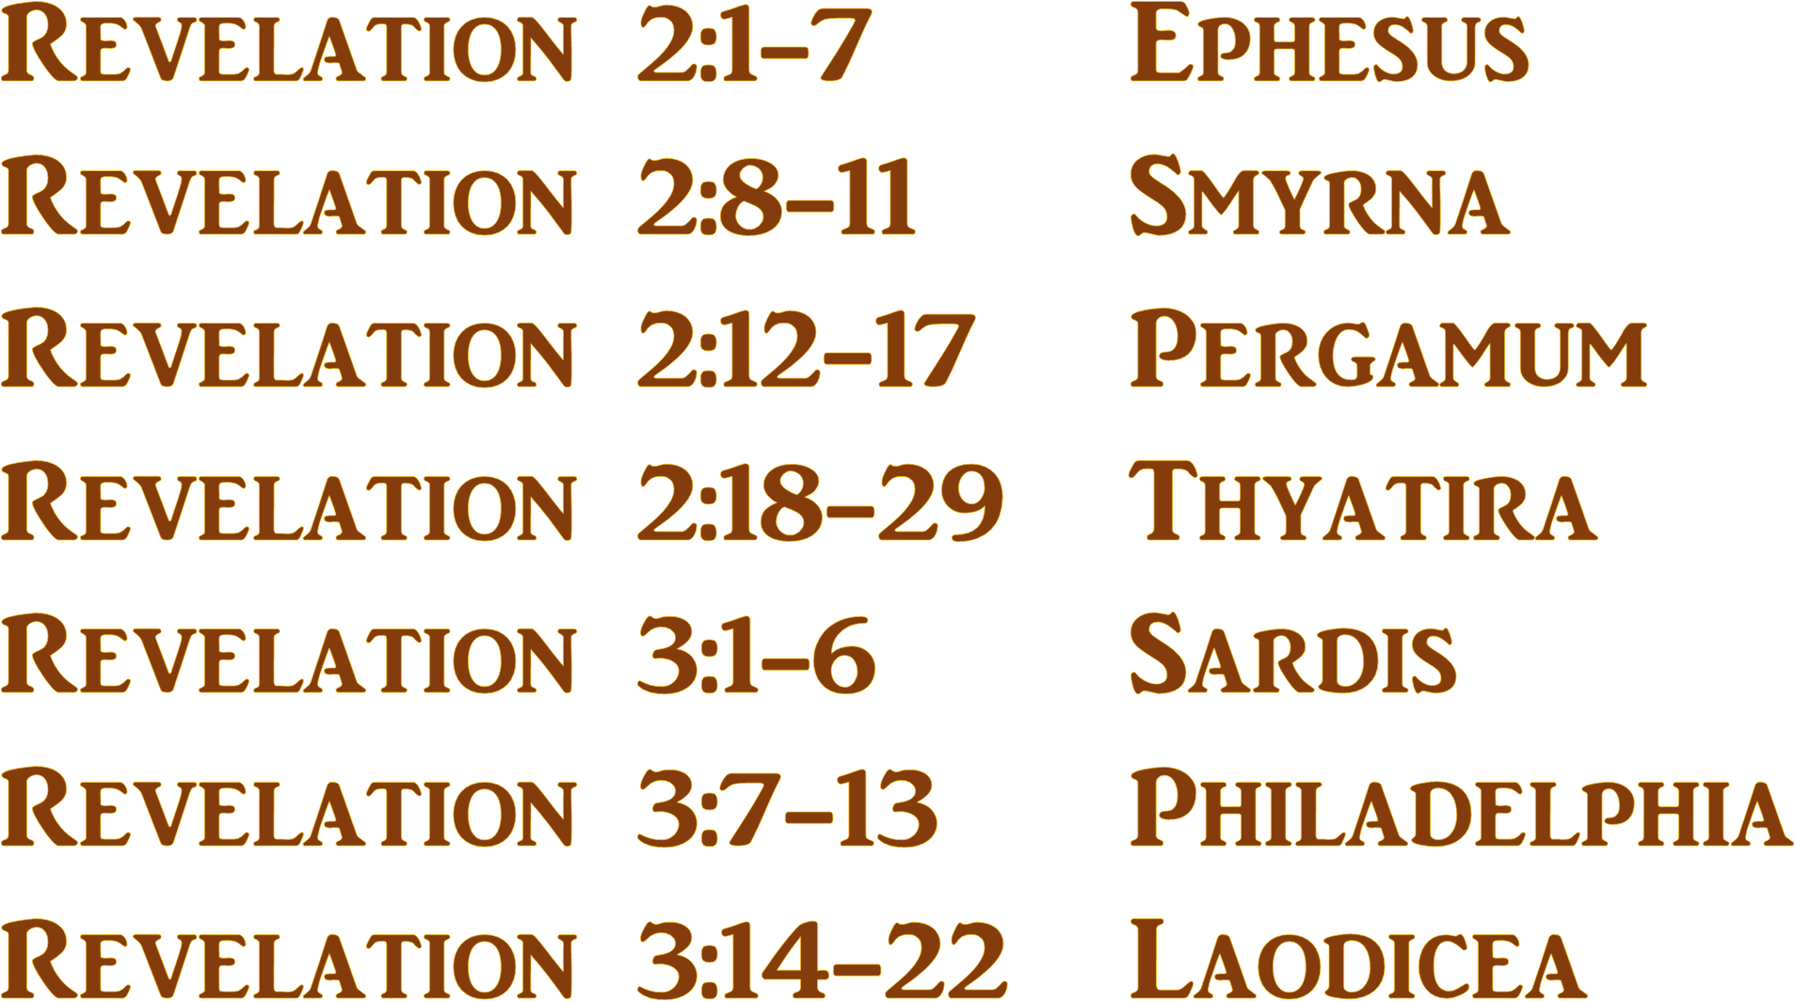

Slide 36

Meditations on Christ
Philippians 2:1-16
CHRISTMAS 2017
Generations Church of LA
Dr. Rick Cook
Four Part Series

Slide 37


All Heaven Breaks Loose!
Acts 1-2
Generations Church of LA
Sermon Series
January-March, 2018
Acts: Evangelizes us and makes us evangelists

Slide 38
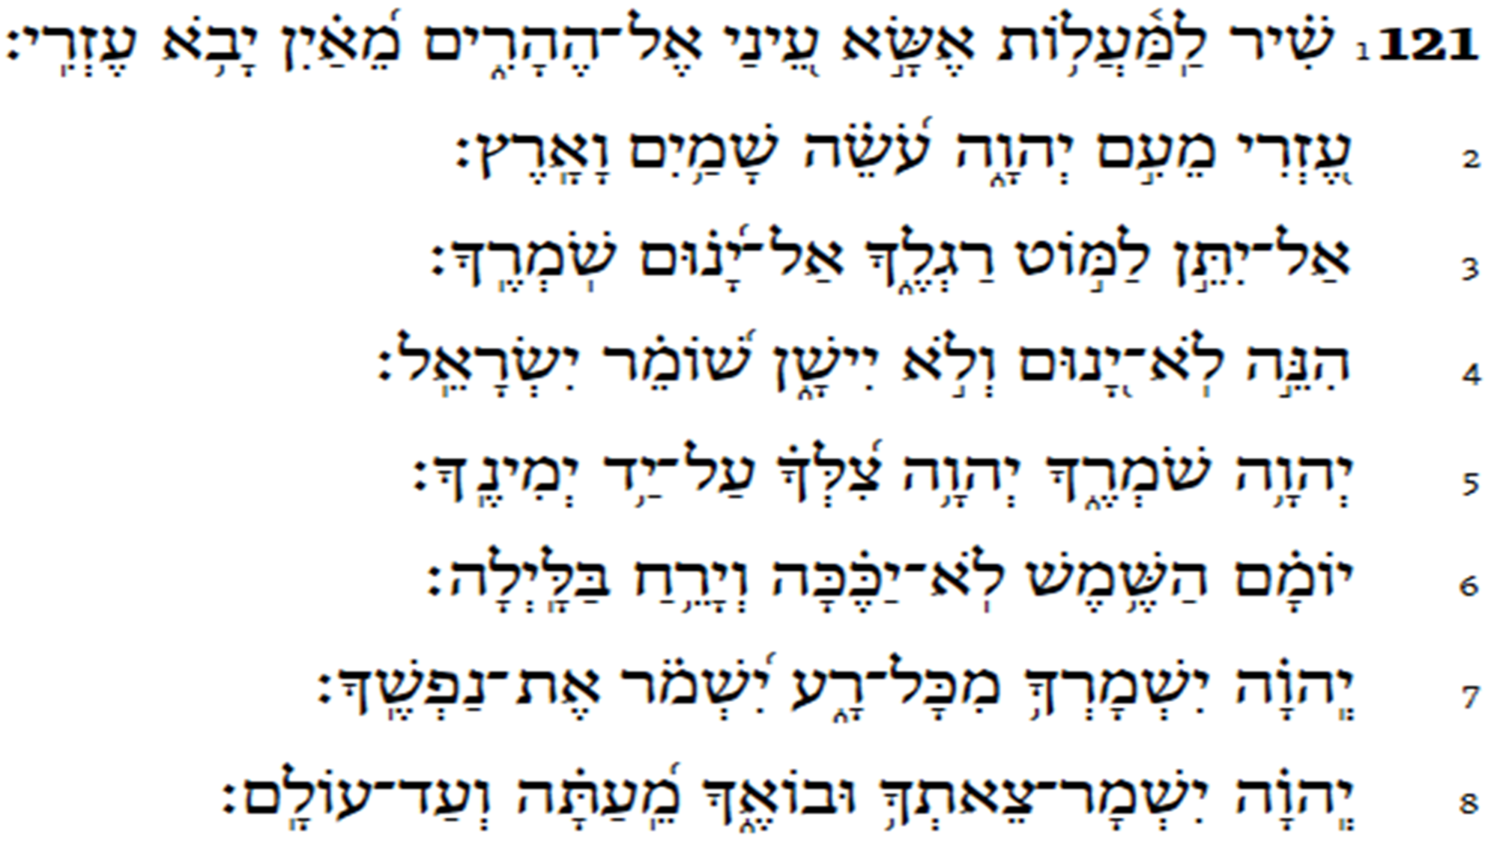

“Where does my
help come from?”
Good Friday 2018
Psalm 121
Dr. Rick Cook

Slide 39



A
cts 3-5
THE WITNESS PR GRAM
Generations Church LA
Rick Cook & Jaylenn Wong
April-June 2018

Slide 40
Acts 6-8
Persecution Power
Generations Church LA
Rick Cook & Jaylenn Wong
April-June 2018

Slide 41
Paul:
New Recruit to the Witness Program
Acts 9:1-19

Slide 42
 | Second Generation English Ministry:
A Case Study
Presenter: Rick Cook
Logos Evangelical Seminary
Language of Presentation: English

