Slide 1
工作邏輯代數：
人= 吃飯 + 睡覺 + 上班 + 玩
豬 = 吃飯 + 睡覺
代入：人 = 豬 + 上班 + 玩
即 ：人 - 玩 = 豬 + 上班
結論 ：不懂得玩的人
= 只會上班的豬
男人 = 吃飯 + 睡覺 + 賺錢
豬 = 吃飯 + 睡覺
男人 = 豬 + 賺錢
豬 = 男人 - 賺錢
所以，男人不賺錢等於豬

Slide 2
女人 = 吃飯 + 睡覺 + 花錢
豬 = 吃飯 + 睡覺
女人 = 豬 + 花錢
豬 = 女人 - 花錢
所以，女人不花錢等於豬
男人為了不讓女人變成豬而賺錢
女人為了不讓男人變成豬而花錢
男人+女人= 豬 + 錢(賺)+豬 - 錢(花)
所以，男人+女人=兩頭豬

Slide 7
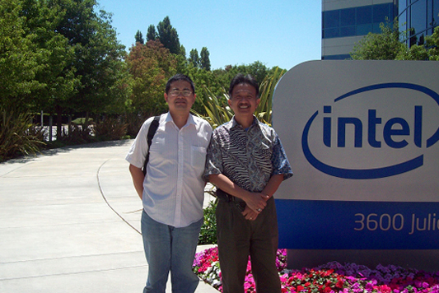
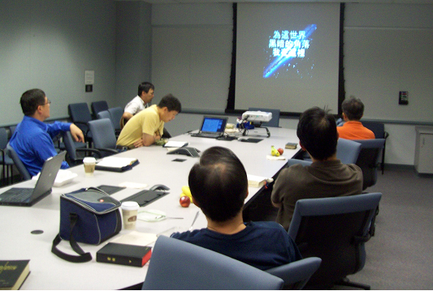
Intel Harvest Church
的職場團契

Slide 12
給老板的一封信 ~從門訓的觀念談起

Slide 13
Thanks again for the opportunity to talk to you about the responsibilities for the position of Thermal Systems Manager. I have presented myself about managing suppliers using an efficient way and proper manner. I am also very confident to lead our engineers to achieve company's goal. Besides my professional experiences in the automotive and aerospace companies, I have been serving in a nonprofit organization for 14 years as a leader coaching members to grow and become successful. My leadership style is gentle but firm. I want my subordinates to be responsible and accountable for what they do and work as a team to influence other people in the organization. I have a motto: "learn and earn", I believe continuous improvement of management skill is important to make a group leader successful and respected by my peers. I look forward to working with you in the future and to be a valuable asset to the company.

Slide 14
以門訓為基礎的工作人際關係
要愛人如己
若是可能總要盡力與他人和睦
我們在工作環境中的見證，將成為我們和他人傳福音的成敗最關鍵的因素

