Slide 1

ABC 2013 Conference專題講座
『門訓為健康教會之靈魂』
9、21、2013（2：30～3：45PM)

Slide 2
【自己評估】
我們靈命是否健康？
GCCI 的個人靈命健康調查表
（附錄）

Slide 3

VIDEO-1
3
Notes:
3

Slide 4

VIDEO-2

Slide 5
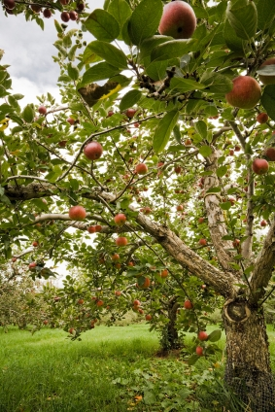

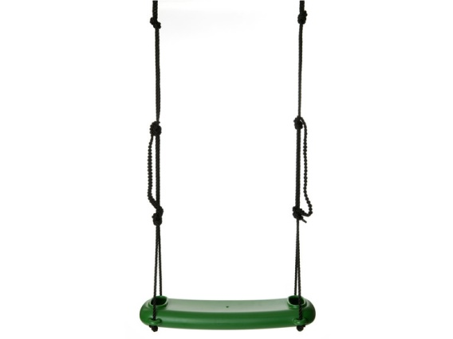

Group Think
Vision Tree
Desired Outcomes
Systems & Ministries
Joy
Church Functions
Biblical
Principles
Discipleship and
Leadership
Core Values

Slide 6
GOD
Discipler’s
Role
Witness
Parent
Servant
Steward
Encourager
1 Cor 1:18
1 Cor 2:1-5
1 Cor 3:1-3
1 Cor 3:5-6
1 Cor 4:1
1 Cor 3:10-16
1 Cor 3:7-9
1 Cor 4:6, 17
Task
Evangelism
Nurture
Training
Equipping
Supporting
Co-laborer
Multiplying Leader
Maturing
Disciple
Spiritual Baby
.::.::
.:.:..
::::. :::::
. : . .
.:.:.:.:.:.:
. . .
::.::.:.:::
Unsaved
. . : .
…. ...
Emphasis
Friendship
Lordship
Discipleship
Leadership
Partnership
Disciple’s Journey – Master Builder

Slide 7
GOD
Discipler’s
Role
Witness
1 Cor 1:18
1 Cor 2:1-5
Task
Evangelism
Unsaved
Emphasis
Friendship
Disciple’s Journey – Master Builder
Notes:
The whole process grows from two aspects
1) the NEED for discipleship
2) the VISION for what God can do thru you

Slide 8
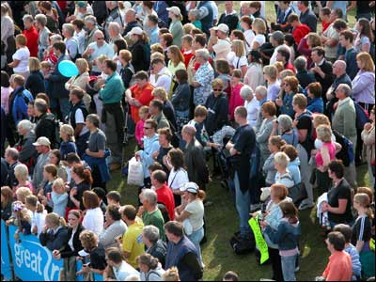
Evangelism
List the names of people with whom you know that are not yet believers.

Slide 9
GOD
Discipler’s
Role
Witness
Parent
1 Cor 1:18
1 Cor 2:1-5
1 Cor 3:1-3
Task
Evangelism
Nurture
Spiritual Baby
Unsaved
Emphasis
Friendship
Lordship
Disciple’s Journey – Master Builder

Slide 10
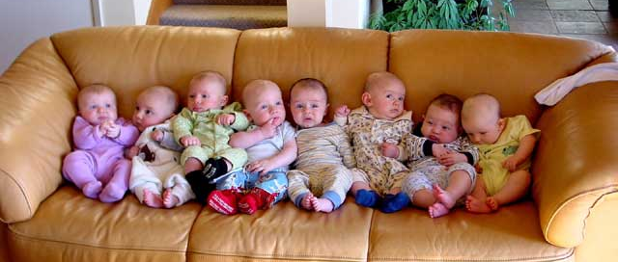
Nurture
List the names of people with whom you are working that are babies in Christ.

Slide 11
GOD
Discipler’s
Role
Witness
Parent
Servant
1 Cor 1:18
1 Cor 2:1-5
1 Cor 3:1-3
1 Cor 3:5-6
Task
Evangelism
Nurture
Training
Maturing
Disciple
Spiritual Baby
. : . .
. . .
Unsaved
. . : .
Emphasis
Friendship
Lordship
Discipleship
Disciple’s Journey – Master Builder

Slide 12
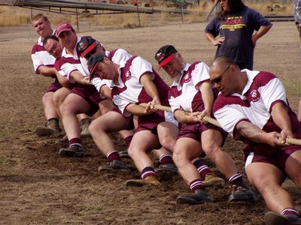
Discipling
Identify the people whom God has brought to you in order for you to disciple them.

Slide 13
GOD
Discipler’s
Role
Witness
Parent
Servant
Steward
1 Cor 1:18
1 Cor 2:1-5
1 Cor 3:1-3
1 Cor 3:5-6
1 Cor 4:1
1 Cor 3:10-16
Task
Evangelism
Nurture
Training
Equipping
Multiplying Leader
Maturing
Disciple
Spiritual Baby
.::.::
. : . .
.:.:..
. . .
Unsaved
. . : .
…. ...
Emphasis
Friendship
Lordship
Discipleship
Leadership
Disciple’s Journey – Master Builder

Slide 14

Multiplying Leaders
Identify the people whom God has brought to you that could become multiplying leaders.

Slide 15
GOD
Discipler’s
Role
Witness
Parent
Servant
Steward
Encourager
1 Cor 1:18
1 Cor 2:1-5
1 Cor 3:1-3
1 Cor 3:5-6
1 Cor 4:1
1 Cor 3:10-16
1 Cor 3:7-9
1 Cor 4:6, 17
Task
Evangelism
Nurture
Training
Equipping
Supporting
Co-laborer
Multiplying Leader
Maturing
Disciple
Spiritual Baby
.::.::
.:.:..
::::. :::::
. : . .
.:.:.:.:.:.:
. . .
::.::.:.:::
Unsaved
. . : .
…. ...
Emphasis
Friendship
Lordship
Discipleship
Leadership
Partnership
Disciple’s Journey – Master Builder

Slide 16

Co-Laborers
Identify the people whom God has brought to you
that could become
co-laborers.

Slide 17
門訓為健康教會之靈魂，
教會牧養不能『速成』，
信徒靈命的成長更沒有所謂的『捷徑』。
唯有透過門徒訓練，
使信徒靈命成長，
使教會恢復健康，
得以完成基督的大使命。

