Slide 1
The Three Solas: A Summation of the Reformation Theology that Rocked the World and China
撼動世界與中國的 “三個唯獨 Solas”
Dr. Richard Cook 柯立天牧師
Logos Evangelical Seminary 正道福音神學院

Slide 2
三個宗教改革基本信仰：唯獨信心，唯獨恩典，和唯獨聖經撼
動了歐洲的基督教世界、西方世界，現在更改變全世界。

Slide 3
Abstract:
Protestant missionaries in the 19th and 20th centuries spread the distinctive faith of the Protestant Reformation to China and around the world. Three theses tie together what is central to Protestant theology: sola fide, sola gratia, and sola scriptura. These crucial themes revolutionized European Christianity, the West, and now is transforming the world.

Slide 4
OUTLINE
Introduction: The power of the Reformation in stories
Part 1 Story of Martin Luther
Part 2 Three solas and Three Stories from China
Story 1 Sola fide
John Song in China
Story 2 Sola gratia
Robert Morrison and the 2003 China Mission Conference in Chicago
Story 3 Sola scriptura
A cautionary story: Hung Xiuquan and the Taiping Rebellion

Slide 5
Introduction
Protestant Christianity-
Traditional view: a “seed種子” that follows predetermined lines
Alister McGrath’s suggestion: a “microorganism微生物” capable of rapid mutation and adaptation to changing environments, but continuous with earlier forms
Alister McGrath, Christianity’s Dangerous Idea: The Protestant Revolution, 2007 (p.4).

Slide 6
Part 1 Story of Martin Luther

Slide 7
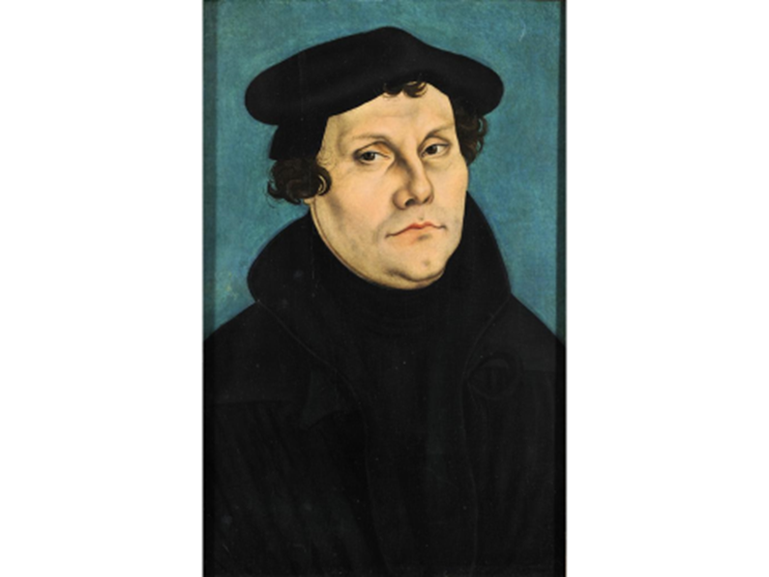
Martin Luther 馬丁路德
As a critical figure in church history, it is worth understadning Martin Luther and his times. We are all “Protestants” thanks to the Reformation that was begun by Martin Luther. 教會歷史上的爭議人物，值得花時間研究。因著他所發起的宗教改革，我們都成了“抗議派”。

Slide 8
Martin Luther 馬丁路德
Born: November 10, 1483 in Germany 德國出生
His father was a poor man who worked hard and saved his money and moved from one city to another for better opportunities. He sent Martin to preparatory schools because he wanted Martin to become a lawyer. His family was loving and strict. When Martin was 7 years old he studied in Latin School. 父親並不富裕，非常勤奮，經常因工作搬家。希望馬丁路德成為一名律師。父母慈愛又嚴厲。馬丁路德7歲就開始在拉丁學校學習。
1502 Received BA 大學學士畢業
Study Law 學習法律
1505 MA 碩士畢業
July 17, 1505 Joined the Augustinian Cluster 加入奧古斯丁修道院
“Lightening experience” 閃電經驗

Slide 9
“Lightening experience” 閃電經驗 (or possibly he fell off his horse and onto dagger 也有說法是他跌落下馬，摔在了匕首上)
He made promise to St. Anne that he would become a monk if he survived. 他向St. Anne起誓，如果活下來要出家作修士。
He survived and kept his promise by almost immediately joining one of the strictest monasteries around. There were some where the rules were very slack, but Luther wanted to have assurance of his salvation. 他活了下來並且信守誓言，很快進入了附近罪嚴格的修道院。雖然有些規條稍鬆懈，但路德迫切需要得到得救的確據。
Luther claims to have become a monk‘s monk. Whatever rules where instituted to help a person be good, he followed them. He would spend hours in the confessional trying to remember all the bad things he might have done or thought. 路德稱自己為“修士中的修士”。他遵行一切使人向善的規矩。他常常認罪數小時。

Slide 10
His health was often poor because of his fasts and religious observances. The leaders of the monastery were exasperated by he constant searching and questioning. 常常禁食使得他身體虛弱。修道院的領袖因他不停地追問而惱怒。
Luther was later to say that if being a good monk could get a person to heaven, he surely would have made it to heaven. But he was never satisfied that he had done enough to satisfy God. 後來路德說，若是作一個好修士能讓人上天堂，那他一定可以上天堂。但是他卻從不認為自己做的能滿足神。
As Luther continued to learn about the righteousness and justice of God, he became more afraid of God. 路德越了解神的公義就越害怕。

Slide 11
He continued to work harder, but the harder he worked, the more he realized that he was unworthy of a perfect God. 他不斷努力，但是越努力，越發現他不配得到一位完美的神。
He eventually came to the point where he felt God could never accept a sinner like him, and therefore he once said, “I think I hate Him.“ 他覺得神永遠不會接納他這樣的罪人，因此他曾說，“我想我恨祂”

Slide 12
1507 Luther became a priest. 路德成為一位神父
His first Communion was delayed until his father could come and participate. But rather than being a great celebration, Luther keenly felt the full force of his guilt and sin before God as he handled the “body and blood” of Christ. 他第一次主領聖餐因等待父親而推遲。在聖禮中，路德感到強烈的罪咎。
Further, his father questioned Martin’s call to ministry. Did not god tell children to obey their parents? Then Martin should have become a lawyer! 父親進而質疑他的呼召。難道神不是要孩子順服父母嗎？若是的話，你應該去作個律師！
1508 Luther sent to Wittenberg 路德被派到威登堡
Teach Aristotelian philosophy. Although Luther was constantly struggling during this period, it never seemed to effect his work. 教授亞里士多德的哲學。這一時期路德有很多掙扎，但並未影響工作。

Slide 13
1510-11 Luther sent to Rome 路德被派往羅馬
Luther continued to struggle, so his mentors sent him to Rome. They hoped that he would be able get over his guilt by visiting the center of the church. 路德一直在掙扎，他的導師將他派往羅馬。他們希望他能在這趟旅途中克服自己的罪疚感。
Luther himself hoped to have the opportunity to save his soul. 路德自己也希望能夠靈魂得救。
Luther was able to climb Pilate’s stairs where it was believed the person who climbed on hands and knees and said a prayer (“Pater Noster”) on each step could free a soul from purgatory. Luther wished that his parents had already died so he could do so great a work for them, but he decided he could only free his grandfather. 路德登上了彼拉多階梯，人們相信手腳並用、禱告著登上去的人會使煉獄里的靈魂得救。路德甚至希望他的父母已死，好藉由此得救。他最後只用這種方式釋放了他祖父的靈魂。

Slide 14
When he reached the top, he could only mutter, “Who knows whether it is so? “ 當他到達頂部的時候，自言自語道“誰知道這是不是真的呢？”
The worst part of his trip was to see the decadence of the Roman clergy, who were unbelieving and immoral. 這次旅行最壞的經歷就是見到羅馬神職人員的墮落、不信和不道德 。
There were those who considered themselves moral if they confined their romantic involvements with women. 有人認為只跟女人有染是道德的表現。
Luther was not totally stunned, however, because he did believe that the sacraments did not rely on the purity of the priests for their validity. 路德沒有非常震驚，因為他相信聖禮是否有效與執行者的聖潔無關。
However, Luther was becoming increasingly upset by the question of the role of the church as a valid means to grace. 但是，路德越來越懷疑教會在“神的恩典”中的角色和地位。

Slide 15
October 15, 1517 Posting of the Ninety-five theses 發佈九十五條
The main point of the Theses were to began a debate on indulgences. 目的是發起對贖罪券的討論
Indulgences 贖罪券
Luther became aware of the abuses of Tetzel. Indulgences were not allowed in Wittenberg where Luther was the local priest. However, in a nearby district Tetzel was selling indulgences to Luther’s church members who could easily travel Tetzel and purchase his indulgences.
路德意識到臺徹爾濫用贖罪券牟利。他禁止贖罪券進入他的教區，但是人們仍舊可以到其他地方買。

Slide 16
Tetzel 台徹爾販賣贖罪券 (Cont.)
Luther’s concern was not only theological, but pastoral and practical. 路德關心的不是神學問題，而是實際的牧養問題。
Luther was horrified to see his church members passing by the needy on the street and going to the next town to spend money on an indulgence. 看到他的會眾對有需要的人置之不理，都跑到隔壁村買贖罪券，路德震驚了
And that money was sent away from Germany to the Pope in Italy. 那些錢被送往德國和意大利。
He was also horrified to see the false sense of assurance of eternal salvation that the people received not from repenting of their sins before God, but by buying an indulgence.他也為人們不再悔改而深信贖罪券能拯救他們而震驚

Slide 17
April 1518 Heidelberg Disputation. 海德堡辯論 (Luther’s opponent: Martin Bucer) 對手：布賽爾
September 1518 Meeting in Augsburg 奧斯堡會議(Opponent: Cajetan) 對手：迦耶坦
1519 Leipzig Disputations. 萊比錫辯論 (Opponent: John Eck- origin and authority of papacy) 對手：厄克-教皇制度的起源和職權

Slide 18
1519 Leipzig Disputations. 萊比錫辯論 (Opponent: John Eck- origin and authority of papacy) 對手：厄克-教皇制度的起源和職權
The core debate was the origin and authority of the papacy. 辯論的重點是教皇制度的起源和職權
Eck, more familiar with church history than Luther, accused Luther of advocating the teachings of Huss. 厄克比路德熟悉教會歷史，指責路德支持胡斯的教導
Luther asked for a break, rushed to the library, and realized his teachings were similar to Huss. 路德請求休會，跑到圖書館看胡斯的書，發現兩人觀點確實相似
Eck believed that this settled the debate, because the church had already made a clear determination that Huss was a heretic. 厄克認為這樣辯論就可以結束了，因為教會已經判胡斯為異端。

Slide 19
1520 Luther comes out with three treatises 路德寫了三篇論文
Luther is developing Lutheran/Protestant theology. 發展路德宗神學
June 15, 1520 Exsurge Domine. 教皇發出諭令
The Pope‘s response to Luther which ends with Luther’s excommunication if he does not recant in 60 days. 教皇命令路德60天內悔改順服，不然就逐出教會。
Luther burned the Bull for a large crowd.路德當中燒毀了諭令。
The Diet of Worms. 沃木斯會議
Called by the Emperor Charles V. 由查理五世召集
Luther was called in and all of his books were laid out on a table and he was asked if the books were his. He was given one day to reply. 路德被問是否仍然站在所寫書本的立場上，路德要求一天時間考慮。

Slide 20
Luther was sure of Scripture, however, and based on Scripture, he held his ground. He insisted the Pope did not have absolute authority. 路德很懂聖經，他的立場在聖經里。他堅持認為教皇沒有絕對權力。
Luther was now clearly moving away from the Roman Catholic Church. 此時路德已經明顯偏離羅馬天主教了。
Even Luther‘s closest friends (eg. Staupitz) begin to question Luther’s claim to be able to understand Scripture when no one else can. 連他罪親密的朋友都開始質疑他對聖經的理解。
This accusation caused Luther to study even more. 這促使路德更加努力研究。

Slide 21
1521 The Diet of Worms. 沃木斯會議 (Cont.)
The next day he returned to the cheering of the crowds. 第二天路德返回，當中宣佈
Here I stand! 這是我的立場，願神幫助我。阿門！
Luther was condemned, and his life was in danger; however, anyone who dared take Luther’s life risked their own life from the supporters of Luther. 路德獲罪，身處險境；但是想殺路德的人自己也要冒著被路德的支持者殺掉的危險
Luther goes into hiding in the Wartburg Castle. 路德藏於瓦特堡。
He works to translate the Bible into German. 開始將聖經翻譯成德文

Slide 22
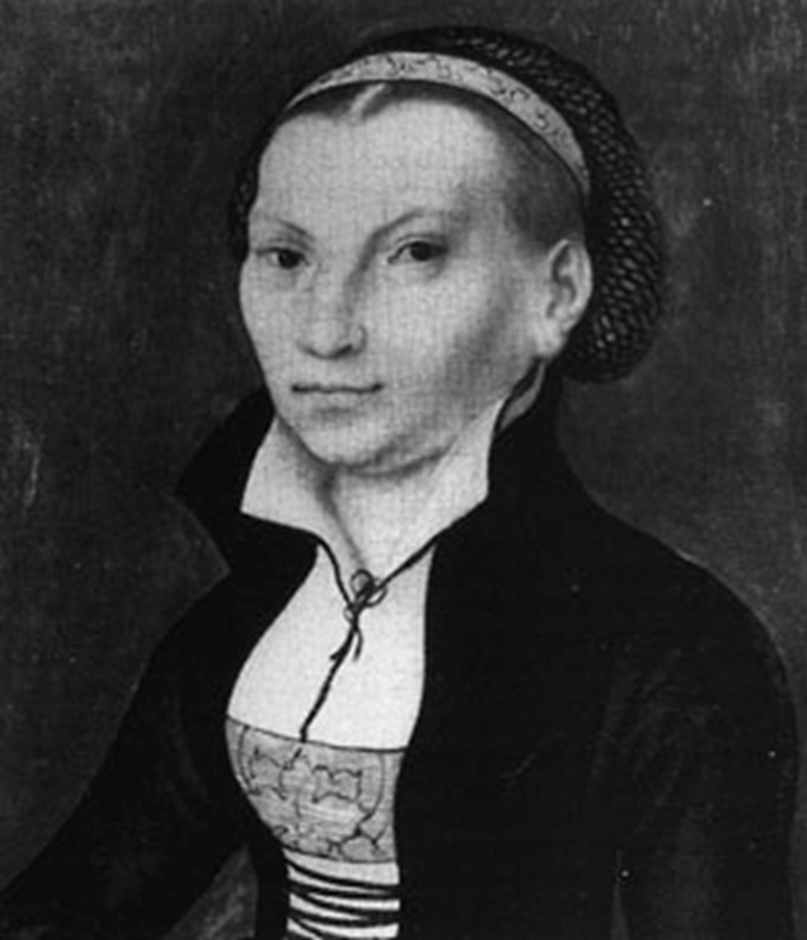
June 13, 1525 Marriage 結婚
Married to Katherine von Bora. 與寶拉結婚
In the Roman Catholic Church marriage was a sacrament, but Luther held that was not biblical. 羅馬天主教中，婚姻是聖禮，但路德認為這不符合聖經
He set the pattern for the marriage of Protestant clergy. 他為復原派教士設立了婚姻模式

Slide 23
Revolutionary Changes from Martin Luther
Priesthood of believers. 信徒皆祭司
Justification by faith; imputed righteousness 因信稱義，

Slide 24
Luther on Justification by faith 因信稱
Gospel: Story and Promise 福音：故事與應許
Story of Jesus is in the Creeds 耶穌的故事在教義中
(Based on lectures from Philip Cary, Eastern University)

Slide 25
Nicene Creed 尼西亞信經 (381)
For us men and for our salvation
he came down from heaven,
and by the Holy Spirit was incarnate of the Virgin Mary,
and became man.
For our sake he was crucified under Pontius Pilate,
he suffered death and was buried,
and rose again on the third day
in accordance with the Scriptures.
祂為了我們人類，並為了我們的得救，從天降下。祂因聖神由童貞瑪利亞取得肉軀，而成為人。
祂在般雀比拉多執政時，為我們被釘在十字架上，受難而被埋葬。祂正如聖經所載，第三日復活了。

Slide 26
Luther loves that “For us”! 路德喜歡“為我們”
Because the “us” includes “me” 因為“我們”包括“我”
If you are an anxious sinner, if you are terrified by the Law, if you are confronted by the fact that you don’t obey God’s commandments, and that you are heading to hell 如果你為罪焦慮，如果你懼怕律法，如果你意識到自己沒有遵守神的命令，要下地獄
It is wonderful to hear, “Christ died for you” 聽到“基督為你而死”該有多麼高興
For us; for me. For my salvation 為我們，為我，為了我的救恩。
For me he came down from heaven, for me he also was crucified 為我祂降世為人，為我他走上十架
That is the Gospel! 這就是福音！

Slide 27
It is the good news that the story of Jesus Christ is the story for me 耶穌的故事，是為了我，這就是好消息。
And that is the part that the devils do not believe; they have faith to a certain extent, they believe that Jesus is the Savior of the world, but they do not believe that Jesus is their Savior 這是魔鬼不相信的，他們的信是有限制的，他們相信耶穌是世界的救主，但是他們不相信耶穌是他們的救主。
It is the “for me” that makes it the Gospel “為我”，使福音成為福音。

Slide 28
The Gospel: Story and Promise 福音：故事與應許
(Or a Promise embedded in a Story)
The Gospel is a Promise in which God gives us the grace we seek 福音是神給我們的應許
For Luther, you seek grace by taking hold of the promise of grace in Christ 對於路德來說，神的應許是恩典的源頭
Faith means believing that God will keep his promise 信心就是相信神的應許會實現
And what God promises… is not just an abstraction like “grace,” what God promises most fundamentally is Himself 神所應許的不止是抽象的概念，而是祂自己。
God promises to give his own Son 神應許賜給我們祂的兒子
By believing the promise, you are united with Christ, and you receive all that is His 相信神的應許，就可以與基督聯合，得到祂的一切

Slide 29
In receiving Christ, you receive all that he is, and all that he has, including righteousness, salvation, justification, sanctification, wisdom, glory, and everlasting life… 接受基督，你就接受了他的一切，包括公義、救恩、稱義、成聖、智慧、榮耀和永生……
…All that belongs to Christ, and all that you receive when you receive Christ by faith 所有這些都是基督的，當你憑信心接受基督的時候，這一切也成了你的。
Because at the heart of Christian faith, this faith in the promise of God in the Gospel, is a union with Christ 基督教信仰的核心，就在神的應許和福音之中，就在基督里。

Slide 30
Part 2 Three solas and Three Stories from China
Story 1 Sola fide (Justification by faith alone)
John Song in China

Slide 31
Doctrine of justification by faith alone 因信就能稱義
A fundamental Protestant doctrine, for Luther, Calvin, etc.; this is in contrast to Roman Catholic doctrine (Faith + Works) 抗議派的基本要義，對比羅馬天主教的“信心+行為”
You receive the promise simply by believing 因信接受應許
There is nothing you can do to earn the right to marry the king’s son 任何事都不能為你贏得與王的兒子的婚姻

Slide 32
Story 1 from China:
Dr. John Song

Slide 33
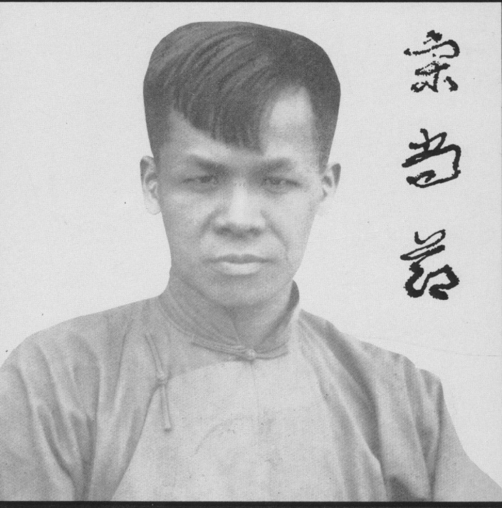
John Song (1901-1944)
1901 Born in Fukien Province
1910 Converted
1920 Study in America
1927 (Feb) Recommit to Christ
宋尚节(1901-1944)
1901 出生于福建
1910 信主
1920 赴美求学
1927 二月，委身于主

Slide 34
After several months of fervent prayer and wrestling with God, John Song wrote this on February 10, 1927:
As days passed, my spirit was weighed down that I felt no peace. On the night of 10 February, I wept and prayed in desperation. Then my sinful life was played out before me scene after scene, even those secret ones. I recalled a copy of the New Testament at the bottom of a chest. I dug it out and flipped open to Luke 23. I felt as though my spirit had floated out of my body and I was following Jesus, cross on back as he walked towards Golgotha. I could also feel the weight of my sins almost crushing me to death.
There was the Lord, hanging high up on the Cross and blood was oozing from His hands. I dropped to my knees, and pleaded with the Lord to cleanse me with His precious blood. Then the Lord said, “Son, your sins are forgiven!” I looked up at His glowing face and saw the marks on His hands. He added, “You must change your name to John.” Now John the Baptist was the one who had prepared the way for though Lord and made straight paths for Him. When the Lord would choose me as His Harold, I was to proclaim the message, “The Kingdom of God is at hand, and of the Lord is coming.”

Slide 35
In a book remembering John Song, William E. Schubert wrote, “At Union, Song was one of the favorite students of Dr. Harry Emerson Fosdick. After he was born again, Dr. Song told Dr. Fosdick: ‘You are of the devil. You made me lose my faith, and you are causing these other young men to lose their faith.’”
After I was born again, everything changed and I began to see God’s handiwork and everything around me. I became conscious of my sins whether in word or thought. Each time I read the Bible, it would show me where I had gone astray. I sought forgiveness from the Lord. The Bible became a lamp at my feet and a light to my path.
I went out daily to spread the Word and to share my testimony. In tears, I urged people to come to Christ. In all sincerity, I pointed out the sins of pastors and ministers but not many could accept my words and pray with me for forgiveness. I had always loved music but now I was bursting into singing or else humming in sorrow. Many people at the Seminary thought I was out of my mind.

Slide 36
John Song (1901-1944)
1901 Born in Fukien Province
1910 Converted
1920 Study in America
1927 (Feb) Recommit to Christ
Incarcerated 193 days
1927 (Oct) Return to Shanghai
Begin preaching ministry
1944 Death
宋尚节(1901-1944)
1901 出生于福建
1910 信主
1920 赴美求学
1927 二月，委身于主
监禁193天
1927 十月回上海
开始佈道事奉
1944 去世

Slide 37
Story 2 Sola gratia (Grace alone)
Robert Morrison and the 2003 China Mission Conference in Chicago

Slide 38
sola fide – faith alone 惟獨信心, (excludes good works 不包括的好行為)
sola gratia – grace alone 唯獨恩典 (excludes merit 不包括功德)
sola scriptura – Scripture alone 唯獨聖經 (excludes tradition 不包括教會傳統)

Slide 39
Luther and Calvin would have the Christian imagine themselves standing on the judgment day before the throne of God.
They envision a conversation like this:
God, the Judge, first asks them, “Why should I let you into my heaven?”
The Christian, will say, “Look, Lord, at my merits!”
Luther and Calvin both say that Christians cannot approach God with that claim, and all the Christian can do is beg for mercy. The Christian can do nothing but claim the blood of Christ.
Catholics of course also stress grace, but they reject the idea of grace “alone.” Roman Catholics will continue to maintain that both grace and merit is necessary for salvation.

Slide 40
Story 2 from China
Robert Morrison and the 2003 China Mission Conference in Chicago

Slide 41
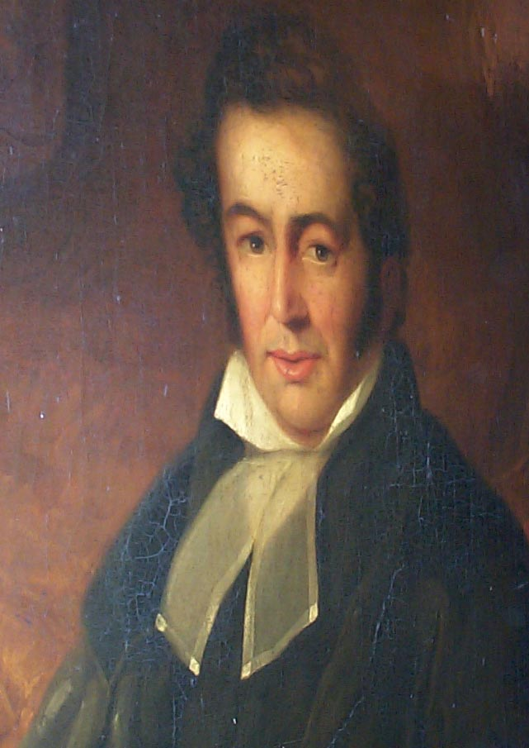
Robert Morrison (1782-1834) 馬禮遜
1807-1834 (in China)
1782 Born in England 英格蘭出生
1798 Join Presbyterian Church 加入長老會
1802 Prepare for missionary work. 預備宣教
1803-1804 Study and join London Missionary Society
加入倫敦傳道會，接受裝備
1807 Ordination and sail for China 按立並前往中國

Slide 42
The story of Robert Morrison’s arrival in China on September 4 in 1807.
As Morrison arrived on a ship to the harbor in China, an American businessman looked at him with a smirk, and, with some contempt, asked him,
“Now Mr. Morrison do you really expect that you will make an impression on the idolatry of the Chinese Empire?”

Slide 43
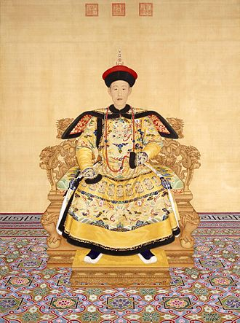
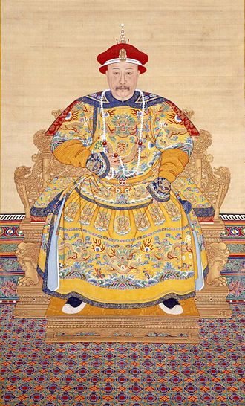
The Qianlong Emperor 乾隆帝 (1711- 1799)
The Jiaqing Emperor 嘉慶帝 (1760 –1820)

Slide 44
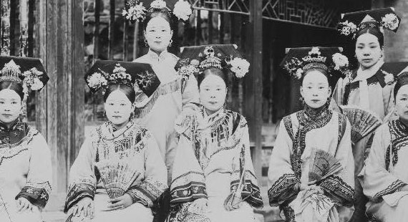
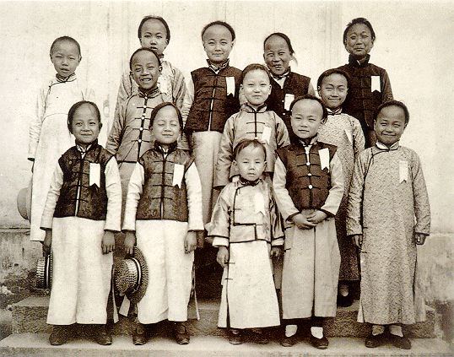
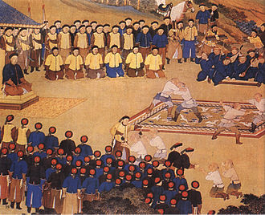
Boys in Shanghai c.1900
Manchu women in Qing era
Qianlong watching wrestling match

Slide 45
2003 China Mission Conference in Chicago
Yes, God had made an impression on the idolatry in China!
“No sir,” said Morrison, “but I expect that God will.”

Slide 46
Story 3 Sola scriptura (Scripture alone)
A Cautionary Story: Hong Xiuquan and the Taiping Rebellion

Slide 47
Nature of Scriptural authority聖經權威的本質
“sola scriptura” 唯獨聖經
Everything to be judged by Scriptures: popes, councils, traditions, all human thought. Reason still has a function, we are reasonable beings. 一切都要由聖經來判斷：教皇、會議、傳統、人的思想
a) inerrancy無誤
b) perspicuity-簡明
c) hermeneutical principle-釋經原則
grammatical/ historical approach文法結構和歷史的方法
“Keep hard at the languages, for language is the sheath in which the sword of the Spirit rests.” Martin Luther 對待語言要極其仔細，因為語言是聖靈的寶劍的劍鞘。

Slide 48
Nature of Scriptural authority 聖經權威
sola scriptura- scripture alone 唯獨聖經 (excludes authority of church apart from scripture不包括教會)
Everything to be judged by Scriptures: popes, councils, traditions, all human thought. Reason still has a function, we are reasonable beings. 一切都要由聖經來判斷：教皇、會議、傳統、人的思想
The church does have a certain kind of authority, but only under the Scriptures. Not a doctrine of “private interpretation” 教會確實有權利，但是在聖經之下的，沒有獨一的解經權力。
Perspicuity-簡明:
systematic exegesis系統解經 and systematic theology系統神學。

Slide 49
Story 3 from China:
Hong Xiuquan and the Taiping Rebellion

Slide 50
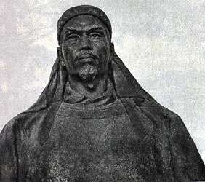
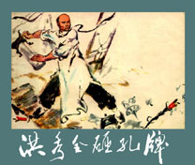
Taiping Rebellion (1851-1864) 太平天國
The Leader領袖
Hong Xiuquan 洪秀全 (1813-1864)
Hakka 客家
Failed Exam three times名落孫山三次
1843 Fourth Failure第四次落榜

Slide 51
Hong Xiuquan 洪秀全 (1813-1864)
Born in 1813 to a well-to-do Hakka farmer from Huaxian, north of Guangzhou
1828 Attempted exam for lowest degree
1836 Second attempt for lowest degree
Coming from the examination hall one day, Hong found an American missionary, Edwin Stephens, and a Chinese interpreter preaching the Christian Gospel. Hong listened and dialogued with them. And on the second day he saw them. He accepted a set of nine Christian tracts titled. “Good Words to Exhort the Age.”
The tracts, which Hong glanced at and then put on his bookshelf when he returned home, were written by Liang Fa the first Chinese minister and the second Chinese Protestant and an assistant to Robert Morrison.

Slide 52
1837 The following year Hong made his third attempt to pass the exam.
Again he failed, but this time the disappointment overwhelmed him causing a nervous collapse. He had to be carried home in a rented sedan chair, and he remained in his room for over a month, thrashing out at devils and falling into deep trances.
He finally awoke with memories of visions of having ascended into Heaven, where mysterious surgeons replaced all his internal organs and he was then lead into a throne room where an old man with a black robe and golden beard handed him a sword to slay demons. He also dreamed of the black robed man scolding the figure of Confucius, who was made to confess his guilt to some nameless crime.
Hong believed he had received divine authority to rule China, and he changed from being compliant and insecure into a fiercely self-confident leader who visibly swelled in physical stature and spoke with new authority. (See Frederick Wakeman)

Slide 53
1843 Six years later,
Hong made his fourth and final attempt to pass the exams. After failing again, Hong made an angry vow to overthrow the Manchus who controlled China and the examination process. Later that year Hong’s cousin noticed the tracts on Hong’s bookshelf and he encouraged Hong to read the tracts. Hong became convinced that Liang Fa’s pamphlets corroborated his dreams.
The black-robed figure was God, his father, and Jesus Christ was his older brother. As the younger brother, Hong believed he was sent to earth with his demon quelling sword to “restore” Christianity to China. Hong wrote,
The “barbarian devils” were not the Europeans but the non-Han Chinese Manchus who were controlling China (Qing Dynasty, 1644-1912). Hong believed that once he could get rid of the Manchu “yao” (demons), the Chinese people could recover their original religion and an age of great peace (taiping) would arrive uniting the world in universal harmony and brotherhood (From Wakeman, p.144.)
Hong was persecuted by the elder’s in his home town for preaching this new ideology and for smashing Confucian tablets. Hong then left home and began to search for a base for his rebellion against the Manchus and also he continued to develop his theology and his ideology of revolution. Eventually he settled in the relative safety of the Mt. Thistle area, with the help of his early convert, Feng Yunshan.

Slide 54
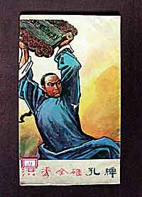
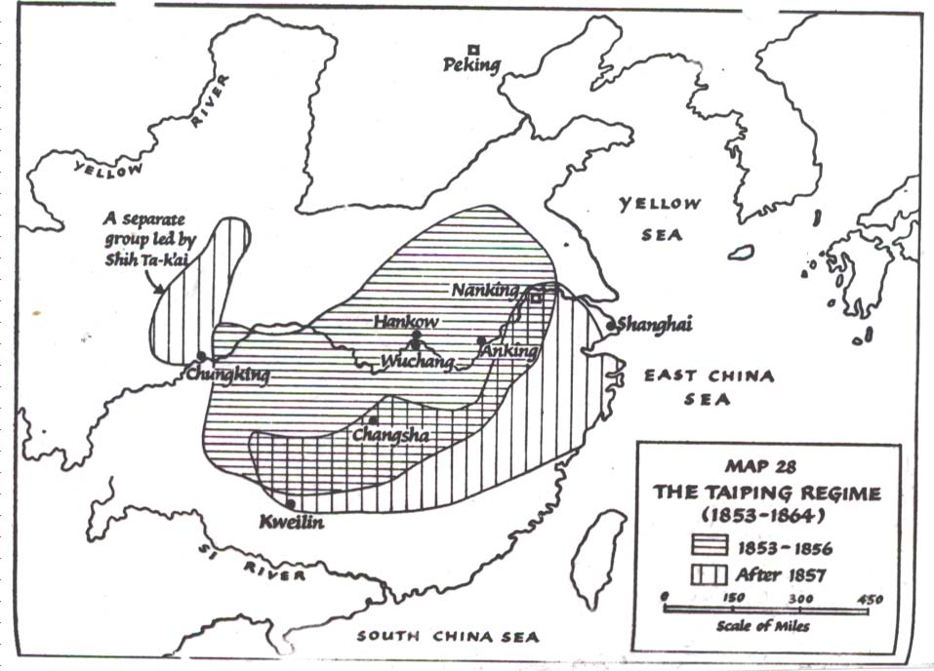
The Rebellion
1846 Bai Shangdi Hui 拜上帝會 (God Worshippers)
1847 Two thousand converts二千信徒
1851 Declare Taiping Tianguo 太平天國
1853 Capture Nanjing 南京被捕
1864 Defeat of Taipings

Slide 55
Sources of Christian Influence
a. Writings of Liang Fa
The volumes proved some solid teaching, but they were designed as evangelistic tools—not as a comprehensive source of Christian doctrine. And although Hong used many of the ideas he found in the books, he also felt free to disregard what he did not like.

Slide 56
b. Visit to Issachar Roberts in 1847
In February of 1847 Hong traveled to Canton to seek the American Baptist missionary Issachar Roberts. The picture of this meeting is intriguing. The American missionary who had been called by God to travel around the globe to preach Jesus Christ and the gospel stood face to face with the Chinese intellectual who could claim he had seen the Heavenly Father and been called to start a movement to overthrow the Qing dynasty and convert China to the truth! One might wonder, as the two faced off, who should be seeking baptism from whom.

Slide 57
Visit to Issachar Roberts in 1847 (Cont.)
After two months, Hong asked Roberts to baptize him and possibly provide some long-term financial support. Roberts was displeased, apparently, with Hong’s urgency, and so he decided to delay Hong’s baptism and rejected Hong’s request for financial support.
With no ability to stay in Canton, Hong returned home. Many commentators have pondered the potential significance of Roberts’s decision. The two months in Canton with Roberts represents the only formal Christian training that Hong Xiuquan ever received.
Until the very closing years of the Taiping Heavenly Kingdom, Hong seems to only have twice come across Western missionaries. Once when he heard the preaching and picked up the tracts in about 1833 and a second time when he studied under Roberts for two months in 1847.
(Boardman, p.76.)

Slide 58
c. Hong’s Dreams
Hong wrote,
“These books … are certainly sent purposely by heaven to me, to confirm the truth of my former experiences; if I had received the books without having gone through the sickness, I should not have dared to believe in them, and on my own account to oppose the customs of the whole world; if I had merely been sick but not also received the books, I should have had no further evidence as to the truth of my visions, which might also have been considered as mere productions of a diseased imagination.” (Jen, p.21)

Slide 59
Hong wrote,
“Father had ordained the Heavenly Kingdom to be in China; since China was originally the home of the Heavenly Kingdom. It is therefore also the home of Father. Before Father descended to the earth, China belonged to Father, and yet the barbarian devils stole into Father’s Heavenly Kingdom. This is the reason Father decreed that I should come to destroy them.” (From Wakeman, p.144)

Slide 60
d. Translated Bible
The Taiping version of the Bible was published in 1853 in separate volumes, one Old Testament and one New Testament. There was no title given for the Bible as a whole. Boardman’s analysis concluded that the Taiping version was a precise copy of the Gutzlaff 郭士立 translation of the 1840s. (Boardman, p.48)

Slide 61
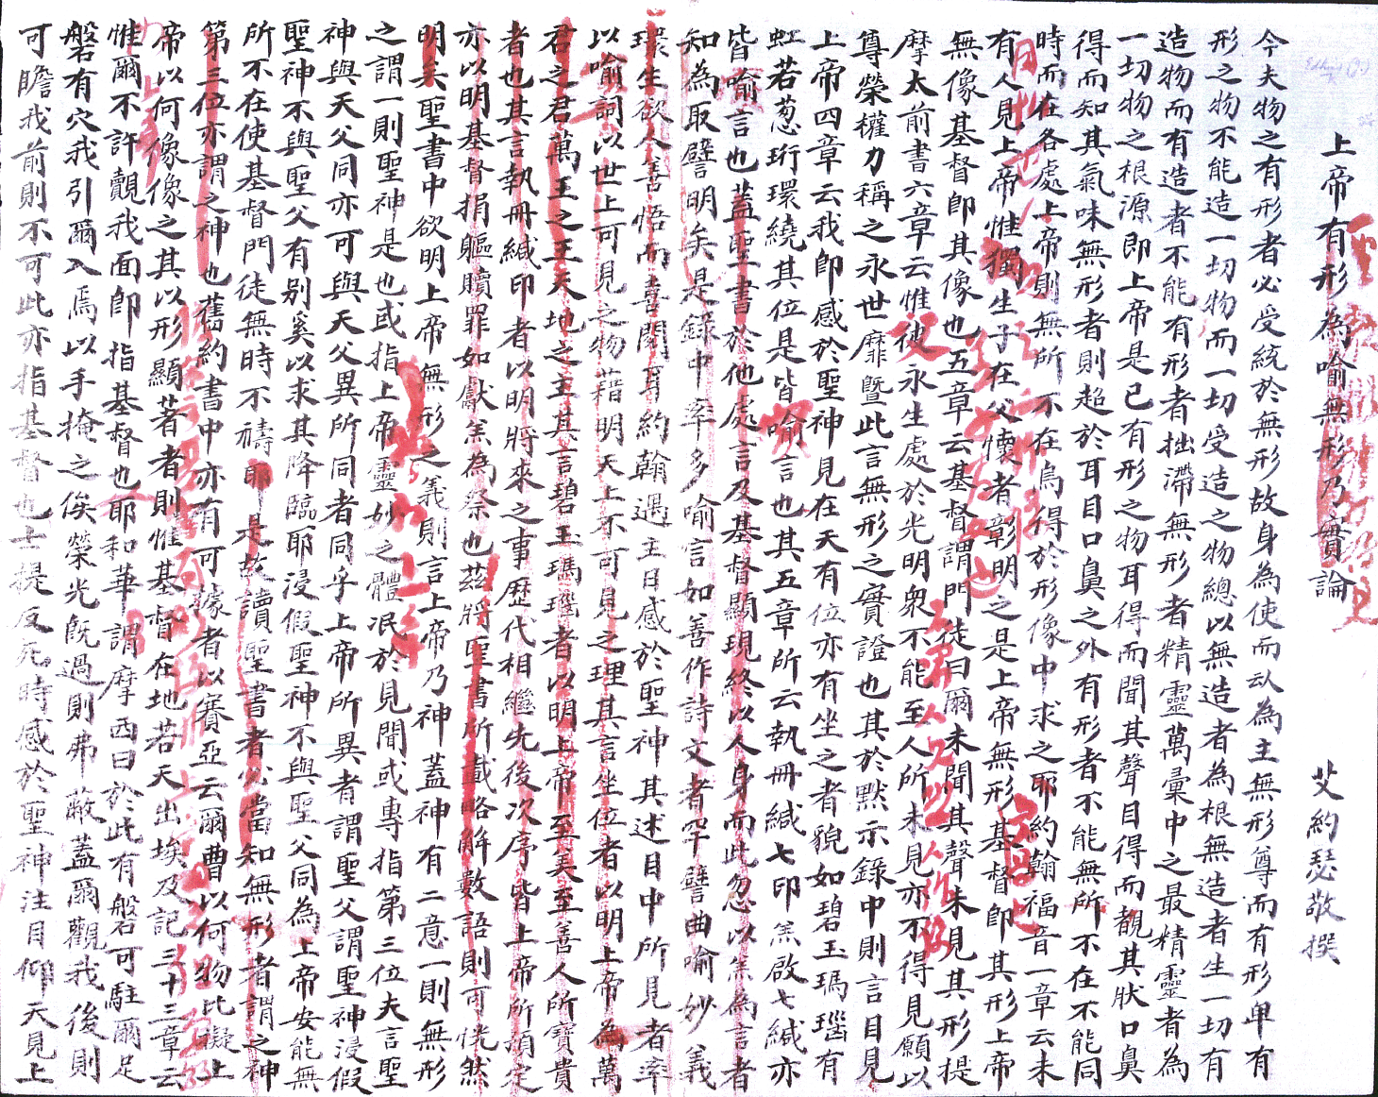
Letter to Hong Xiuquan from a missionary c.1860
Hong’s response is in red!

Slide 62
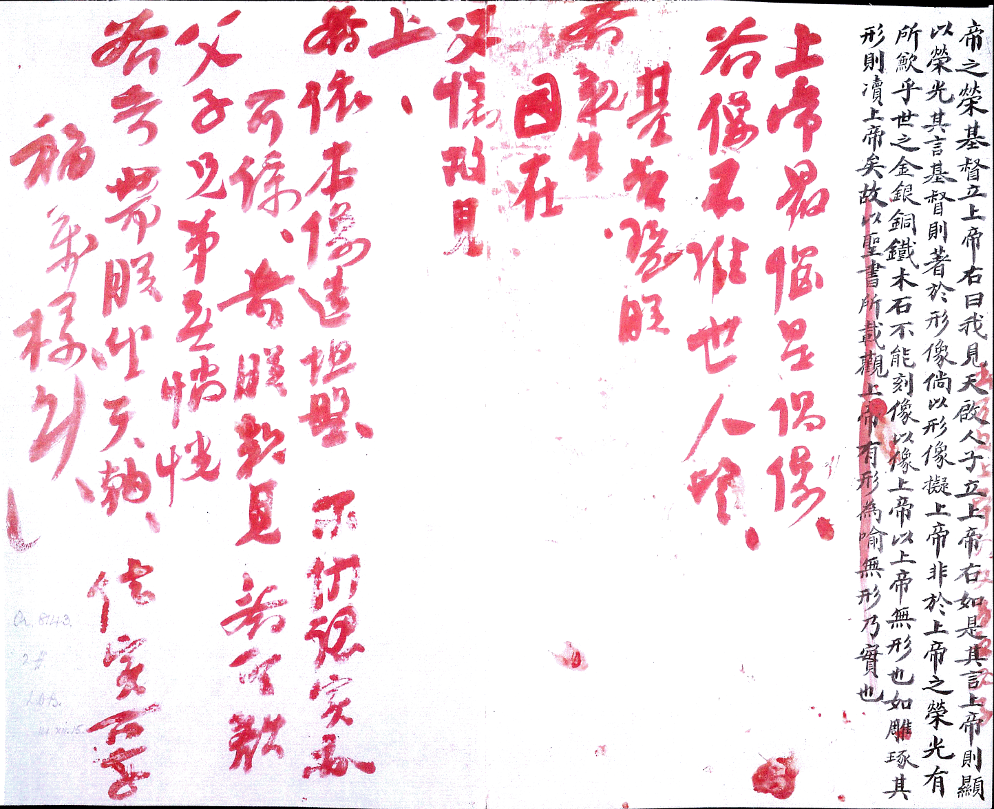

Slide 63
Roman Catholic Criticism
Roman Catholics were long skeptical of Protestant efforts at translation. The simple Protestant notion that Scripture can be understood by each individual may be challenged somewhat by the events of the Rebellion. A Roman Catholic book from 1907 provides this vigorous and searching criticism of the indiscriminate use of the Bible in evangelical work in China:
“There can be no doubt that the indiscriminate circulation of the Bible, aided by the ‘inalienable right of private interpretation’ thereof, is capable of producing the most disastrous material results. Of such nature was the Taiping Rebellion… We also see in this movement the effect of distribution in the country of Bibles and Christian tracts.”
Hong felt free to edit the bible, as he was God’s Chinese Son! See his corrections of letter from missionary Joseph Edkins, 1861.

Slide 64
Nature of Scriptural authority 聖經權威
sola scriptura- scripture alone 唯獨聖經 (excludes authority of church apart from scripture不包括教會)
Everything to be judged by Scriptures: popes, councils, traditions, all human thought. Reason still has a function, we are reasonable beings. 一切都要由聖經來判斷：教皇、會議、傳統、人的思想
The church does have a certain kind of authority, but only under the Scriptures. Not a doctrine of “private interpretation” 教會確實有權利，但是在聖經之下的，沒有獨一的解經權力。
Perspicuity-簡明:
systematic exegesis系統解經 and systematic theology系統神學。

Slide 65
OUTLINE
Introduction: The power of the Reformation in stories
Part 1 Story of Martin Luther
Part 2 Three solas and Three Stories from China
Story 1 Sola fide
John Song in China
Story 2 Sola gratia
Robert Morrison and the 2003 China Mission Conference in Chicago
Story 3 Sola scriptura
A cautionary story: Hung Xiuquan and the Taiping Rebellion

